Slide 1
人文學、數位資源、與數位工具的跨界整合：
來自中國史研究和教學的兩個範例 － 中國歷代人物傳記資料庫(CBDB)和哈佛中國課(ChinaX)
哈佛大學包弼德 Prof. Peter K. Bol, Vice Provost for Advances in Learning
Max Planck Institute 陳詩沛Dr. Chen Shih-pei, Researcher, Max Planck Institute, Berlin
哈佛大學于文 Yu Wen, Ph.D. candidate, Department of History, Harvard University

Slide 2
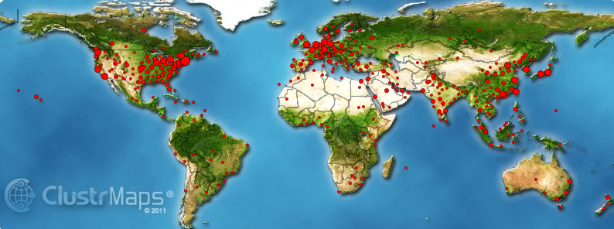
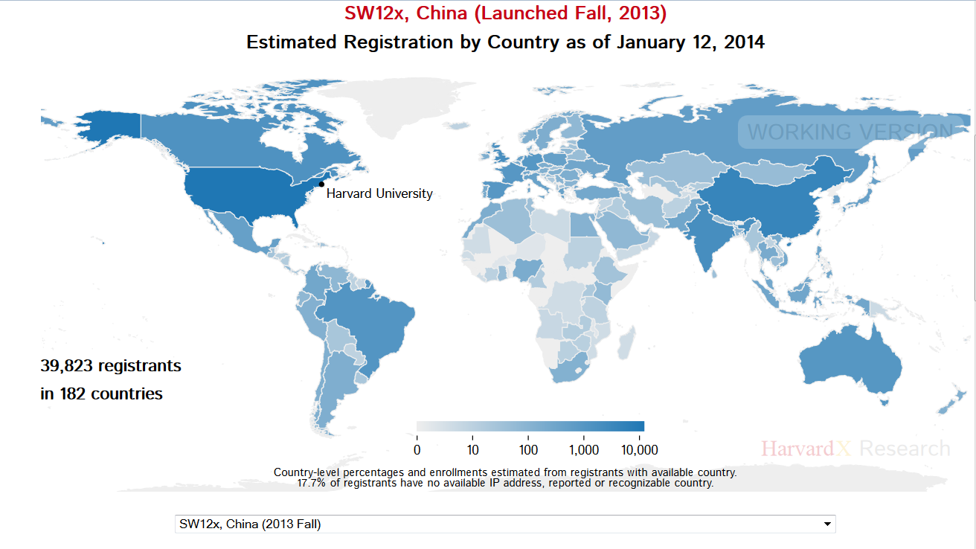

Slide 3
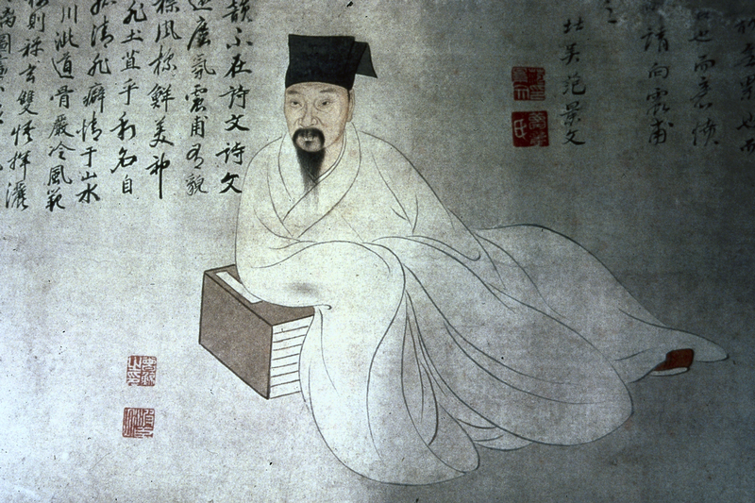
中國歷代人物傳記資料庫 (CBDB)
–從軼事到資料

Slide 4
時代 | 人數
唐 | 45386
五代 | 374
宋 | 45072
遼 | 318
金 | 275
元 | 19887
明 | 145692
清 | 37915
民國 | 3222
其它 | 23879

Slide 5
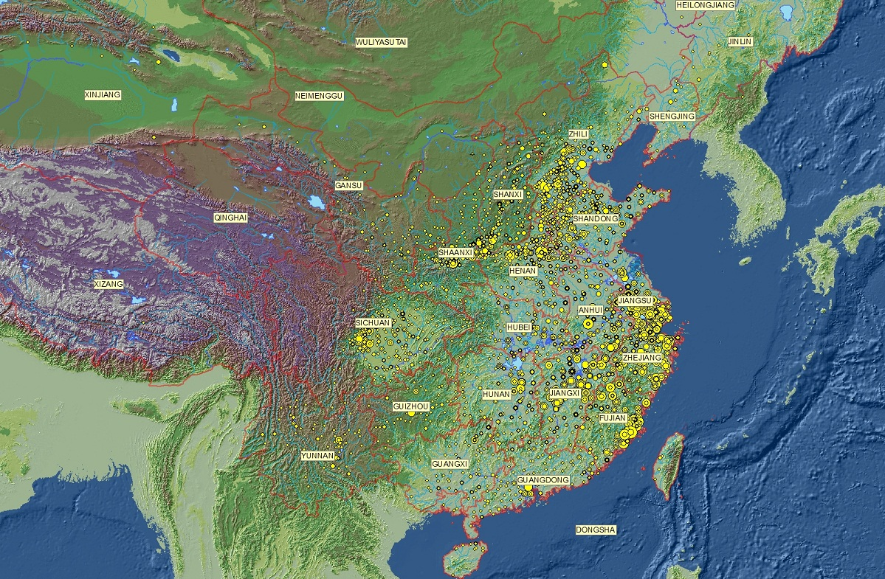
CBDB中的人物組成的有代表性的樣本繪出的累積空間分佈圖 (n=67,000)

Slide 6
(1) Biographical data are coded and stored in tables.
傳記資料以代碼的形式存儲於資料表中。
BIOG_MAIN
Biography Addresses
Alternate Names
Writings
Postings
Mode of Entry into Government
Kinship
Associations
Social Status
Possessions
Events
基本資料
地址資料
別名資料
著述資料
任官資料
入仕途徑
親屬資料
社會關係資料
社會區分資料
財產資料
事件資料
Notes:
6

Slide 7
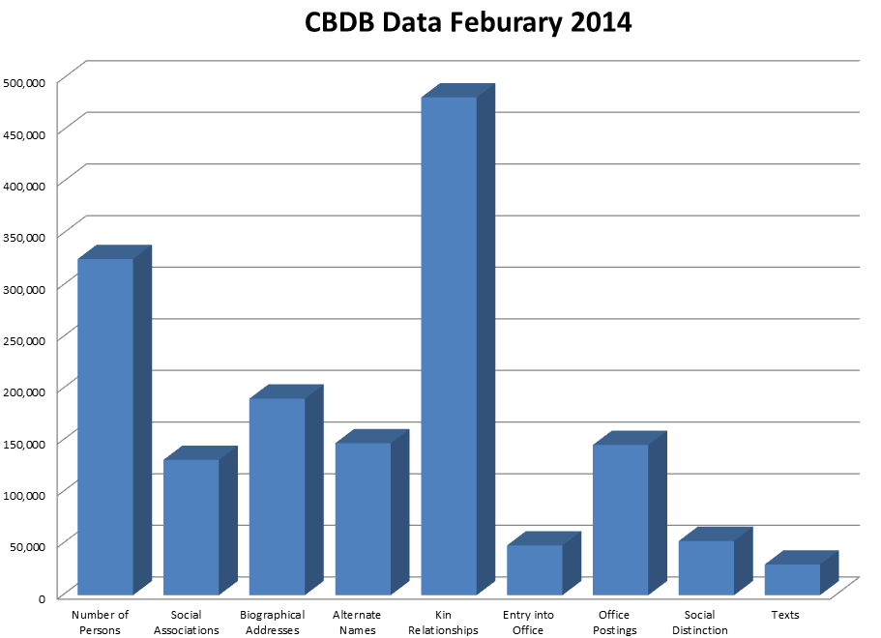

Slide 8

  概念飛躍:
    文本挖掘/文本建模 Text-mining/text-modeling
    基於關係型資料的建模 Modeling lives with relational databases
    群體傳記學 Prosopography
    空間分析 Spatial analysis
    社會網絡分析 Social network Analysis

Slide 9
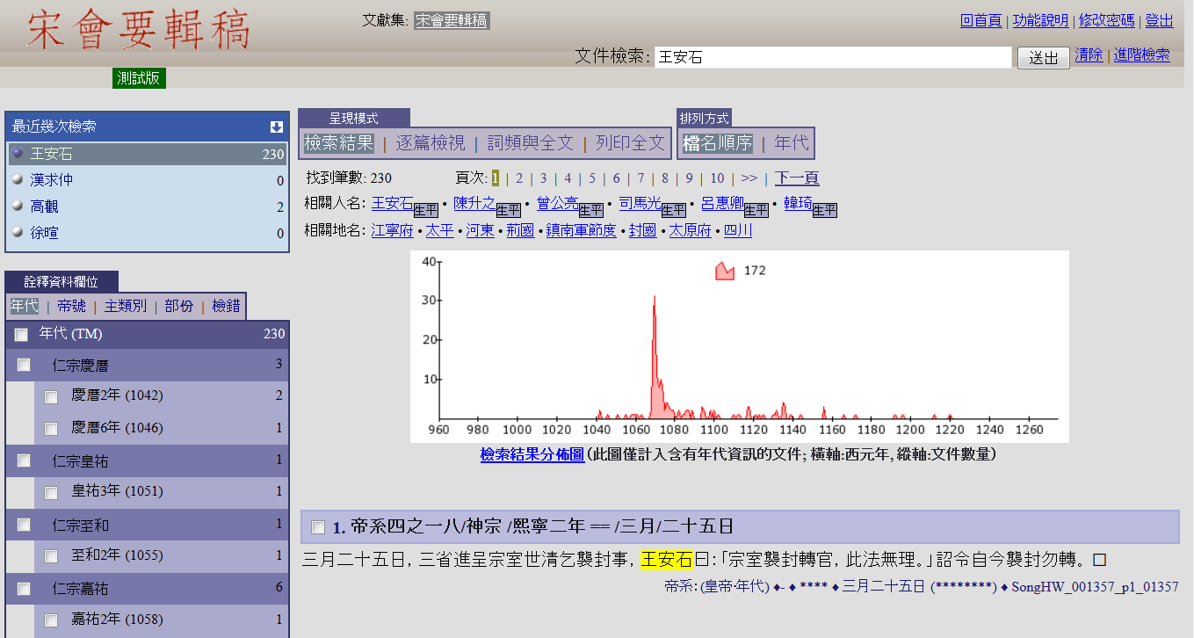

Slide 10
Lü Zuqian, whose style name was Bogong, was a grandson of the Right Assistant Director to the Imperial Secretary Haowen. His family had lived in Wuzhou since his grandfather's generation. The learning of Zuqian was based on family [tradition], and embodied the textual transmission from the Central Plain. When he grew up, Zuqian studied with Lin Zhiqi, Wang Yingchen, and Hu Xian respectively. Then he also befriended Zhang Shi and Zhu Xi, and his explication and inquiry became more sophisticated. First he obtained official rank by way of the protection privilege. But later he obtained his Jinshi degree and also passed the special decree examination for "Erudite Learning and Exceptional Literary Composition." Then he was appointed to the School for the Imperial Clan in the Southern Outer Office. During the mourning period for his mother, when he stayed in Mt. Mingzhao (in Wuyi), literati from all directions raced there. He was appointed Erudite in the National University. | 呂祖謙字伯恭，尚書右丞好問之孫也．自其祖始居婺州．祖謙之學本之家庭，有中原文獻之傳．長從林之奇、汪應辰、胡憲游，既又友張栻、朱熹，講索益精． 初，蔭補入官，後舉進士，復中博學宏詞科，調南外宗教．丁內艱，居明招山，四方之士爭趨之．除太學博士
傳記文文本中的 “Factoids”

Slide 11
[English] Using “Regular Expressions”正則表達式 to find data in digital texts
In computing, a regular expression provides a concise and flexible means for "matching" (specifying and recognizing) strings of text, such as particular characters, words, or patterns of characters. Abbreviations for "regular expression" include "regex" and "regexp". The concept of regular expressions was first popularized by utilities provided by Unix distributions, in particular the editor ed and the filter grep. A regular expression is written in a formal language that can be interpreted by a regular expression processor, which is a program that either serves as a parser generator or examines text and identifies parts that match the provided specification. Historically, the concept of regular expressions is associated with Kleene's formalism of regular sets, introduced in the 1950s.
http://en.wikipedia.org/wiki/Regular_expression

Slide 12
[中文]使用“正則表達式”在數位文本中發掘資料
正規表示式，又稱正則表達式、正規表示法、常規表示法（英語：Regular Expression，在代碼中常簡寫為regex、regexp或RE），電腦科學的一個概念。正規表示式使用單個字串來描述、匹配一系列符合某個句法規則的字串。在很多文字編輯器裡，正則運算式通常被用來檢索、替換那些符合某個模式的文字。
許多程式語言都支援利用正則運算式進行字串操作。例如，在Perl中就內建了一個功能強大的正則運算式引擎。正則運算式這個概念最初是由Unix中的工具軟體（例如sed和grep）普及開的。
http://zh.wikipedia.org/zh-tw正则表达式

Slide 13


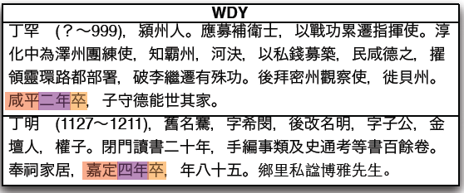
正則表達式
13

Slide 14
正則表達式和專名辨識(Named Entity Recognition-NER)
至元十八年為東陽縣丞
年號 | 年號代碼 | 年 | year | 地名 | 地名代碼 | 官名 | 官名代碼
至元 | 623 | 18 | 1281 | 東陽 | 18340 | 縣丞 | 841

Slide 15
  概念飛躍:
    文本挖掘/文本建模 Text-mining/text-modeling
    基於關係型資料的建模Modeling lives with relational databases
    群體傳記學 Prosopography
    空間分析 Spatial analysis
    社會網絡分析 Social network Analysis

Slide 16
基本資訊: 姓名, 性別, 日期(與時間的關係)
地址(與空間的關係)
別名(與不同種類稱呼的關係)
著作(學術關係)
任職(與政府的關係)
入仕方式
親屬(與別人的親屬關係)
社會關係(與別人的非親屬關係)
社會區分(與社會區分模式的關係)
財產(贈與和接受財產的關係)
事件(參加的事件)

Slide 17
A Subset of the Data on Sima Guang:
有關司馬光的部分數據：
Name 姓名 | Dates 日期 | Offices 任官 | Associations 社會關係
Sima Guang 司馬光 | 1019-1086 | (1) 1059 度支勾院 Budget Auditor; (2) 1085 門下侍郎 Executive of the Chancellery; (3) 1086 左僕射兼門下侍郎 Left Executive, Dept of Ministries [….] | (1) Yuanyou coalition member (元祐黨); (2) An Dun 安惇 Desires opposed by; (3) Chao Buzhi 晁補之 Sacrificial prayer written by; (4) Chen Jian 陳薦 Sacrificial prayer written for; (5) Chen Min 陳敏 Honored by; (6) Cheng Yi 程頤 Recommended; (7) Ding Du 丁度 Sacrificial prayer written for; (8) Fan Chunli 范純禮 Patron of; [….]
Notes:
17

Slide 18
Relational Database:
關係型數據庫
Many Entities 多個實體
People 人物
Offices 職官
Association Types 社會關係
Name 姓名 | Dates 日期
Sima Guang 司馬光 | 1019-1086
Person 人物 | Posting Date 任命日期 | Office Title 官名
Sima Guang 司馬光 | 1059 | 度支勾院 Budget Auditor
Sima Guang 司馬光 | 1085 | 門下侍郎 Executive of the Chancellery
Sima Guang 司馬光 | 1086 | 左僕射兼門下侍郎 Left Executive, Dept of Ministries
Person 人物 | Association Type 社會關係 | Associate 社會關係人
Sima Guang 司馬光 | Yuanyou member (元祐黨) | (not applicable)
Sima Guang 司馬光 | Desires opposed by | An Dun 安惇
Sima Guang 司馬光 | Sacrificial prayer written by | Chao Buzhi 晁補之
Sima Guang 司馬光 | Patron of | Fan Chunli 范純禮
Sima Guang 司馬光 | Sacrificial prayer written for | Ding Du 丁度
Notes:
18

Slide 19
One can now sort on the separate columns:
現在我們可以按照不同欄位分別排序：
Name 姓名 | Dates 日期
Sima Guang 司馬光 | 1019-1086
Person 人物 | Posting Date 任命日期 | Office Title 官名
Sima Guang 司馬光 | 1059 | 度支勾院 Budget Auditor
Sima Guang 司馬光 | 1085 | 門下侍郎 Executive of the Chancellery
Sima Guang 司馬光 | 1086 | 左僕射兼門下侍郎 Left Executive, Dept of Ministries
Person 人物 | Association Type 社會關係 | Associate 社會關係人
Sima Guang 司馬光 | Yuanyou member (元祐黨) | (not applicable)
Sima Guang 司馬光 | Desires opposed by | An Dun 安惇
Sima Guang 司馬光 | Sacrificial prayer written by | Chao Buzhi 晁補之
Sima Guang 司馬光 | Patron of | Fan Chunli 范純禮
Sima Guang 司馬光 | Sacrificial prayer written for | Ding Du 丁度
Notes:
19

Slide 20
ALT NAMES 別名
Person ID Name Type ID Alt Name, etc
WRITINGS 著述
Person ID Text ID, etc
ENTRY 入仕
Person ID Entry ID Year, etc
BIOG ADDR 地址
Person ID Addr Type ID Place ID, etc
Data tables are linked to each other via Person IDs.
這些資料表通過人物代碼關聯起來。
POSTINGS 任官
Person ID Postings ID Office ID Start Date End Date, etc
BIOG_MAIN 基本資料
Person ID Name 姓名 Born Died Index Year Choronym ID Dynasty ID, Etc
ASSOCIATIONS 社會關係
Person ID Assoc Relation ID Associate ID, etc
POST ADDR 任官地
Postings ID Place ID, etc
KINSHIP 親屬
Person ID Kin Relation ID Kin ID, etc
SOCIAL STATUS 社會區分
Person ID Status ID, etc

Slide 21
    Sima Guang 司馬光. 1019-1086.
    Offices
    1059 度支勾院 Budget Auditor
    1085 門下侍郎
    Executive of the Chancellery
    1086 左僕射兼門下侍郎
    Left Executive, Dept of Ministries
Employment
1 office: finance
2 office: state council
Entry 入法:
蔭yin
進士 jinshi
Places
Basic Affiliation
Yongxing 永興,
Shan 陝,
Xia Xian 夏縣 0-0
Alternate Names
Junshi 君實 Capping Name
Wenzheng Gong 文正公 Posthumous Name
Sushui Xiansheng 涑水先生 Other
Yufu 迂夫 Style Name
Yusou 迂叟 Style Name
Data on people in a relational database is in the interaction between entities (person, place, etc.)在關係型數據庫中，人物的數據資料存在於各種實體（人物、地址等）的互動之中。
Notes:
21

Slide 22
  概念飛躍:
    文本挖掘/文本建模 Text-mining/text-modeling
    基於關係型資料的建模 Modeling lives with relational databases
    群體傳記學 Prosopography
    空間分析 Spatial analysis
    社會網絡分析 Social network Analysis

Slide 23
[English]Prosopography
‘Prosopography’ is the investigation of the common background characteristics of a group of actors in history by means of a collective study of their lives. The method employed is to establish a universe to be studied, and then to ask a set of uniform questions – about birth and death, marriage and family, social origins and inherited economic position, place of residence, education, amount and source of personal wealth, occupation, religion, experience of office and so on. The various types of information about the individuals in the universe are then juxtaposed and combined, and are examined for significant variables. They are tested both for internal correlations and for correlations with other forms of behaviour or action. (L. Stone, 'Prosopography', in F. Gilbert and S. Graubard eds., Historical Studies Today (New York, 1972)

Slide 24
[中文]群體傳記學
群體傳記學乃係透過對一群歷史人物的生平所做的集體性的研究，探討其共同之背景特徵。其方法乃係先建立一個研究範圍，然後就此提出一組相同的問題 ──包括出生、死亡、婚姻、家庭、社會出身、經濟地位、居住地、教育、個人財富與來源、職業、宗教、宦歷等方面。然後，將此研究範圍中所有人物的各類信息加以羅列、組合，通過對這些信息的考察找出具有顯著意義的變量。研究者可以檢測這些信息的內在相關性，及其與其他行為形式或行動形式的相關性。 (L. Stone, 'Prosopography', in F. Gilbert and S. Graubard eds., Historical Studies Today (New York, 1972)

Slide 25
CBDB 資料中從唐代到清代 22270 人的死亡年齡

Slide 26
CBDB 資料中 3072 名女性的死亡年齡

Slide 27
  概念飛躍:
    文本挖掘/文本建模 Text-mining/text-modeling
    基於關係型資料的建模 Modeling lives with relational databases
    群體傳記學 Prosopography
    空間分析 Spatial analysis
    社會網絡分析 Social network Analysis

Slide 28
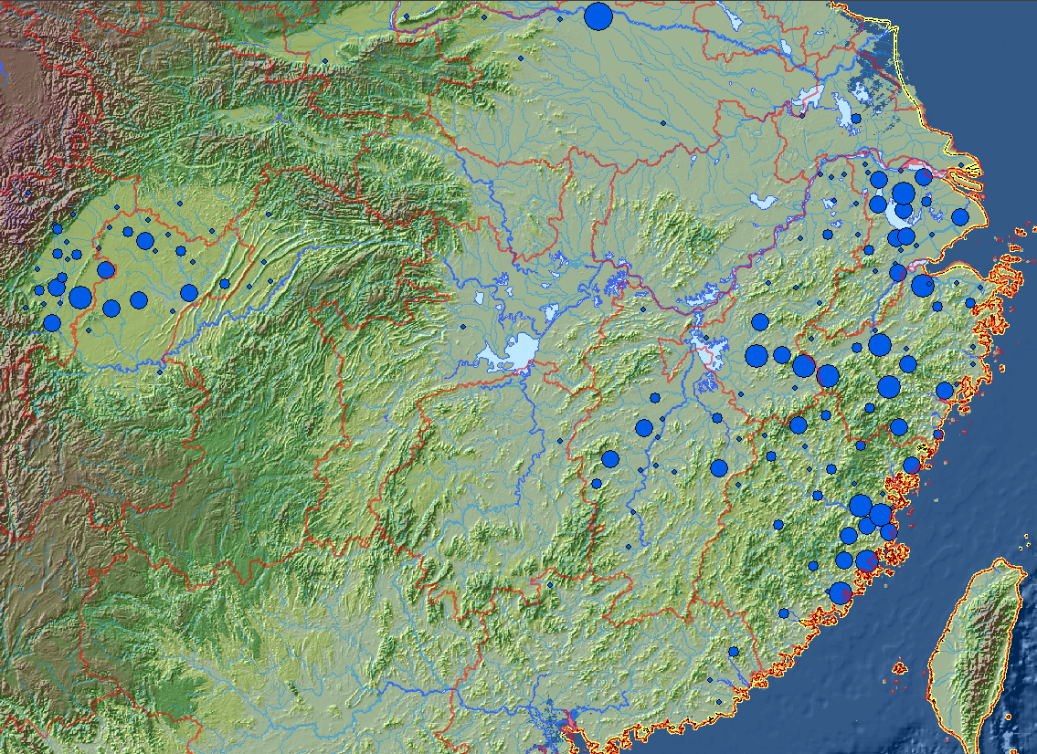
紹興十八年（1148）科舉考試名單

Slide 29
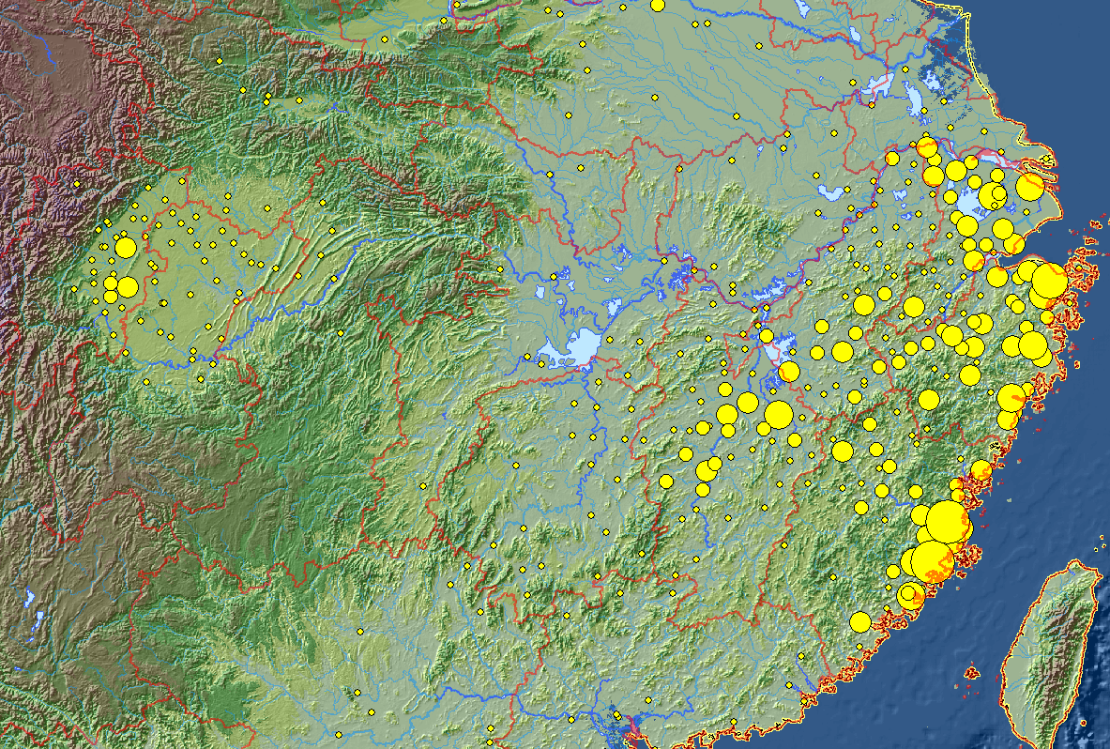
南宋時期有功名者空間地理分佈
（中國歷代人物傳記資料庫-CBDB）

Slide 30
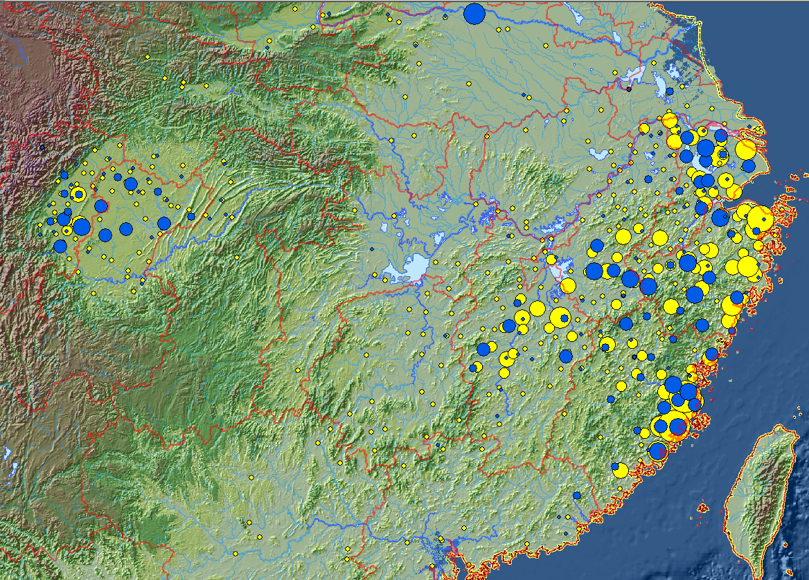

Slide 31
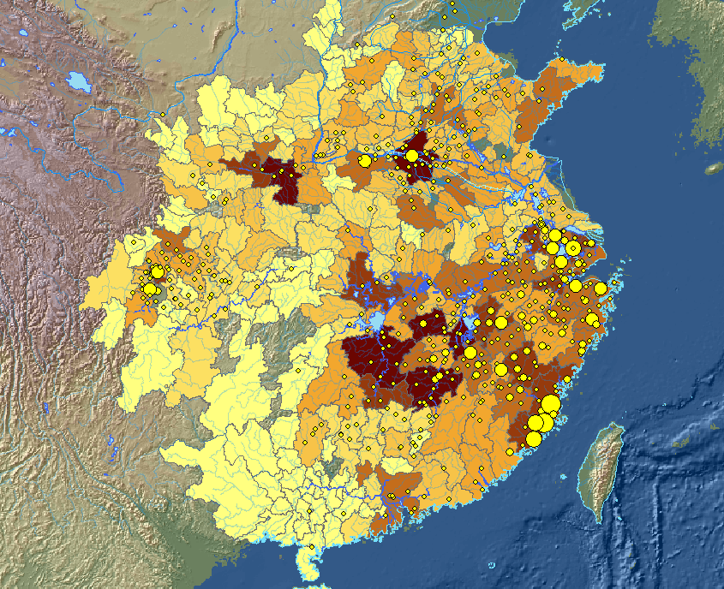
960－1126年間的4730 名進士題名者，及1080年的人口分佈圖

Slide 32
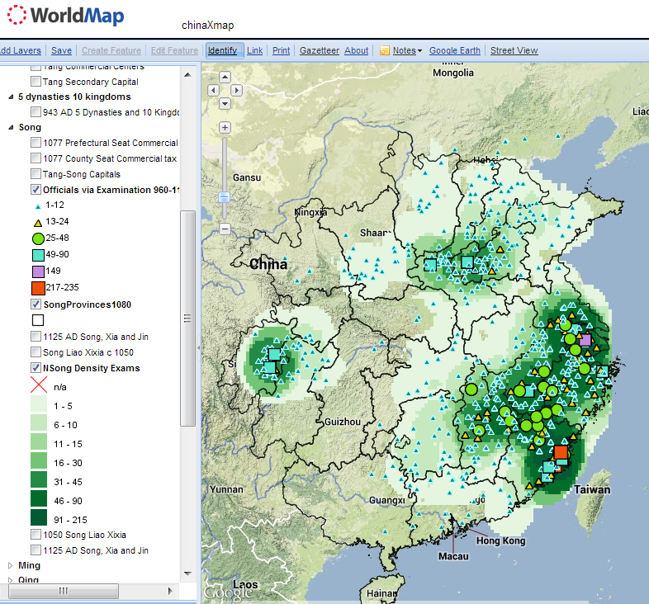
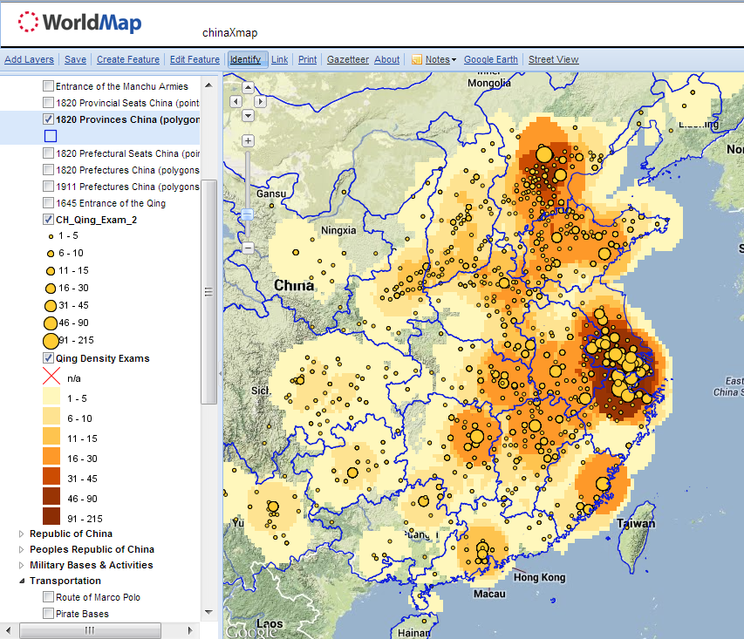
CBDB中北宋(960-1126)進士的空間分佈
CBDB 中清代(1644-1905)進士的空間分佈

Slide 33
  概念飛躍:
    文本挖掘/文本建模 Text-mining/text-modeling
    基於關係型資料的建模 Modeling lives with relational databases
    群體傳記學 Prosopography
    空間分析 Spatial analysis
    社會網絡分析 Social network Analysis

Slide 34
Social Networks 社會網絡
“短期來講，個體創造了網絡；從長遠來講，網絡創造了個體。”
“In the short term individuals create networks; in the long term networks create individuals.”
  (borrowing from John Padgett, University of Chicago)

Slide 35
[English]Social Network Analysis
社會網絡分析
Conceptualizing community as collections of personal relationships … provides historians with a blueprint for evaluating when, how and why people in the past used kin and non-kin in the course of their lives. The findings of social network analysts that people need and seek emotional and economic support of different kinds, from different kinds of people, suggest new analytical imperatives. It is not enough now to look solely at how people used kin in times of crisis. Rather, historians need to pursue how people in the past used the kin and friends they had, for different things, throughout the life course, and in the context of the opportunities they enjoyed and the constraints they faced courtesy of demography and culture. Other approaches might be applied to the problem, but HSNA contains the essential perspectives that cannot only advance the debate, but also help historians to meet Tilly's challenge to connect the lives of ordinary people to large-scale change in meaningful ways. (Charles Wetherell, “Historical Social Network Analysis,” International Review of Social History 43 (1998), Supplement)

Slide 36
[中文]社會網絡分析
社會網路關係(Social network analysis, SNA)係L. Stone關於群體傳記學方法論討論的例子之一。如同Charles Wetherell所述，「個人關係組成之集合體的概念化，提供歷史學家評估古人於何時、如何，及為何利用親族與非親族關係。社會網路關係分析家發現，人們須從不同的社會關係中、不同的人身上，尋求情緒上與經濟上的支持。因此，僅研究人們如何於危機時刻利用親族關係已不足夠；相反地，歷史學的研究必須涵蓋過去人們如何為不同目的而利用親族與朋友關係，以及此一利用關係的優勢與限制。事實上，社會網路關係做為一種研究方法不僅有助於此一論辯，更幫助歷史學家達到Tilly所提出的挑戰：將平民百姓的日常生活與大規模的社會變遷作有意義的連結。(Charles Wetherell, “Historical Social Network Analysis,” International Review of Social History 43 (1998), Supplement)

Slide 37
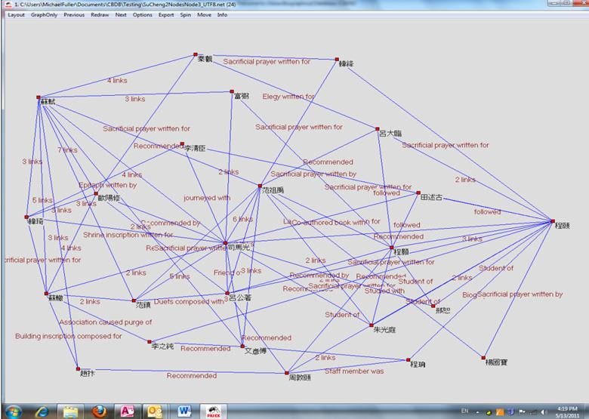

Slide 38
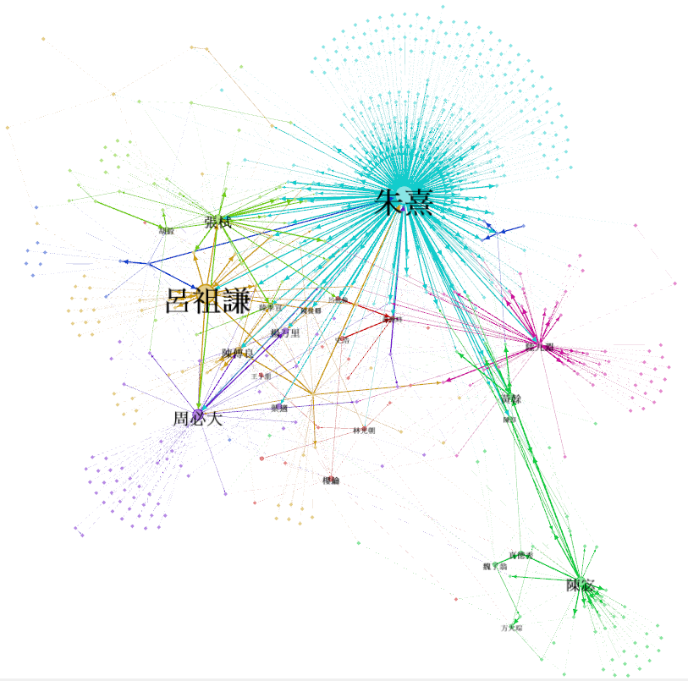
呂祖謙收到與寄出信的人與其書信網絡，共597人。結點的大小和對應的人名大小反映人物的重要性。不同顏色表示不同的團體。

Slide 39
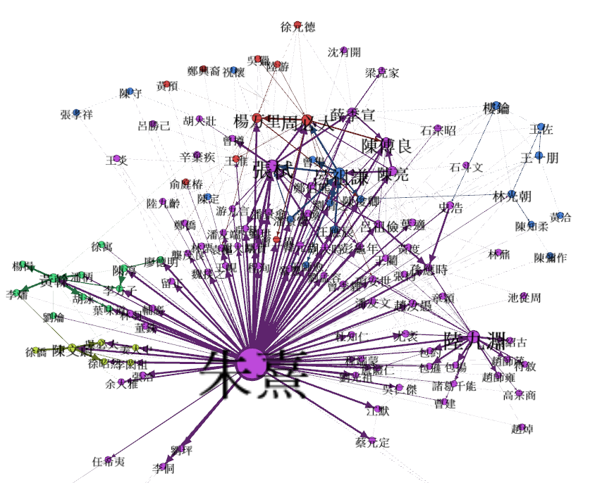
朱熹的書信網絡。這幅圖顯示了接收過朱熹兩封以上書信的人，以及他們之間的書信往來。人名大小反應了書信往來的數量；顏色用於區分書信往來的子網絡

Slide 40
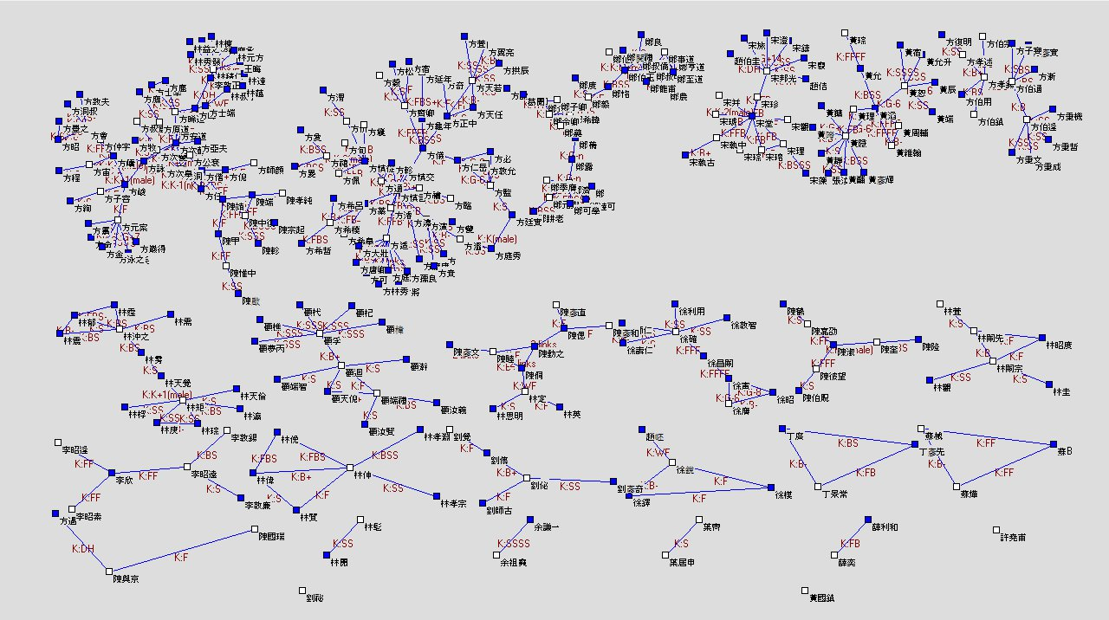
福建莆田於1050至1100年間取得進士學位者的第一級親屬網路關係
Michael A. Fuller

Slide 41
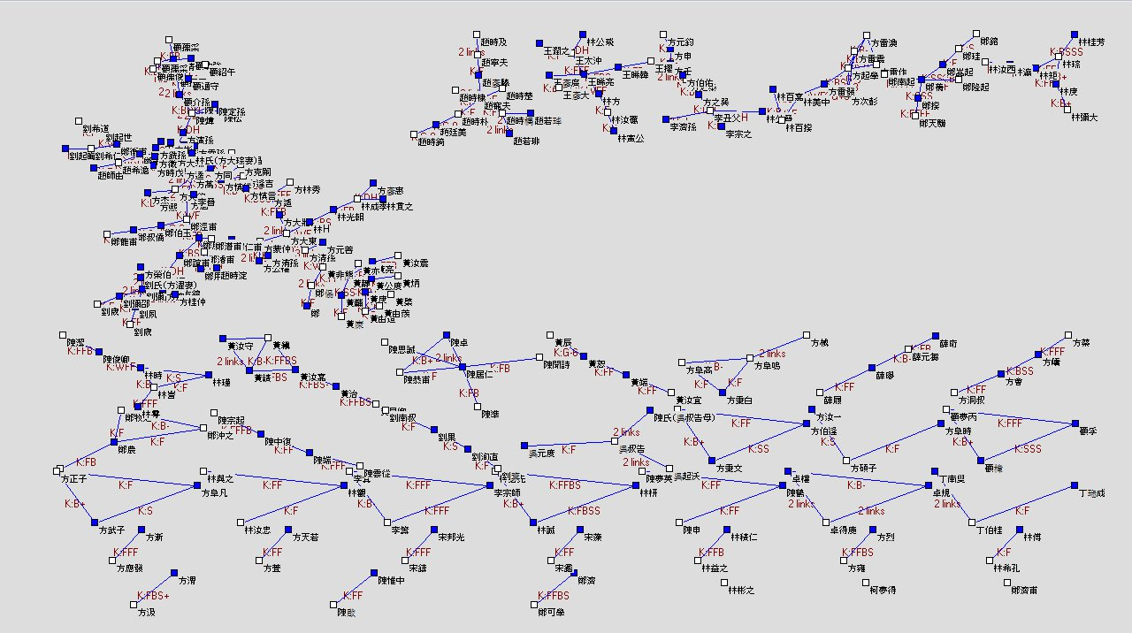
福建莆田於1200至1250年間取得進士學位者的第一級親屬網路關係
Michael A. Fuller

Slide 42
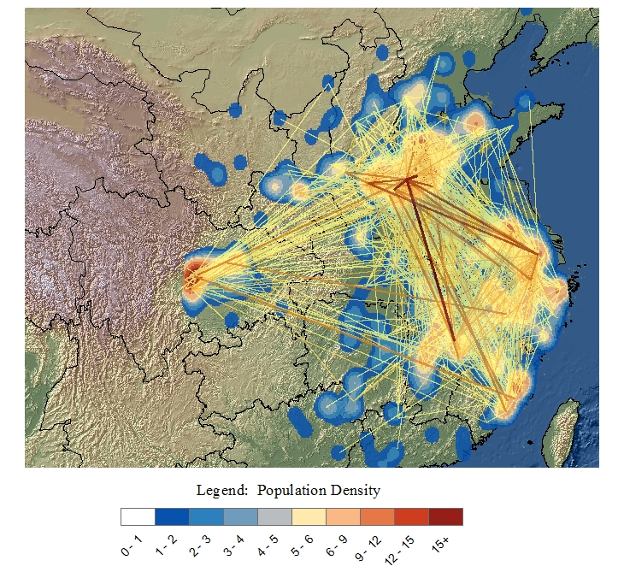
1060-1080 年間中國歷代人物傳記資料庫中人物的空間密度以及書信往來
CBDB 資料庫中 120,000 人中的 2359 人

Slide 43
三種使用方式

Slide 44
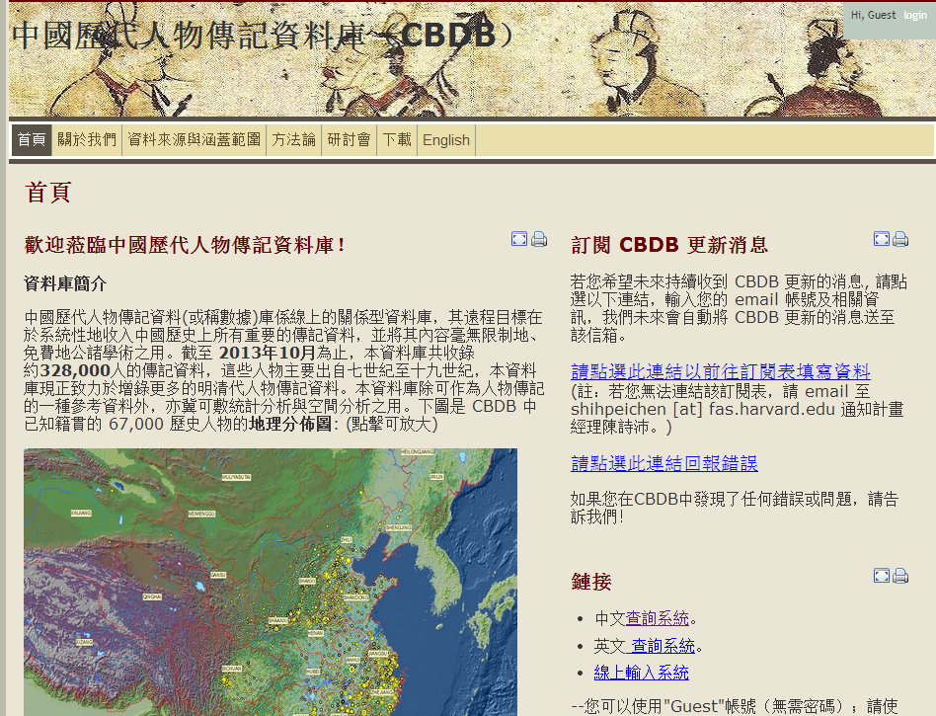

Slide 45
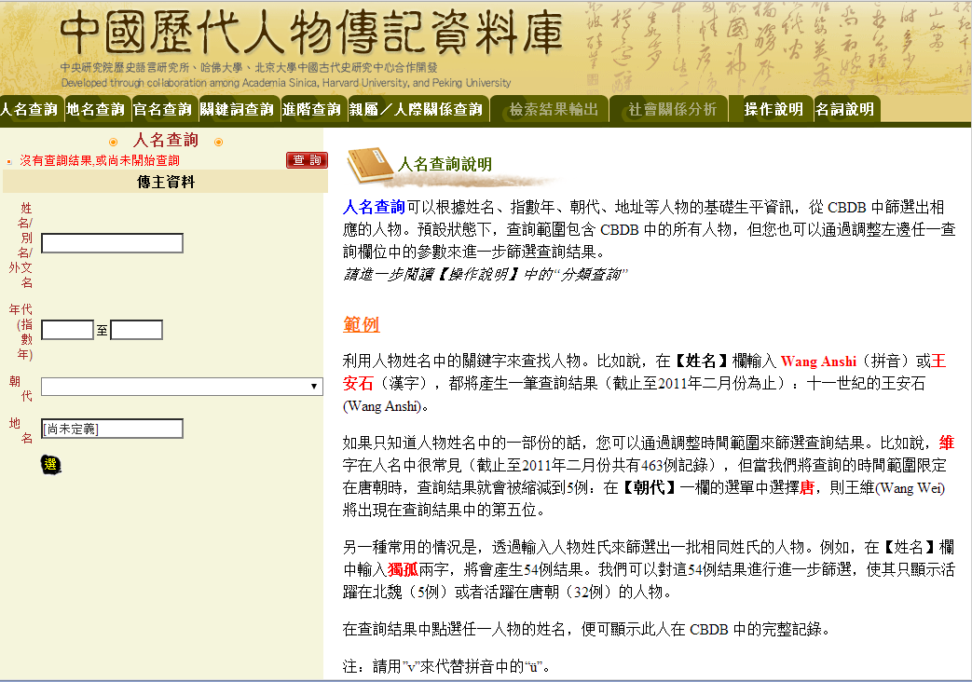

Slide 46
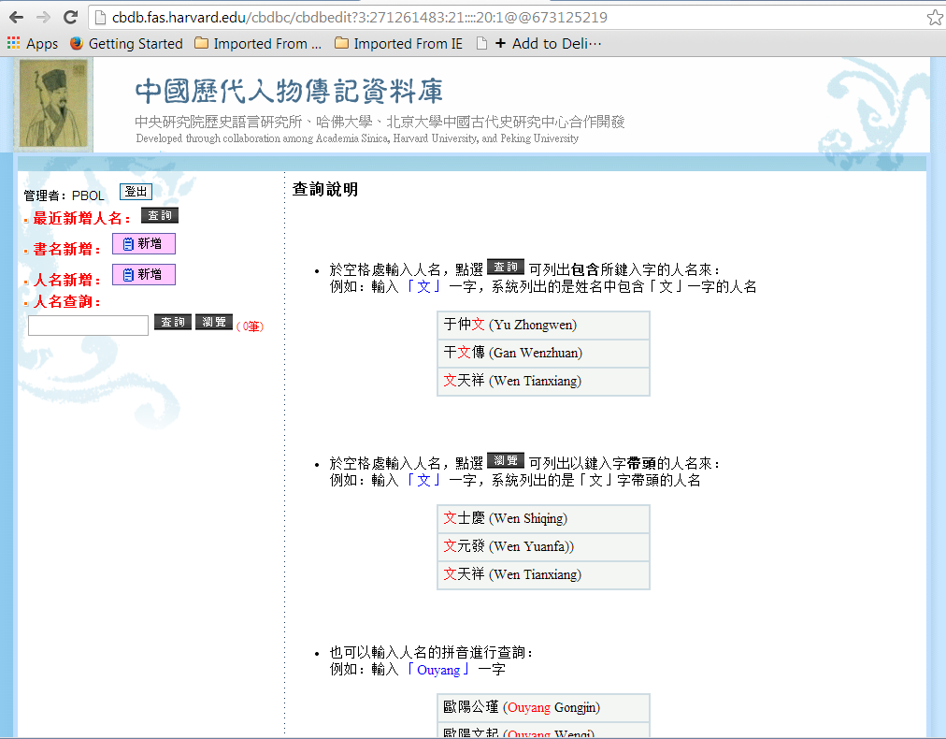

Slide 47
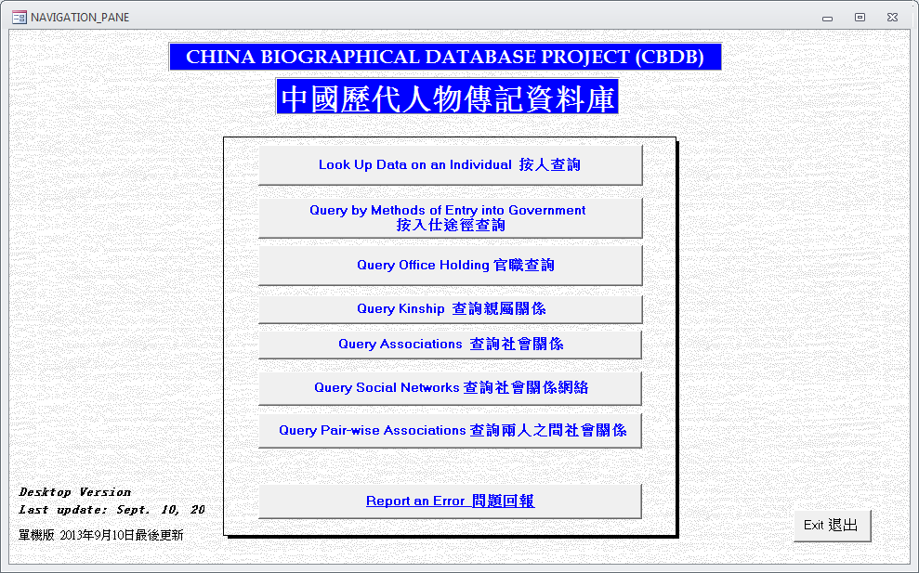
MS Access CBDB 離線資料庫

Slide 48
Data Acquisition for CBDB
Chen Shih-pei 陳詩沛

Slide 49
CBDB用到的數位技術/工具
Relational database 關連式資料庫
沒有數位全文: 明代進士登科錄
有數位打字全文
  XML Tagging: 全文標記
  人工標記: 唐代墓誌銘
  自動標記: 宋/元/明人傳記資料索引
  Regular expressions 正則表達式
工具
  CBDB Regex Machine
  地方志 interface
跨資料庫合作: CBDB API

Slide 50
關連式資料庫 (Relational databases)
把人物傳記提到的各種資訊抽象化、結構化、模型化Entity Relations Modeling:
Abstracting the features of the Biographical World
Association Types社會關係
Person人物
Place地址
Offices職官
is an
是一種
has an
擁有
has a
擁有
is at
位於
is a
是一種
Association 社會關係資料
Postings 任官資料
Notes:
50

Slide 51
ALT NAMES 別名
Person ID Name Type ID Alt Name, etc
WRITINGS 著述
Person ID Text ID, etc
ENTRY 入仕
Person ID Entry ID Year, etc
BIOG ADDR 地址
Person ID Addr Type ID Place ID, etc
Data tables are linked to each other via Person IDs.
不同資料表透過人物ID關連起來
POSTINGS 任官
Person ID Postings ID Office ID Start Date End Date, etc
BIOG_MAIN 基本資料
Person ID Name / 姓名 Sex Birth year Death year Index Year Dynasty ID Ethnicity ID Choronym ID
ASSOCIATIONS 社會關係
Person ID Assoc Relation ID Associate ID, etc
POST ADDR 任官地
Postings ID Place ID, etc
KINSHIP 親屬
Person ID Kin Relation ID Kin ID, etc
SOCIAL STATUS 社會區分
Person ID Status ID, etc

Slide 52
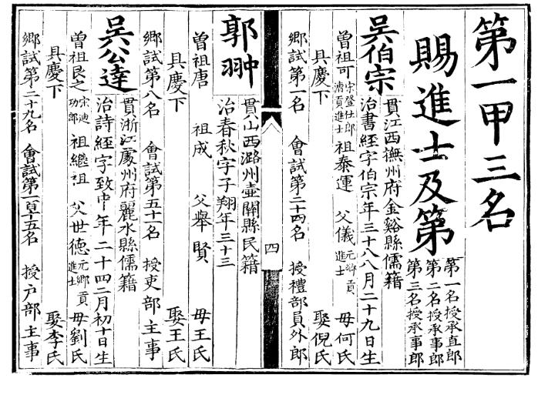
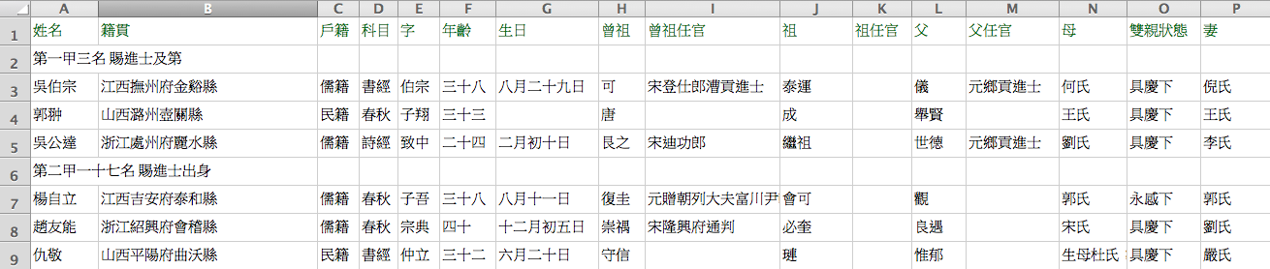
明進士登科錄

Slide 53
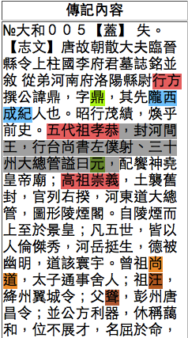
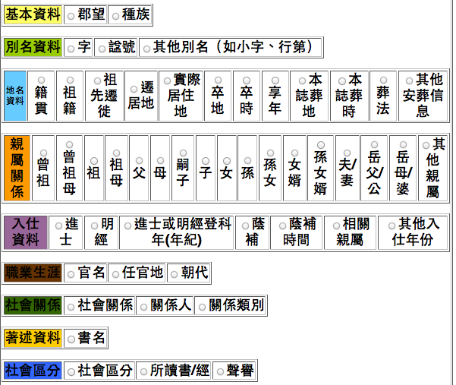
唐代墓誌銘:
全文+人工標記

Slide 54
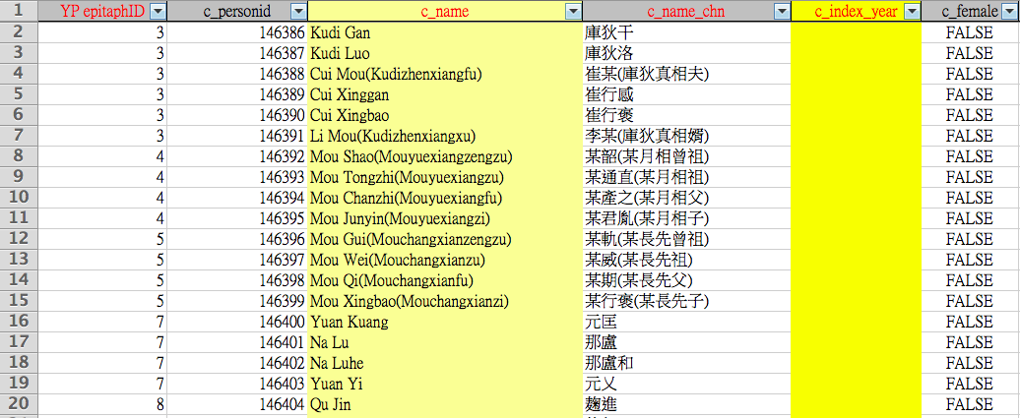
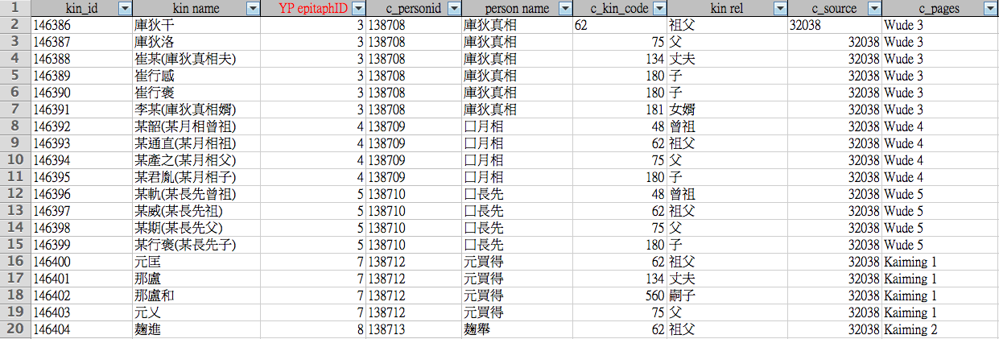

Slide 55
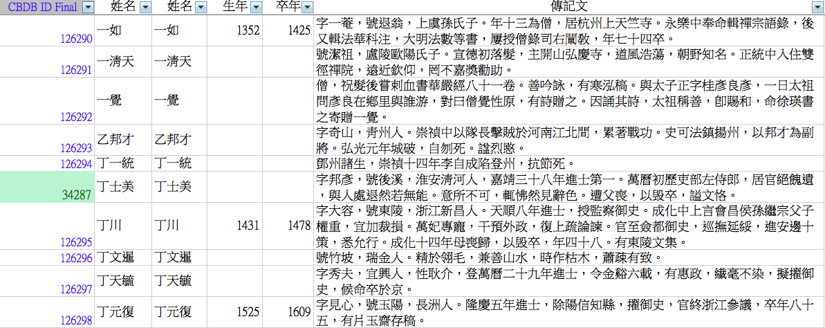
宋/元/明人傳記資料索引:
電腦自動標記 + 人工驗證

Slide 56
Regular expressions: 正則表達式
告訴電腦要抓「號」、「名」後面的文字，抓到標點符號為止
號(?P<name>[^ ，、。]{2,4})(?=[( ，、。：；])
名(?P<name>[^ ，、。]{1,2})(?=[ ，、。：；]以字行)

Slide 57
用GATE軟體檢查電腦抓取結果

Slide 58
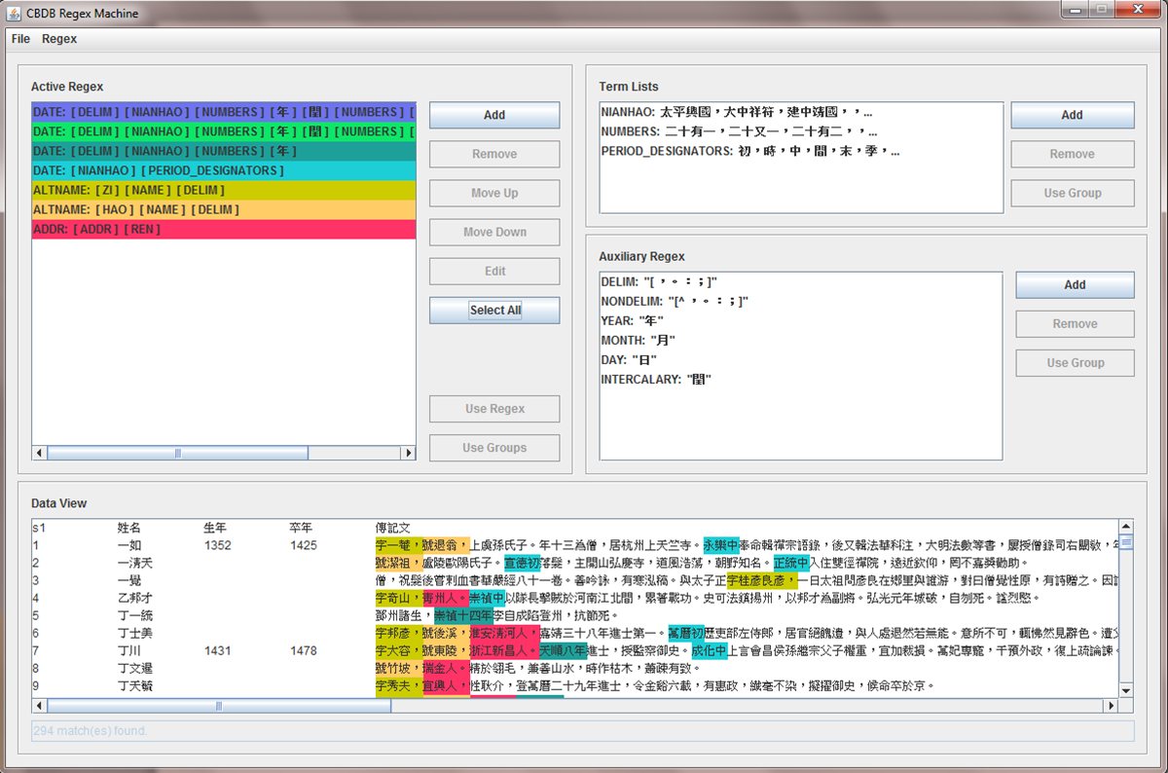
CBDB Regex Machine
把上述動作做成工具，可讓人載入全文檔、設計 regular expressions、套用到全文檔讓電腦自動抓取資訊
設計好的regexes
載入全文看套用結果, 匯出XML

Slide 59
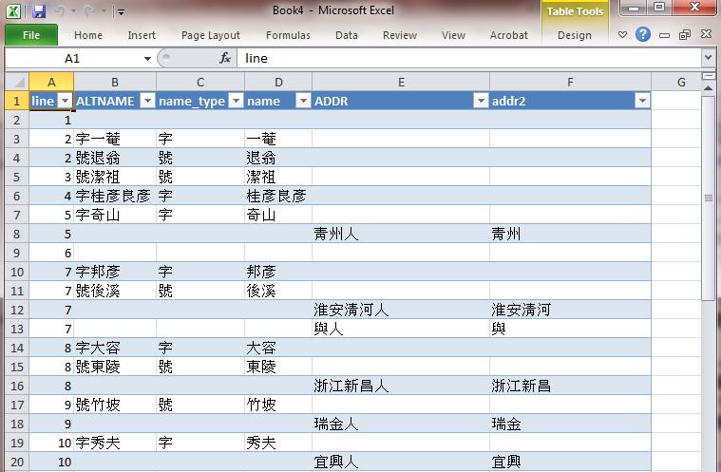
用 Excel 開 XML 轉成表格

Slide 60
Computer Assisted Tagging and Data Extraction

Slide 61
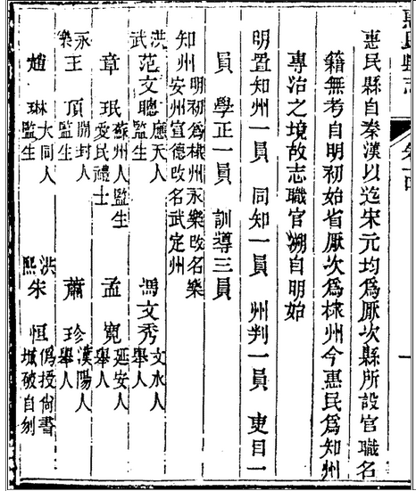
原文
任職時間
任官
人名
籍貫
入仕/出身
Notes:
Compare the original text and the text we have in the tagging system.

Slide 62
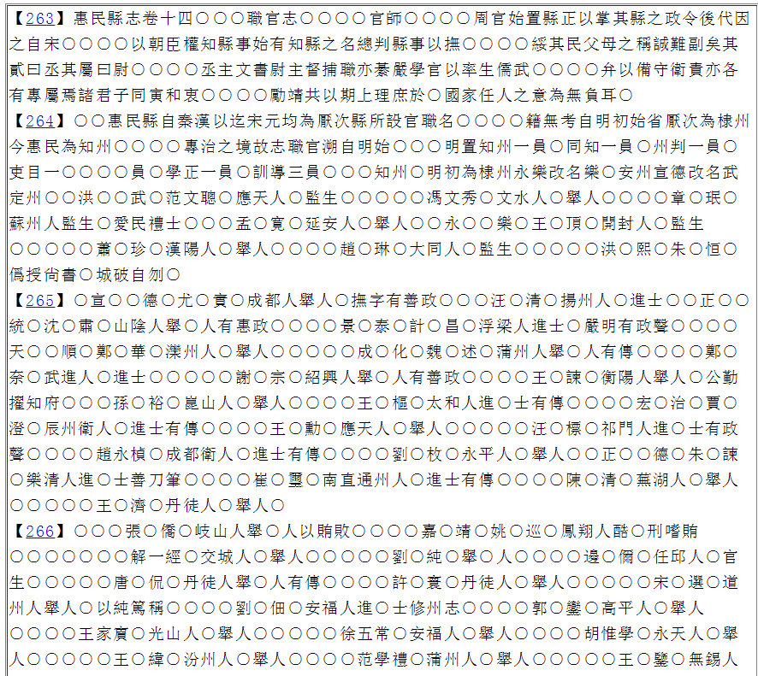
想標的資訊

Slide 63
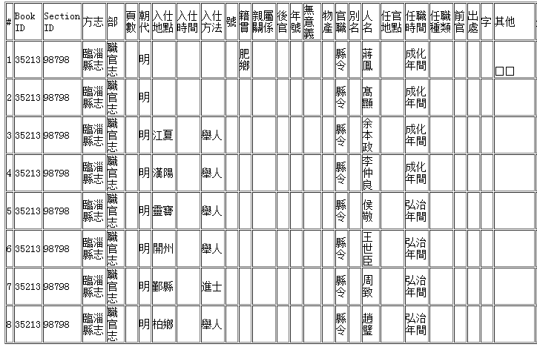
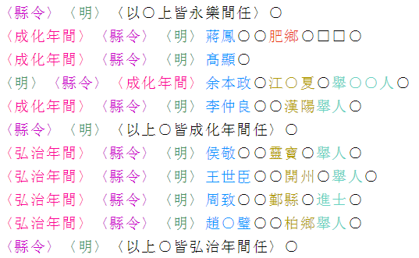
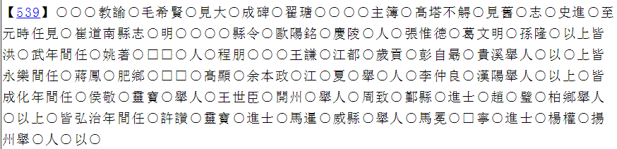
作法: A computer Assisted Tagging and Data Extraction System
運用 regular expressions 來標記有特殊寫法的文字區段
流程:
Import
–> Tag
–> Tag
–> Export
–> Export
系統開發: 彭維謙 (台大資工系)
Notes:
We use regular expressions to tag texts with patterns from the full text. We import text, tag them and export it into a table. Credit: CBDB&Wai-Him Pang

Slide 64
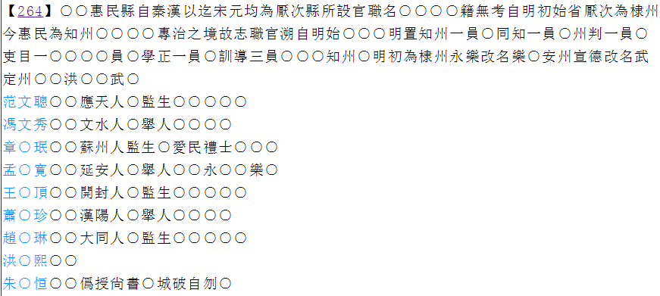
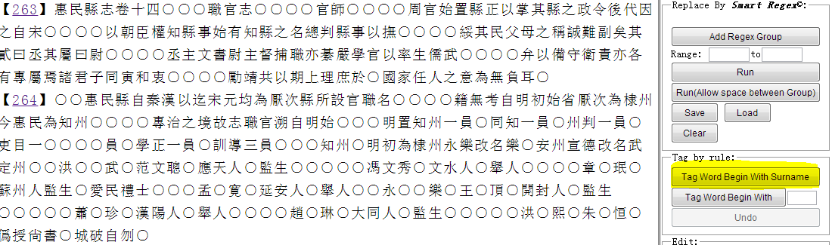
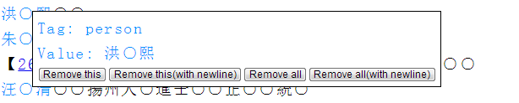
抓取「誰什麼時候任什麼官」
Tagging Names
Separate the names into different rows
Notes:
We will use the office data as an example. We start from separating the names into different rows since we want to obtain the biographical data of each individual. By clicking the “Tag word begin with surname” button, we will automatically tag all the names with a surname in 百家姓, displaying in blue. This system also allows you to correct the things that is tagged incorrectly. For example, in this text, 洪熙 should be a 年號 rather than a person’s name. We can click on it and choose “remove this”, and the tag will be removed.

Slide 65
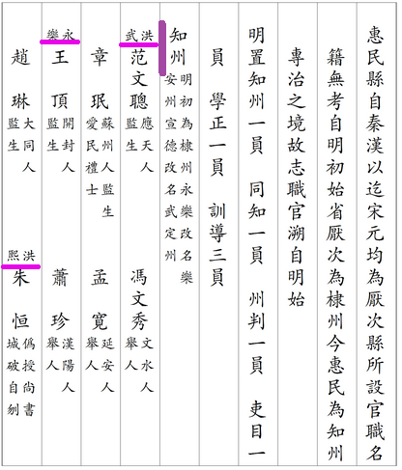
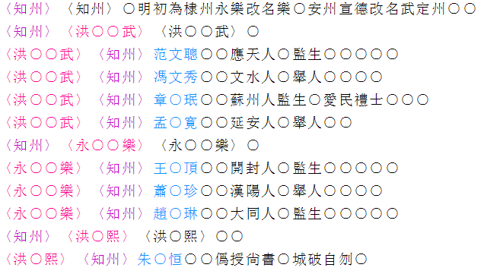
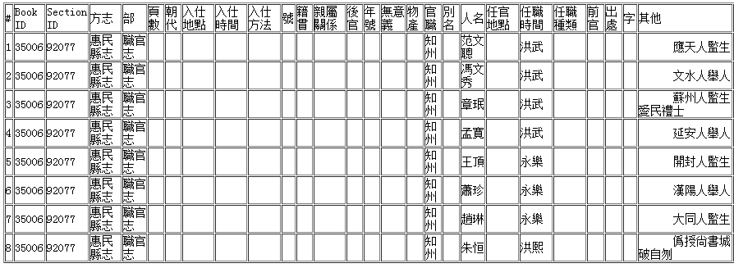
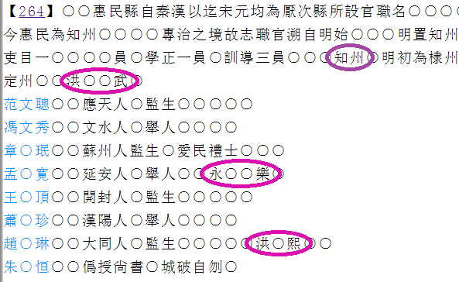
Adding shared information
Select certain words and add them as titles
Add shared information to a number of records at one time
Notes:
We can see from the original text, that a number of people may share the same office or post time. We can tag these as titles by selecting the shared information, e.g., selecting “知州” and tag it as “官職”. Then, we can select the rows in which the people all share this office, and add the office “知州” into each row. (Same with post time) When we export these rows, we can see that the office and post data now appears in each row.

Slide 66
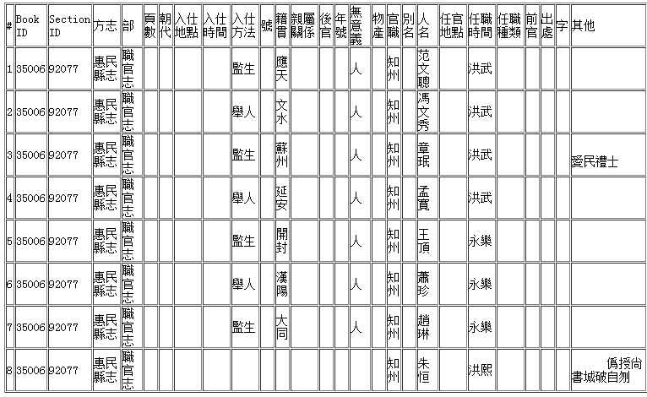
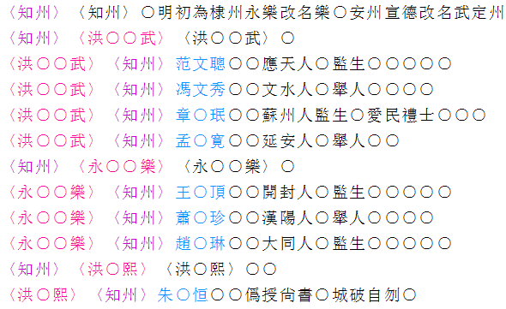
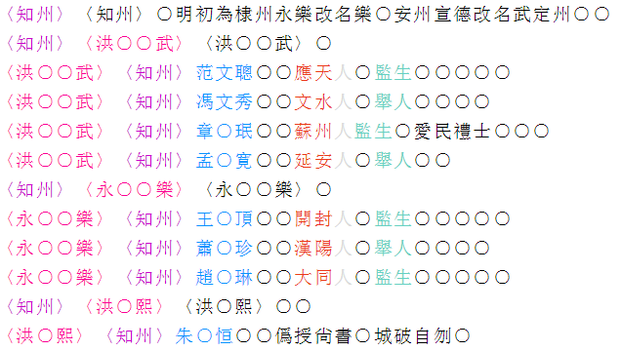
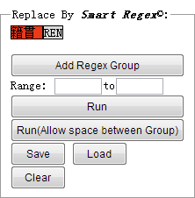
Creating your own Regexes
Finding patterns in the text
Load and run predefined regular expressions
Notes:
Even though we now have the 官職 and 任職時間, we find that there is still information that we want in the rows, yet they have not been tagged. We can see that they follow a certain pattern, XX人 is the basic address of a person, followed by their entry method. We can use the regex machine, which is in the upper right corner of the system, to tag them. We can load the predefined regular expressions, and run them. After we run them, the basic addresses and entry methods will be tagged. Now we can take another look at the export table – it has everything that we want. (We know that by looking at the column “其他” where anything that is untagged will show up.)

Slide 67
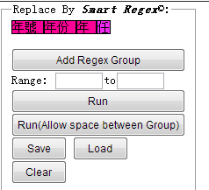
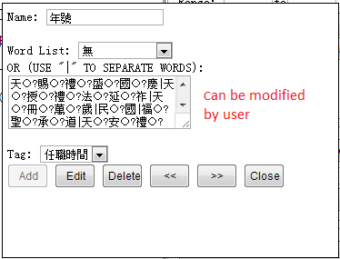

Customizing the Regexes
Can modify the regular expressions to fit the variation of patterns in each gazetteer
The number, e.g. 一,二十
The character “年”
A list of words equivalent to “任” e.g.署
Manage wordlist
Delete Regex group
Notes:
Sometimes we find that the regular expressions we prepared may not suit the current text patterns. We can modify them by modifying the wordlist, or deleting, adding or changing the regex groups. For example, we can load the post time regex, and it consists of 年號 年份 年 and 任. If we click on 年號, we can see that it consists of a word list with every 年號 in CBDB. We can modify the list. We can also modify the regex groups. For instance, we can remove the regex group 年號 by clicking the “delete” button. Now we have this new post time pattern 年份 年 任. 年份is the actual number, 年is the character “年” and 任 includes a list of words that are equivalent to任. Now when we run this regex, it will tag everything in this pattern [number]年[任].

Slide 68


Export
Export extraction result as a table
Notes:
After we tagged all the things we want, we can export it into a table. The table can be easily copied and pasted into excel, where you can manage your data conveniently. Here are a few examples of the gazetteers that has been tagged. You can see that their patterns are all different, thus, we need humans to use this computer assisted system to complete the tagging process.

Slide 69
Managing your own tag list
Import your own text
Create your own regular expressions
Extract the data that you want
Notes:
We hope that our system can be used as a platform where historians can import their own text, manage their own tag list, and create their own regular expressions in order to extract the data that they want.

Slide 70
CBDB API: 資料庫之間的互通
不同團隊建立的資料庫, 各有不同著重的面相
  CBDB
  明清人名權威資料 (中研院史語所, 故宮)
  Communication and Empire (Leiden University)
若要求資料庫廣泛涵蓋各種面相的資料, 花很多力氣, 模糊焦點, 不容易
=>互通, 互相串連資料

Slide 71
System Interoperability
CBDB: 傳記資料
明清人名權威
取用CBDB傳記資料
Communication and Empire
取用CBDB傳記資料作為
參考服務 (字典)

Slide 72

Make an API call to get external data

Slide 73
Harvardx and Chinax
MOOCs
大型線上免費開放課程
Peter Bol 包弼德

Slide 74


Slide 75
[
]
“Knowledge is the most important currency of the
21st century.”
Drew Faust, Harvard University President
Notes:
Full quote: “We live in an era in which knowledge is more vital than ever to nations, economies and societies. Knowledge is, I often say, the most important currency of the twenty-first century. And universities are the places that, more than any other, generate and disseminate that knowledge.”
President Faust often emphasizes this idea---for good reason.
It is understanding knowledge in the broader context of how technology is changing our world and higher education, the constant desire by our faculty to innovative and lead, and the global importance of knowledge, that Harvard decided to take a big step. A big step with a help from another institution near by.

Slide 76

Goal 1: Improve Teaching
[
]
Enhanced online &
on-campus learning
      1st humanities course on edX
      integrated tools for campus students
Brought faculty together
    59 faculty in HX pipeline
    5 faculty town halls
    Joint Harvard-MIT summit
Notes:
1st humanities course was “Ancient Greek Hero” – a resounding success (“best MOOC, period” --- Jonathan Haber, blogger.)
Most number of courses and modules: HX courses comprise nearly 1/3 of the total edX user base
CS50x is using automated tools to provide just-in-time feedback; HeroesX online videos being used as a supplemental textbook
HSPH is using HarvardX courses to redesign their core curriculum and deliver their first fully online academic program
HX is really a way for faculty to come together around innovative teaching and learning
Sharing ideas and best practices
Working with colleagues from across the country
It is led by and for faculty

Slide 77

Goal 2: Advance Research
[
]
Built a team of research fellows
      creating an online learning community
      at Harvard and beyond
      received a grant from the Gates Foundation
      to study personalizing MOOCs
      HX & HILT fellows are collaborating
Published findings
    “Studying Learning in the Worldwide
    Classroom: Research into edX’s
    first MOOC” (Breslow, Ho)
Notes:
CopyrightX ran two version of the course to test traditional
versus non-traditional methods of learning
HSPH is using HarvardX courses to redesign their core curriculum
and deliver their first fully online academic program
explores correlations of background and capabilities
to achievement and persistence
examines relationships between student interactions
with content and level of success
We have learned a great deal over the past academic year and made great progress over the summer.
As we look ahead, we have a solid plan in place as well as some initial ideas about how to ensure that our endeavor is sustainable.

Slide 78
Goal 3: Expand Access
[
]
Engaged global learners
      800,000+ students enrolled
      10 completed courses and 30 future
Offered breadth and depth
      10 Harvard schools
      topics in the humanities,
      government, health, medicine
70%
of students
are international
Notes:
Delivered 6 open courses + 15 complete (the most on edX)
500,000 + students
CS50x, “Intro to Computer Science”
PH207x, “Health in Numbers”
PH278x, “Health and Environment”
CB22x, “Ancient Greek Hero”
ER22x, “Justice”
HLS1x, “Copyright”
Offered breadth and depth
10 Harvard schools
Topics ranging from the humanities, health, science, education,
physics, poetry, government, medicine

Slide 79

37%
1.5%
9%

Slide 80
30%
10%

Slide 81


Slide 82


Slide 83

32
24
23
27

Slide 84
ChinaX
Yu Wen 于文

Slide 85

Course trailer： https://www.edx.org/course/harvardx/harvardx-sw12x-china-920

Slide 86


Slide 87


Slide 88
Some different module examples

Slide 89


Slide 90


Slide 91


Slide 92


Slide 93


Slide 94


Slide 95


Slide 96


Slide 97


Slide 98


Slide 99


Slide 100


Slide 101



Slide 102


Slide 103


Slide 104


Slide 105


Slide 106


Slide 107


