Slide 1
Data Processing and Analysis of Biographies of Chinese Buddhists
Shaojian Li
Renmin University of China, Harvard University
lishj27@ruc.edu.cn
09.08.2024

Slide 2
Data Processing
Data Analysis

Slide 3
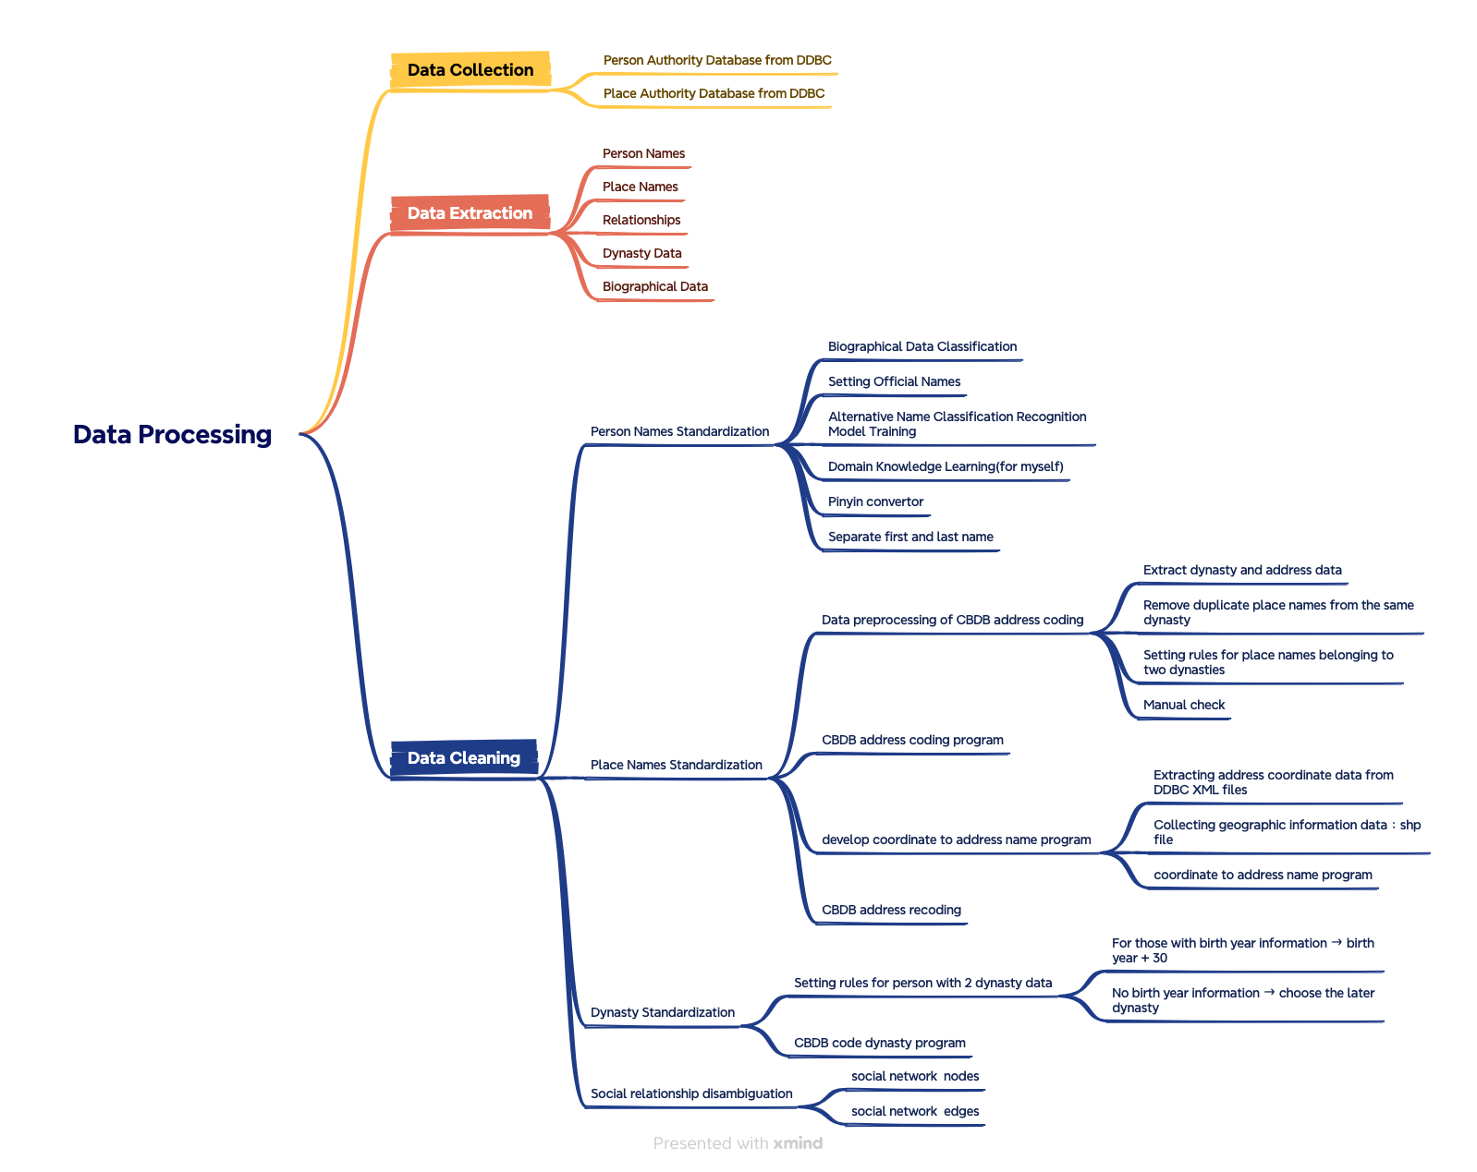
Data Processing
Data Analysis

Slide 4
Data Source and Processing
The data used for this project comes from the Dharma Drum Institute of Liberal Arts Buddhist Studies Person Authority Databases. Data was extracted from the TEI code document published by the database. The XML file was parsed using beautiful soup to extract all person elements, and the information of each person element was parsed. All other child elements were traversed to extract the corresponding text content, and the data was saved in a CSV file.
Finally, the following useful information was extracted
Person ID | 46728 | Dynasty | 44636
Name | 46728 | Place | 11779
Alternative Name | 17699 | Place Code | 11779
Birth Year | 4312 | Person Disambiguation | 195
Death Year | 3492 | CBDB ID | 1547

Slide 5
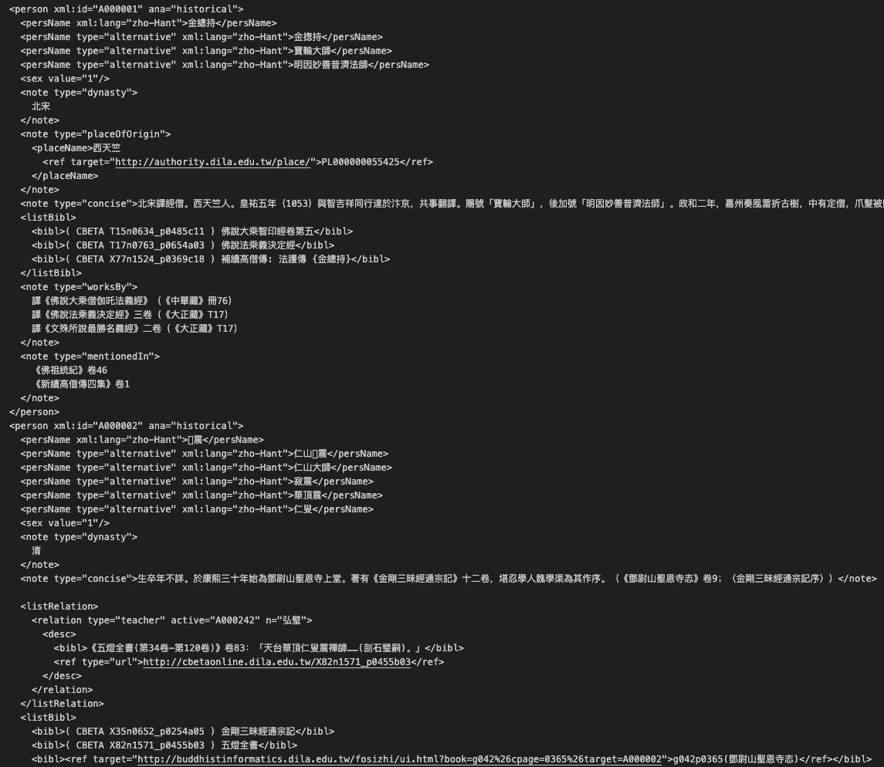

Slide 6
Categories | Data Description |  |  | Solution
 | Has names | Has Alternative Name | Has names starting with "Shi"（“释”）
Category1 | √ | × | × | Matching CBDB | Matched | Reuse matching results | 6110
Category2 | √ | √ | × |  | No match result | Training model | 13855
Category3 | √ | √/× | √ | Person names starting with "Shi" are used as official names |  |  | 1238

Slide 7
Training model
data set
Label “1”:
Extract all three-character names starting with "Shi" from CBDB and the Buddhist Studies Person Authority Databases , remove "Shi", and create a two-character Dharma name list. All names in the list are considered as one Dharma name, totaling 3938 two-character words

Slide 8
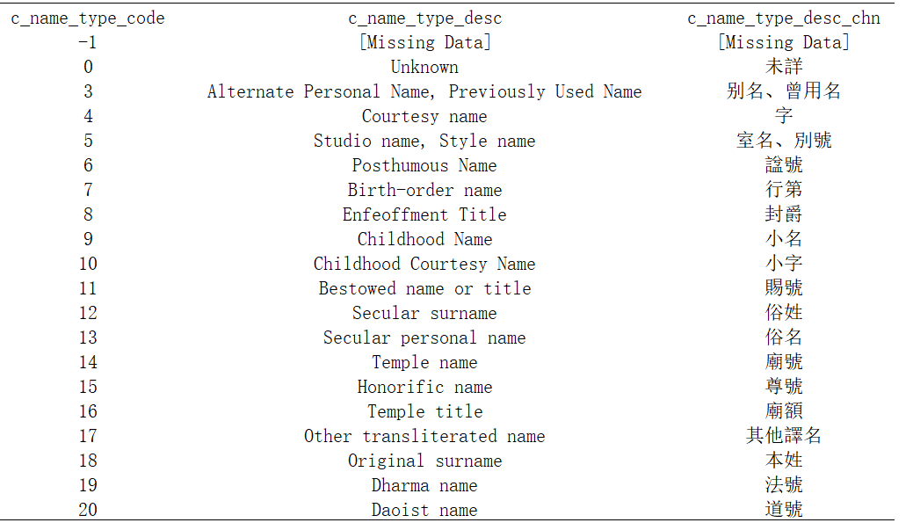

Slide 9
Words | Frequency
先生 | 707
居士 | 629
山人 | 282
老人 | 259
道人 | 239
主人 | 96
女史 | 86
大師 | 46
處士 | 35
散人 | 34
山樵 | 28
禪師 | 22
野人 | 18
布衣 | 15
山民 | 13
逸民 | 13
逸叟 | 12
和尚 | 11
漫士 | 10
山翁 | 10
拙翁 | 10
Character | Frequency
齋 | 2357
堂 | 1325
山 | 938
菴 | 825
軒 | 698
庵 | 612
溪 | 502
亭 | 418
谷 | 326
泉 | 305
園 | 294
巖 | 260
樓 | 260
川 | 247
峰 | 242
峯 | 224
隱 | 213
村 | 204
館 | 182
湖 | 176
閣 | 161
洲 | 158
房 | 156
石 | 151
江 | 150
雲 | 148
Label “0”:
style name (code5) of CBDB and the Dharma name that does not start with "Shi", as long as it is two characters
remove regular characters from some regular names, select words with a frequency of more than 10 as filters, and only keep two characters.
In addition, since Code5 also contains studio names, the last character is extracted and sorted, and the first 100 characters with obvious studio name characteristics are used as studio name filters.
Finally, 10,803 two-character words are obtained

Slide 10
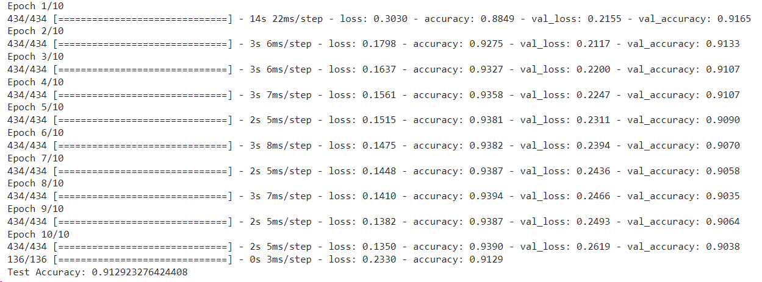
Use the DebertaForSequenceClassification function in transformers to train the above data, use model prediction results as the official names.

Slide 11
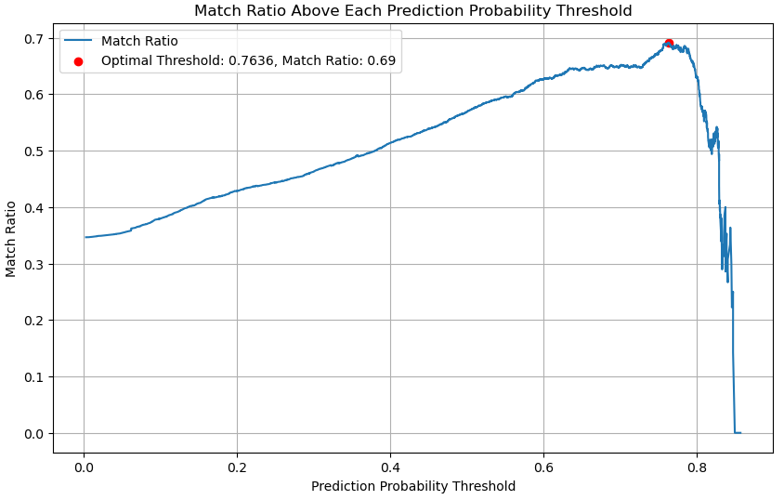
Evaluation

Slide 12
Evaluation
Based on the prediction results, the first character of each name is matched with the 70 characters to see if a matching result can be returned. After analysis, it was found that when the prediction result probability was 0.7636, the most matching results were found above this threshold, and the matching rate reached 69%. Then the names with a prediction probability below 0.7636 were manually checked, and it was found that most of the names with a prediction probability above 0.70 could be found to have "Shi xx", and most of the names with a prediction probability below 0.30 could not be found to have "Shi xx". Therefore, this method can effectively standardize the names of Buddhists.

Slide 13
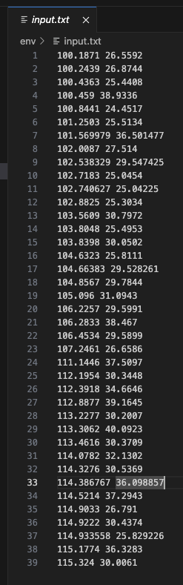
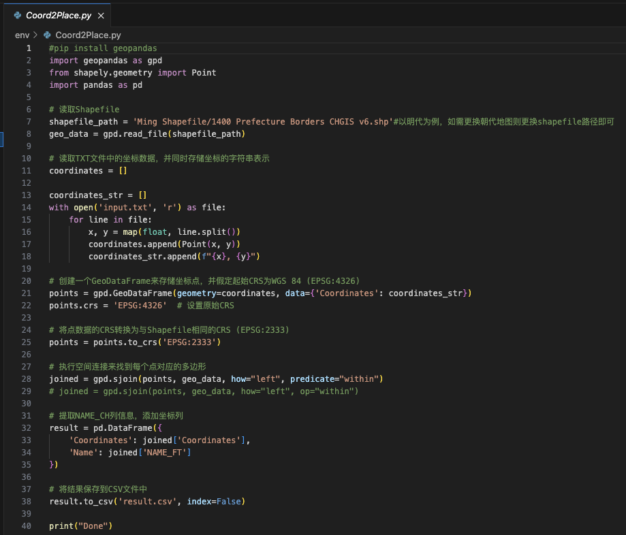
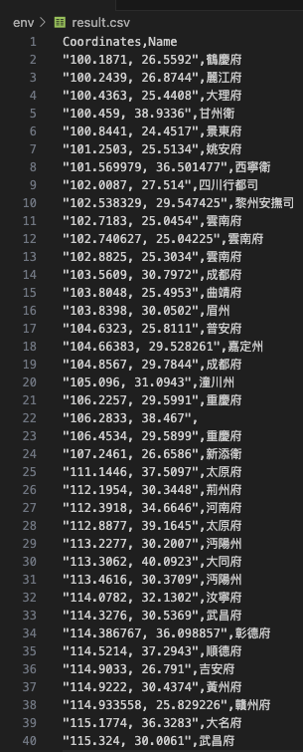

Slide 14
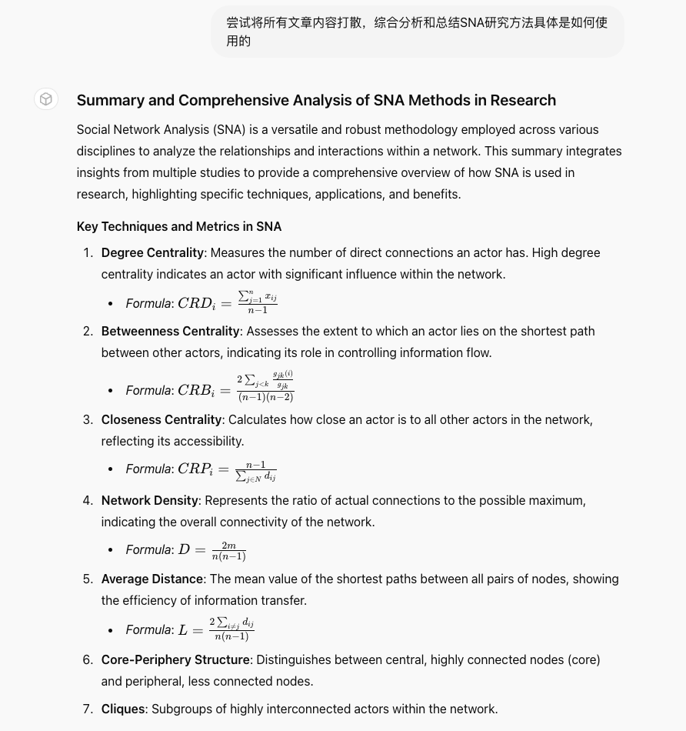
Data Analysis
SNA Lliterature Review by GPTs
Collecting papers from Nature

Slide 15


Slide 16


Slide 17
An Analysis of Social Network Relationships among Buddhists in the Ming Dynasty
By parsing the DDBC name standard data database and extracting the relationship elements, we obtained 3011 social relationship data, which were cleaned into a data format that can be imported into Gephi,
finally get 893 nodes and 3011 edges

Slide 18
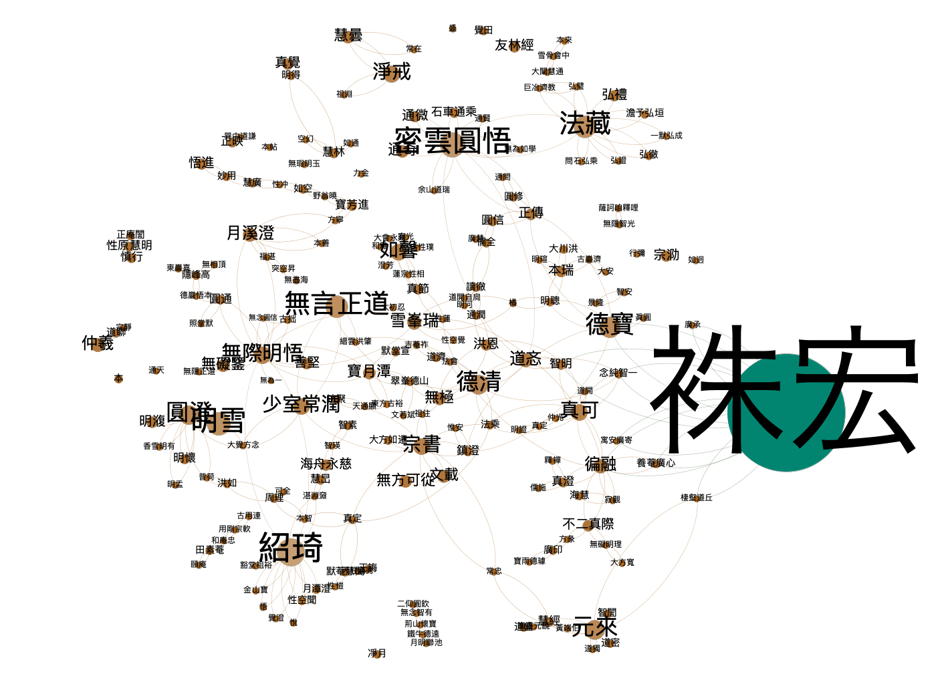

Slide 19
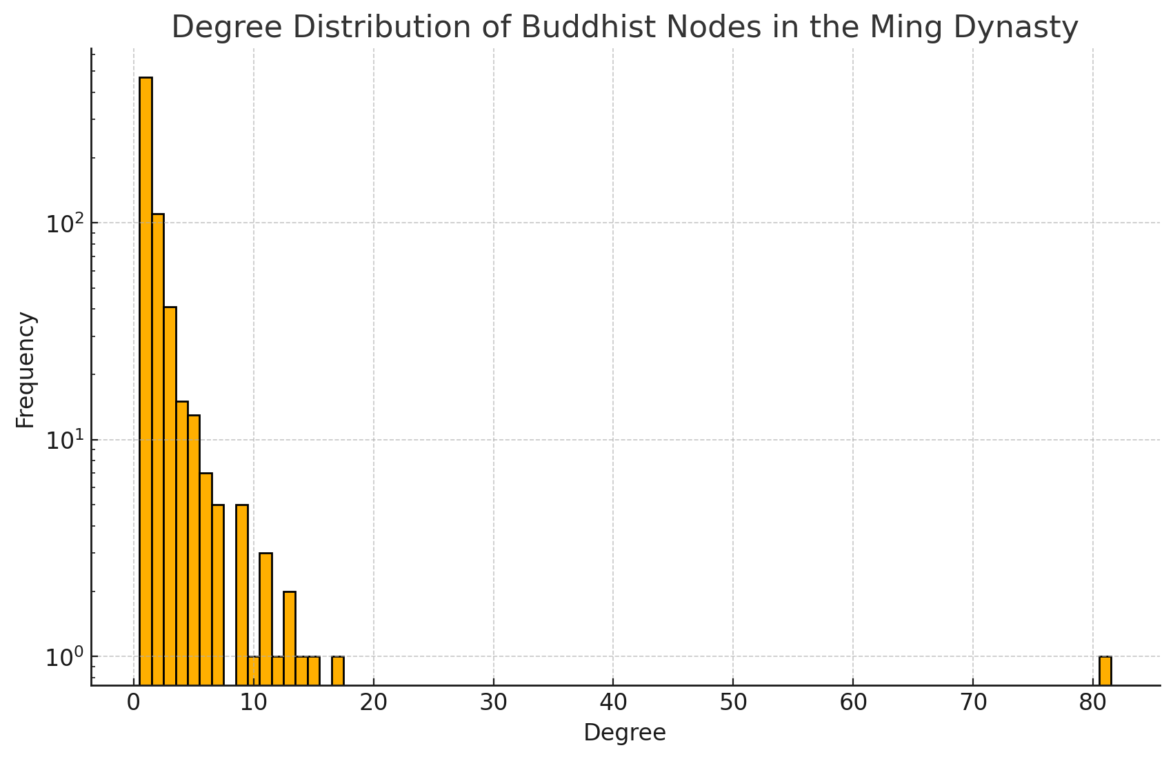
Degree distribution analysis
Notes:
The degree distribution graph shows that most nodes in the network have low degrees, while a few nodes have high degrees. This scale-free property is common in many social networks and usually indicates that some nodes play an important role in connecting the network.
The impact of this distribution is that most of the low-degree nodes in the network are ordinary monks or believers, and their connections with a few highly connected nodes reflect the hierarchical structure and information dissemination patterns of Buddhism. The characteristics of the degree distribution indicate that the Buddhist network has a high degree of centralization in information dissemination and social organization.
1. Low degree: Most nodes have low degrees, which means that many Buddhists have direct connections with only a few others. This may reflect the presence of a large number of marginal members in the Buddhist network or people who have few connections with core members.
2. Long-tail distribution: The figure shows that the degree distribution has a clear long-tail characteristic, that is, as the degree increases, the number of nodes with that degree decreases rapidly. Only a few nodes have high degrees, which indicates that only a few Buddhists play a central or hub role in the network.
3. Low centralization: The low concentration of connections in the network indicates that the network may be composed of many small, tightly connected groups, each of which has close connections within it, but few connections between groups.
4. The importance of key nodes: Although most Buddhists have few connections, key nodes in the network (such as the nodes with high degrees and high centrality analyzed earlier) are extremely important for the connectivity and information flow of the entire network.

Slide 20
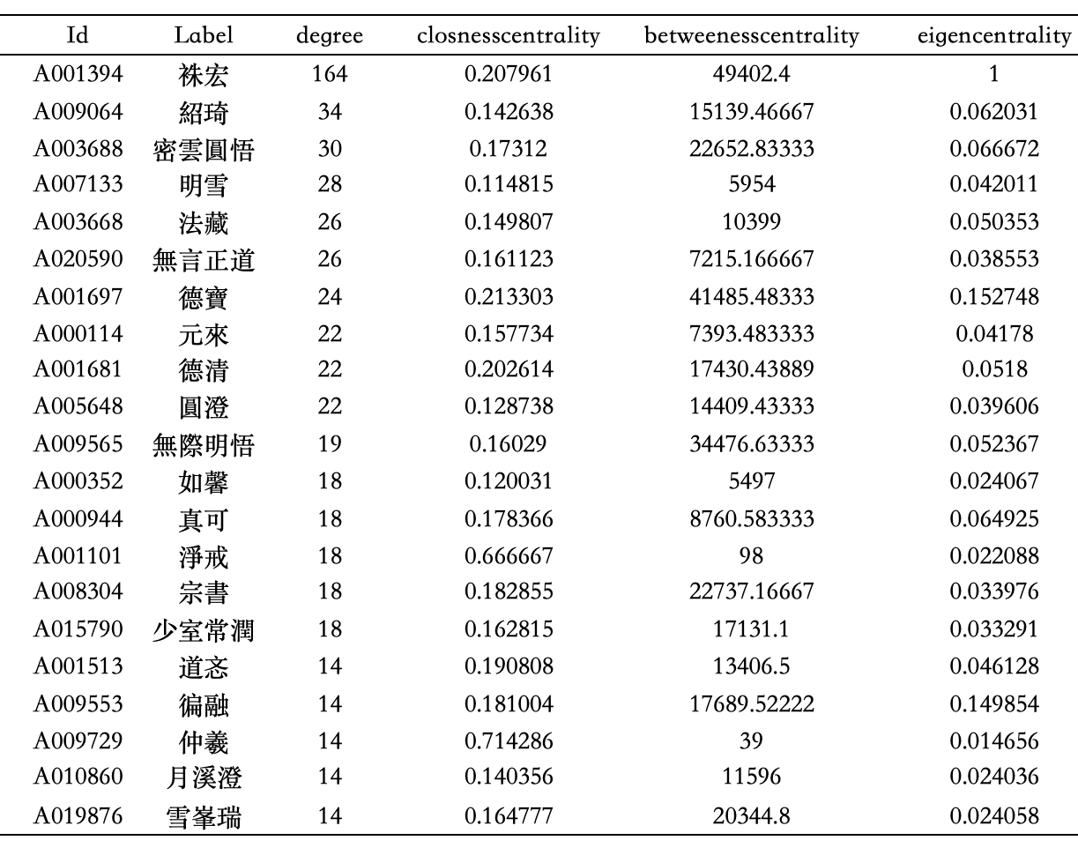

Slide 21
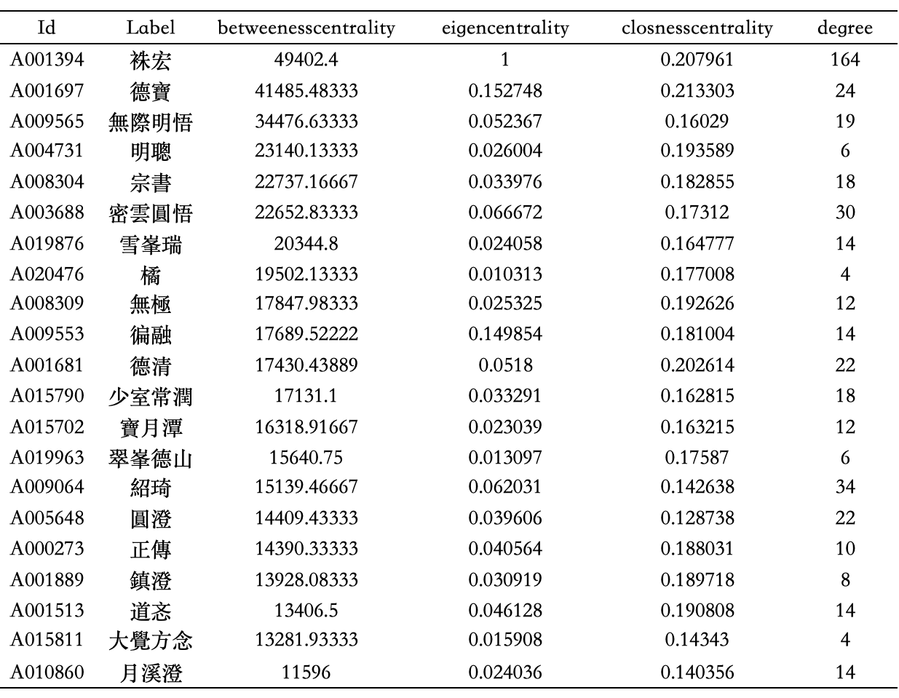
Notes:
Betweenness centrality: To find important people who play a bridging role, we can analyze the indicator of "betweenness centrality", which measures the ability of a node to serve as a bridge between the components of the network. In other words, to what extent does it depend on point C to get from point A to point B? The highest "betweenness centrality" indicator means that they play a key role in connecting different groups in the network.
Zhuhong (A001394): He has the highest betweenness centrality, which means that he plays an extremely important bridge role in the Buddhist network, connecting many different groups or individuals.
These nodes may act as bridges between different communities or groups, allowing information to spread more efficiently throughout the network. Their presence helps reduce information silos in the network and promotes communication and cooperation between various groups.

Slide 22
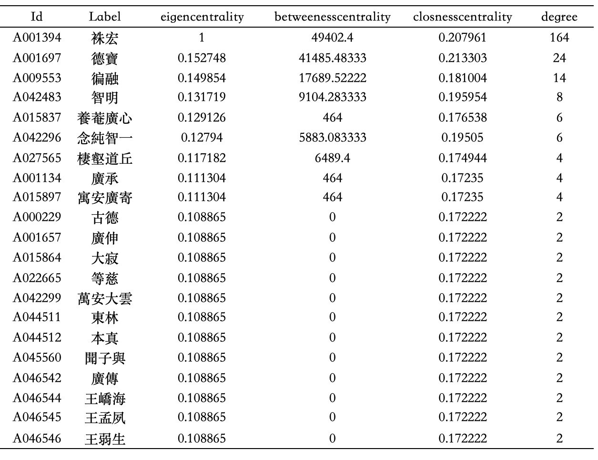

Slide 23
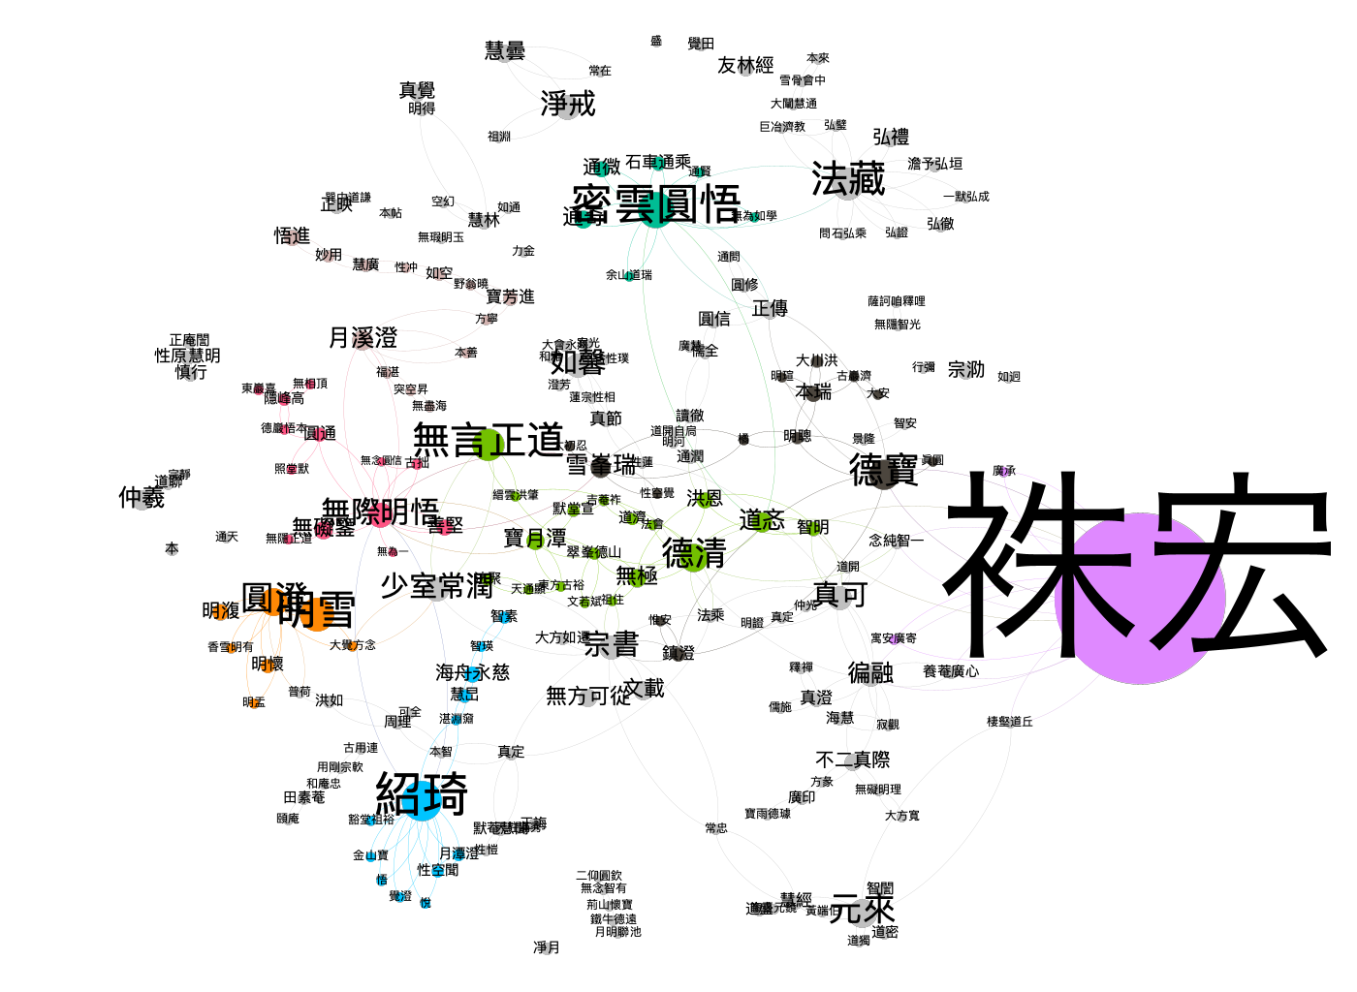
Notes:
Community detection is a technique for identifying closely connected groups of nodes in a network, which are often referred to as "communities" or "modules". In social network analysis, modularity is an important metric used to assess the quality of community divisions in a network. A high modularity value indicates that there is a clear community structure in the network, that is, the nodes in the network can be clearly divided into multiple groups, and the connection density within the group is higher than the connection density between groups.
The data shows that there are multiple communities in the Buddhist network, with a total of 157 different modularity categories, indicating that multiple obvious groups or communities have indeed formed in the network. The number of members in each community varies, and some of the larger communities have the following number of members:
Community 4: 137 members
Community 10: 125 members
Community 21: 111 members
Community 15: 100 members
Community 110: 89 members
The existence of this community structure suggests that in the interaction network of Buddhists, there are some groups of nodes that are closely connected around common interests, teachings, or other social factors, forming obvious groups. Each community may represent different denominations, geographical locations, or shared religious practices and beliefs.

Slide 24
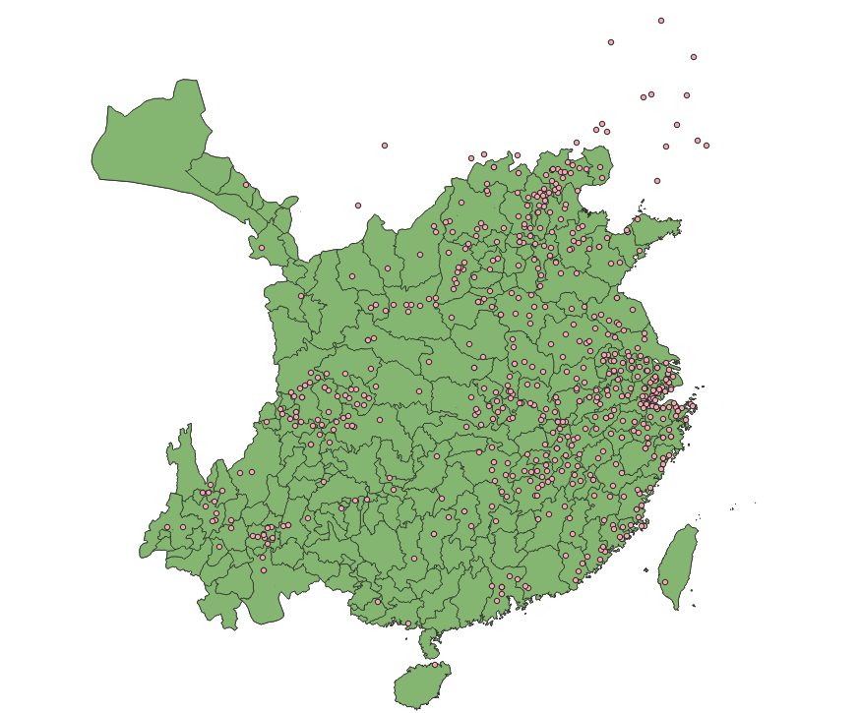
Notes:
Community detection is a technique for identifying closely connected groups of nodes in a network, which are often referred to as "communities" or "modules". In social network analysis, modularity is an important metric used to assess the quality of community divisions in a network. A high modularity value indicates that there is a clear community structure in the network, that is, the nodes in the network can be clearly divided into multiple groups, and the connection density within the group is higher than the connection density between groups.
The data shows that there are multiple communities in the Buddhist network, with a total of 157 different modularity categories, indicating that multiple obvious groups or communities have indeed formed in the network. The number of members in each community varies, and some of the larger communities have the following number of members:
Community 4: 137 members
Community 10: 125 members
Community 21: 111 members
Community 15: 100 members
Community 110: 89 members
The existence of this community structure suggests that in the interaction network of Buddhists, there are some groups of nodes that are closely connected around common interests, teachings, or other social factors, forming obvious groups. Each community may represent different denominations, geographical locations, or shared religious practices and beliefs.

Slide 25
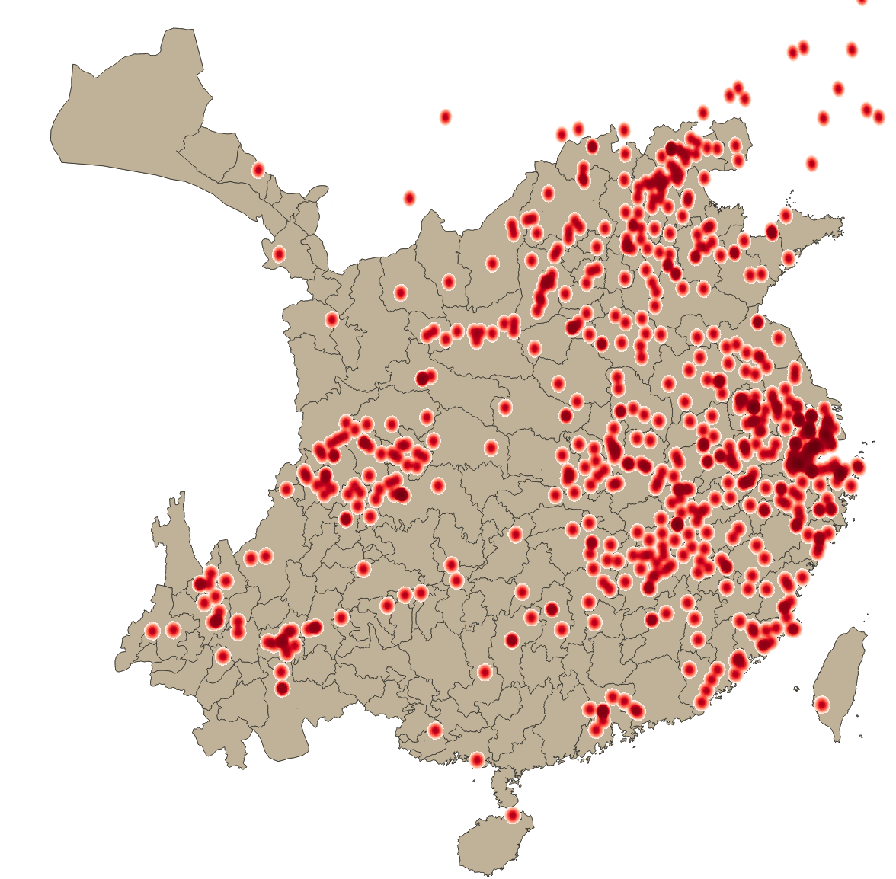

Slide 26
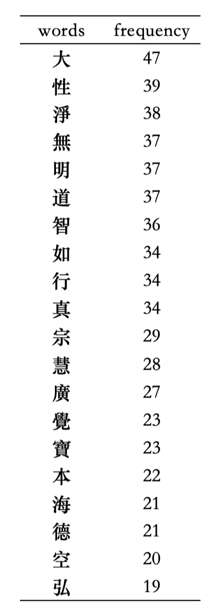
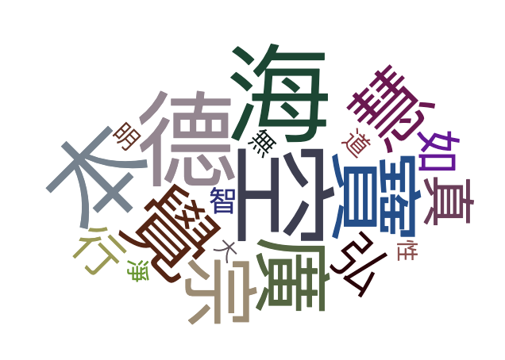

Slide 27
Case Study
袾宏（1535年—1615年），浙江仁和（今杭州市）人，俗姓沈，法名袾宏，字佛慧，法号莲池，故常称为莲池大师，又因常居云栖寺，常称为云栖莲池或云栖株宏，是中国佛教净土宗的第八代祖师，与紫柏真可、憨山德清、蕅益智旭等并称明末四大高僧。
其家是杭州世族，父名沈德鉴，庵号明斋，母亲姓周。十七岁时中秀才，成为庠生，学行俱优，但是他志不在此。见邻家日诵佛号数千之老妪，其夫念佛乃能无疾而终，令他深感佛法不可思议，尝书“生死事大”于书桌前以自警惕。妻子张氏，生子时过世，后又娶汤氏为妻。
隆庆五年（1571年）至云栖山，重建云栖寺，开始有许多弟子依止在他门下，成为一方丛林。
莲宗系谱可信的话，莲宗七祖省常以后的净土宗传承可谓中绝，一直到莲宗八祖袾宏，至少有五百年的空白。五百年间，虽然不废念佛的禅门宗匠屡有所闻，但几乎未闻直持净土念佛法门标宗立派。称名念佛、愿生极乐等法门其实贯串各家各派，因此佛教史专家汤用彤先生否认净土宗是一个独立的佛教宗派。
在明代，明太祖分佛教为禅、讲、教三科，所以在明代的现实环境之中，净土宗不可能独立存在。因此，云栖袾宏力主持戒念佛（虽然仍然带有高度的禅宗门风），以戒杀放生为法门，又是一时人望所归，多少亦有几分标宗立派之实，但在现实环境的制约之下，开宗立派已经注定是不可能的任务。云栖袾宏成为晚明佛教净土的代言人之后，又与诸方论战不休，于禅家教家的批评之语绝对不假辞色，言辞激切，颇有明人俨然一代教主之姿。因此，云栖袾宏可谓扶倾救倒。

Slide 28
临济宗是汉传佛教禅宗南宗五个主要流派之一，自洪州宗门下分出，始于唐朝临济义玄（？－866年）大师。义玄从黄蘗希运禅师学法33年，之后往镇州（今河北石家庄正定）滹沱河畔建临济院， 弘扬希运禅师所倡启“般若为本、以空摄有、空有相融”的禅宗新法、大张天下，后世称之为“临济宗”，而临济寺也成为临济宗祖庭。因其禅风比较刚劲，故而后世与理论较为细密的曹洞宗相比，称“临济将军，曹洞士民”。
杨岐宗，也称杨岐派，是中国佛教禅宗五家七宗之一，是临济宗一派，其祖庭为江西萍乡市杨岐山普通寺，宋庆历年间（1041年），为杨岐方会禅师所创，后传至南宋大慧宗杲，大倡话头禅，成为禅宗主流。
杨岐宗在中华佛教史上有着重要的地位和深远的影响。公元1246年中国僧人兰溪道隆将杨岐派传入日本，至今为日本佛教大宗之一，信徒过百万以上。东亚、东南亚等许多国家和台湾地区也广有信徒。

Slide 29
Conclusion
1. Obvious community structure: The data shows that there are multiple modular categories in the Buddhist network, indicating the formation of obvious communities or groups. These communities may be formed based on geographical location, sectarian differences, or specific religious activities.
2. The existence of central figures: There are some key figures with high proximity centrality and characteristic centripetality in the network. These figures play important roles in the network, such as information transmission, community connection, and doctrine transmission.
3. Dense teacher-student relationship: Through edge data analysis, we see that there are a large number of "teacher-student" type relationships in the network, which shows that the traditional teacher-disciple system is
very important in Buddhist social networks and plays a key role in the inheritance of knowledge and doctrines.
4. Efficient information flow: The proximity centrality analysis shows that many nodes in the network can communicate quickly with other members, indicating that the transmission of information and ideas is efficient.

Slide 30
Thanks！

