Slide 1
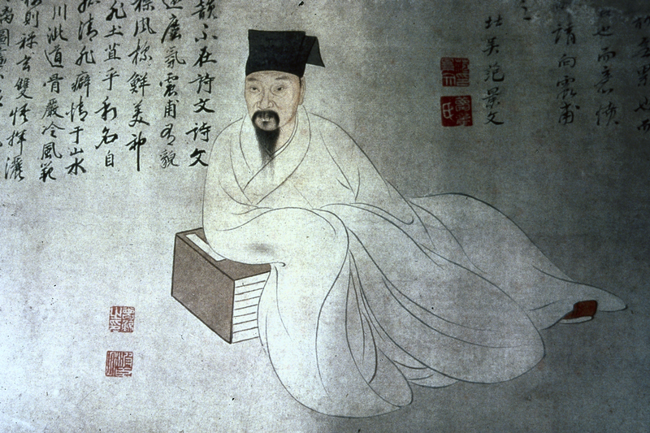
The China Biographical Database – from anecdote to data

Slide 2

  Conceptual Leaps:
    Text-mining/text-modeling
    Modeling lives with relational databases
    Prosopography
    Spatial analysis
    Social network Analysis

Slide 3
Lü Zuqian, whose style name was Bogong, was a grandson of the Right Assistant Director to the Imperial Secretary Haowen. His family had lived in Wuzhou since his grandfather's generation. The learning of Zuqian was based on family [tradition], and embodied the textual transmission from the Central Plain. When he grew up, Zuqian studied with Lin Zhiqi, Wang Yingchen, and Hu Xian respectively. Then he also befriended Zhang Shi and Zhu Xi, and his explication and inquiry became more sophisticated. First he obtained official rank by way of the protection privilege. But later he obtained his Jinshi degree and also passed the special decree examination for "Erudite Learning and Exceptional Literary Composition." Then he was appointed to the School for the Imperial Clan in the Southern Outer Office. During the mourning period for his mother, when he stayed in Mt. Mingzhao (in Wuyi), literati from all directions raced there. He was appointed Erudite in the National University. | 呂祖謙字伯恭，尚書右丞好問之孫也．自其祖始居婺州．祖謙之學本之家庭，有中原文獻之傳．長從林之奇、汪應辰、胡憲游，既又友張栻、朱熹，講索益精． 初，蔭補入官，後舉進士，復中博學宏詞科，調南外宗教．丁內艱，居明招山，四方之士爭趨之．除太學博士
“Factoids” in biographical texts

Slide 4
Basic Biography: name, gender, dates (relationship to time)
Biography Addresses (relationship with places)
Alternate Names (relationship to names of different kinds)
Writings (relationship to learning)
Postings (relationship with government)
Mode of Entry into Government
Kinship (kin relationships with others)
Associations (non-kin relationships to others)
Social Status (relationship with modes of social distinctiveness)
Possessions (relationship to property as giver and receiver)
Events (participation in events)

Slide 5
Using “Regular Expressions”正則表達式 to find data in digital texts
In computing, a regular expression provides a concise and flexible means for "matching" (specifying and recognizing) strings of text, such as particular characters, words, or patterns of characters. Abbreviations for "regular expression" include "regex" and "regexp". The concept of regular expressions was first popularized by utilities provided by Unix distributions, in particular the editor ed and the filter grep. A regular expression is written in a formal language that can be interpreted by a regular expression processor, which is a program that either serves as a parser generator or examines text and identifies parts that match the provided specification. Historically, the concept of regular expressions is associated with Kleene's formalism of regular sets, introduced in the 1950s.
http://en.wikipedia.org/wiki/Regular_expression

Slide 6


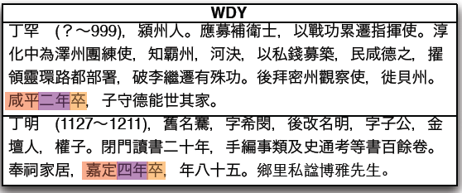
Regular expressions
6

Slide 7
Regular Expressions and Named Entity Recognition (NER)
至元十八年為東陽縣丞
年號 | 年號代碼 | 年 | year | 地名 | 地名代碼 | 官名 | 官名代碼
至元 | 623 | 18 | 1281 | 東陽 | 18340 | 縣丞 | 841

Slide 8
#!/usr/bin/python2.5
import sys
import codecs
import getopt
import re
from removeDups import removeDups
from copy import copy
# chinese string printing
def cprint(s):
print s.encode('utf-8')
# name to string when ID unknown
def name2str(ids, name):
s = '<%s,' %name
for id in ids[name]: s += '%s/' %id
s = s[:-1]
s += '>'
return s
# name to string when ID known
def name2strID(id, names, intervals):
name = names[id]
s = '<%s,%s,' %(name,id)
if intervals[id][0] and intervals[id][1]: s += '%d~%d>' %(intervals[id][0], intervals[id][1])
else: s += 'None~None>'
return s

Slide 9
  Conceptual Leaps:
    Text-mining/text-modeling
    Modeling lives with relational databases
    Prosopography
    Spatial analysis
    Social network Analysis

Slide 10
A Subset of the Data on Sima Guang:
有關司馬光的部分數據：
Name 姓名 | Dates 日期 | Offices 任官 | Associations 社會關係
Sima Guang 司馬光 | 1019-1086 | (1) 1059 度支勾院 Budget Auditor; (2) 1085 門下侍郎 Executive of the Chancellery; (3) 1086 左僕射兼門下侍郎 Left Executive, Dept of Ministries [….] | (1) Yuanyou coalition member (元祐黨); (2) An Dun 安惇 Desires opposed by; (3) Chao Buzhi 晁補之 Sacrificial prayer written by; (4) Chen Jian 陳薦 Sacrificial prayer written for; (5) Chen Min 陳敏 Honored by; (6) Cheng Yi 程頤 Recommended; (7) Ding Du 丁度 Sacrificial prayer written for; (8) Fan Chunli 范純禮 Patron of; [….]
Notes:
10

Slide 11
Relational Database:
關係型數據庫
Many Entities 多個實體
People 人物
Offices 職官
Association Types 社會關係
Name 姓名 | Dates 日期
Sima Guang 司馬光 | 1019-1086
Person 人物 | Posting Date 任命日期 | Office Title 官名
Sima Guang 司馬光 | 1059 | 度支勾院 Budget Auditor
Sima Guang 司馬光 | 1085 | 門下侍郎 Executive of the Chancellery
Sima Guang 司馬光 | 1086 | 左僕射兼門下侍郎 Left Executive, Dept of Ministries
Person 人物 | Association Type 社會關係 | Associate 社會關係人
Sima Guang 司馬光 | Yuanyou member (元祐黨) | (not applicable)
Sima Guang 司馬光 | Desires opposed by | An Dun 安惇
Sima Guang 司馬光 | Sacrificial prayer written by | Chao Buzhi 晁補之
Sima Guang 司馬光 | Patron of | Fan Chunli 范純禮
Sima Guang 司馬光 | Sacrificial prayer written for | Ding Du 丁度
Notes:
11

Slide 12
One can now sort on the separate columns:
現在我們可以按照不同欄位分別排序：
Name 姓名 | Dates 日期
Sima Guang 司馬光 | 1019-1086
Person 人物 | Posting Date 任命日期 | Office Title 官名
Sima Guang 司馬光 | 1059 | 度支勾院 Budget Auditor
Sima Guang 司馬光 | 1085 | 門下侍郎 Executive of the Chancellery
Sima Guang 司馬光 | 1086 | 左僕射兼門下侍郎 Left Executive, Dept of Ministries
Person 人物 | Association Type 社會關係 | Associate 社會關係人
Sima Guang 司馬光 | Yuanyou member (元祐黨) | (not applicable)
Sima Guang 司馬光 | Desires opposed by | An Dun 安惇
Sima Guang 司馬光 | Sacrificial prayer written by | Chao Buzhi 晁補之
Sima Guang 司馬光 | Patron of | Fan Chunli 范純禮
Sima Guang 司馬光 | Sacrificial prayer written for | Ding Du 丁度
Notes:
12

Slide 13
(1) Biographical data are coded and stored in tables.
傳記資料以代碼的形式存儲於資料表中。
BIOG_MAIN
Biography Addresses
Alternate Names
Writings
Postings
Mode of Entry into Government
Kinship
Associations
Social Status
Possessions
Events
基本資料
地址資料
別名資料
著述資料
任官資料
入仕途徑
親屬資料
社會關係資料
社會區分資料
財產資料
事件資料
Notes:
13

Slide 14
ALT NAMES 別名
Person ID Name Type ID Alt Name, etc
WRITINGS 著述
Person ID Text ID, etc
ENTRY 入仕
Person ID Entry ID Year, etc
BIOG ADDR 地址
Person ID Addr Type ID Place ID, etc
Data tables are linked to each other via Person IDs.
這些資料表通過人物代碼關聯起來。
POSTINGS 任官
Person ID Postings ID Office ID Start Date End Date, etc
BIOG_MAIN 基本資料
Person ID Name 姓名 Born Died Index Year Choronym ID Dynasty ID, Etc
ASSOCIATIONS 社會關係
Person ID Assoc Relation ID Associate ID, etc
POST ADDR 任官地
Postings ID Place ID, etc
KINSHIP 親屬
Person ID Kin Relation ID Kin ID, etc
SOCIAL STATUS 社會區分
Person ID Status ID, etc

Slide 15
    Sima(1) Guang 司馬光. 1019-1086.
    Offices
    1059 度支勾院 Budget Auditor
    1085 門下侍郎
    Executive of the Chancellery
    1086 左僕射兼門下侍郎
    Left Executive, Dept of Ministries
Employment
1 office: finance
2 office: state council
Entry 入法:
蔭yin
進士 jinshi
Places
Basic Affiliation
Yongxing 永興,
Shan 陝,
Xia Xian 夏縣 0-0
Alternate Names
Junshi 君實 Capping Name
Wenzheng Gong 文正公 Posthumous Name
Sushui Xiansheng 涑水先生 Other
Yufu 迂夫 Style Name
Yusou 迂叟 Style Name
Data on people in a relational database is in the interaction between entities (person, place, etc.)在關係型數據庫中，人物的數據資料存在於各種實體（人物、地址等）的互動之中。
Notes:
15

Slide 16
  Conceptual Leaps:
    Text-mining/text-modeling
    Modeling lives with relational databases
    Prosopography
    Spatial analysis
    Social network Analysis

Slide 17
Prosopography
‘Prosopography’ is the investigation of the common background characteristics of a group of actors in history by means of a collective study of their lives. The method employed is to establish a universe to be studied, and then to ask a set of uniform questions – about birth and death, marriage and family, social origins and inherited economic position, place of residence, education, amount and source of personal wealth, occupation, religion, experience of office and so on. The various types of information about the individuals in the universe are then juxtaposed and combined, and are examined for significant variables. They are tested both for internal correlations and for correlations with other forms of behaviour or action. (L. Stone, 'Prosopography', in F. Gilbert and S. Graubard eds., Historical Studies Today (New York, 1972)

Slide 18
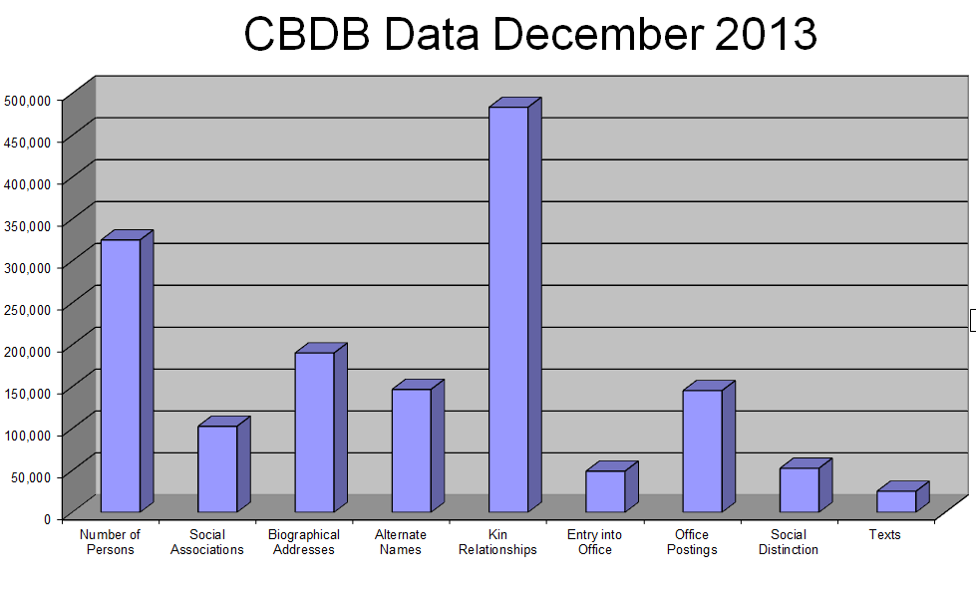

Slide 19
Period | Number
Tang | 56432
5 Dynasties | 1889
Song | 47071
Liao | 318
Jin | 275
Yuan | 19886
Ming | 150585
Qing | 37848
Minguo | 3215
Other | 20000

Slide 20
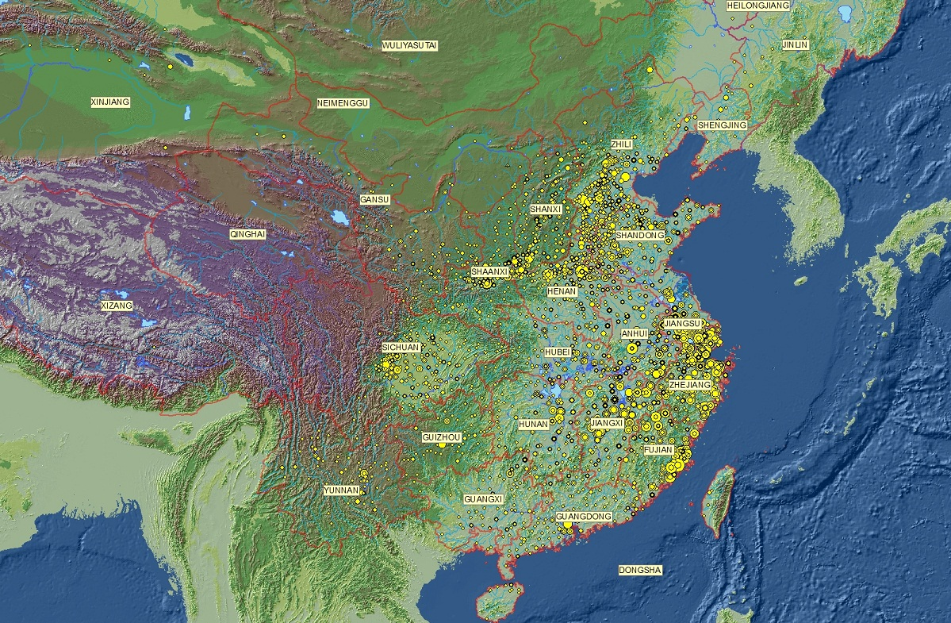
Cumulative Spatial Distribution of a Representative Sample of 67,000 CBDB Persons

Slide 23
  Conceptual Leaps:
    Text-mining/text-modeling
    Modeling lives with relational databases
    Prosopography
    Spatial analysis
    Social network Analysis

Slide 24
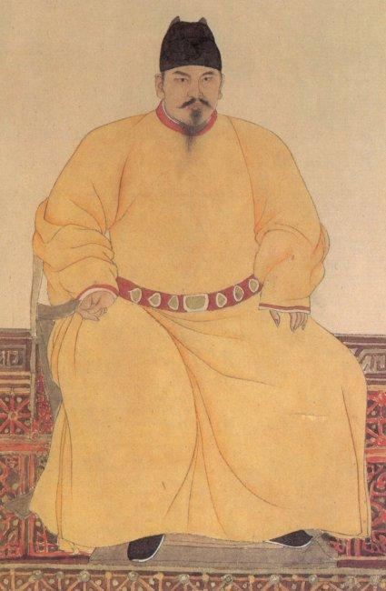
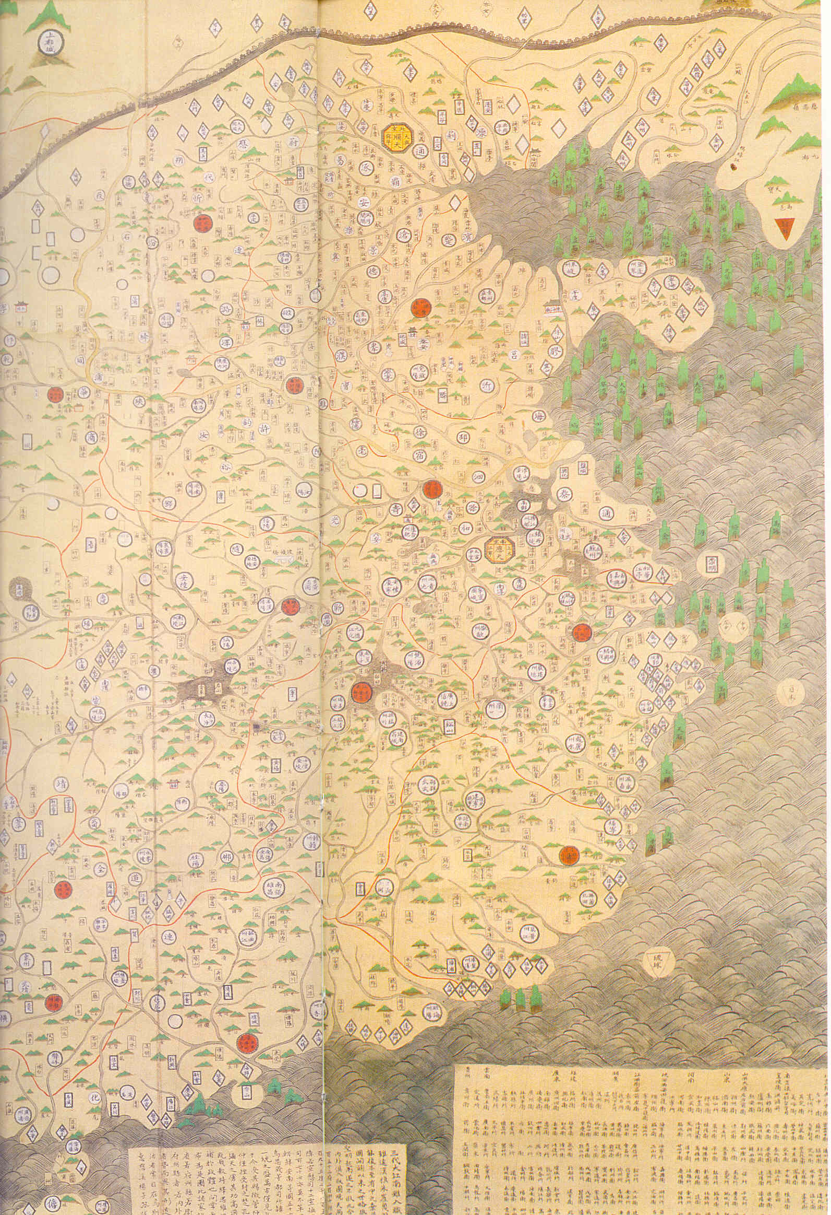
A Map is a Proposition

Slide 25
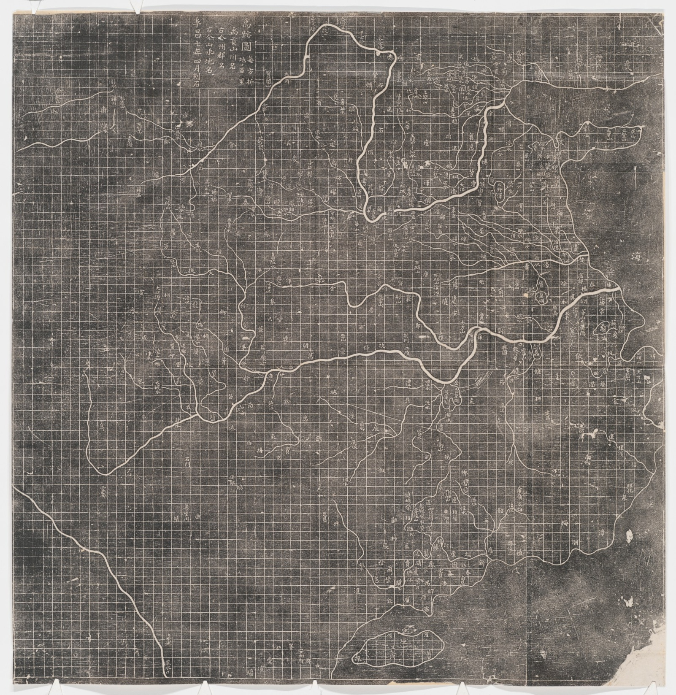
Chart of the Traces of Yu
Each square covers
100 li
Names of mountains and rivers in the “Tribute of Yu”
Names of past and present prefectures
Names of past and present mountains and rivers
Engraved in 4th month of the 7th year of Fuchang (=1136)

Slide 26
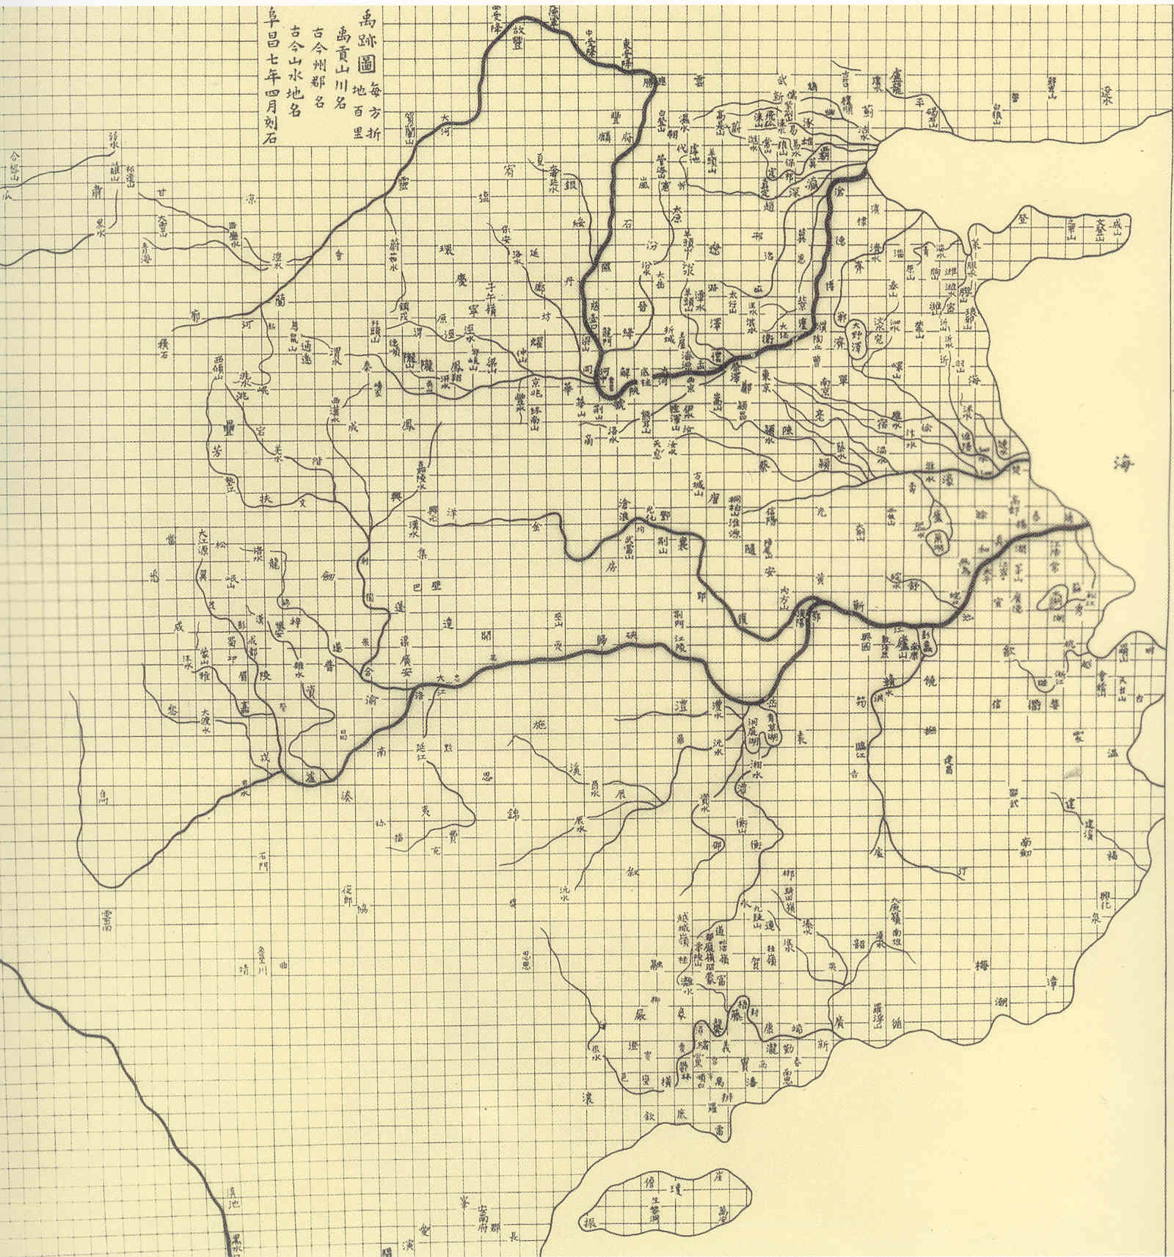

Slide 27
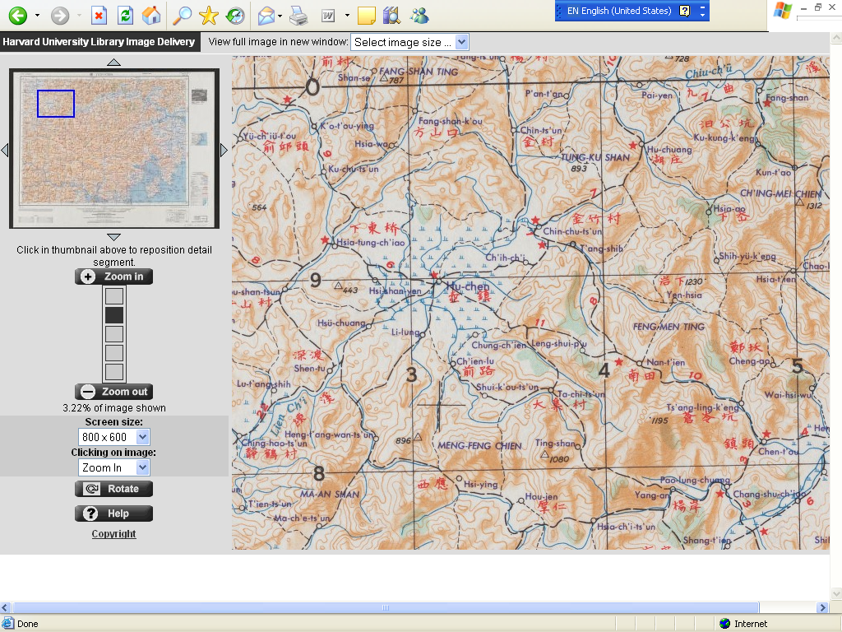
from the Army Map Service, ca. 1950/ CHGIS website

Slide 28
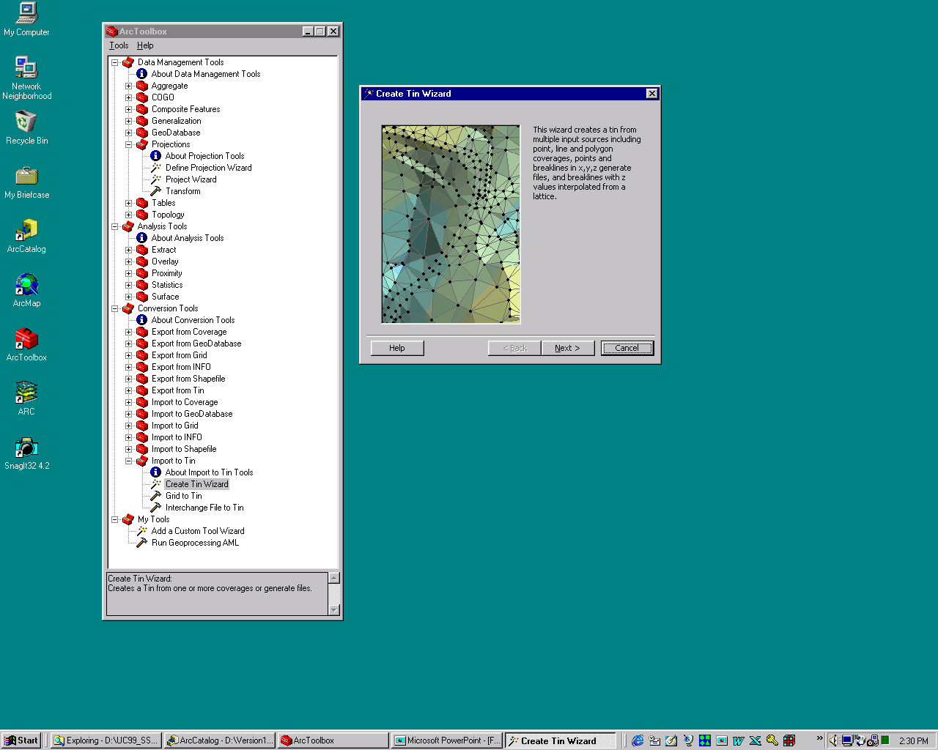
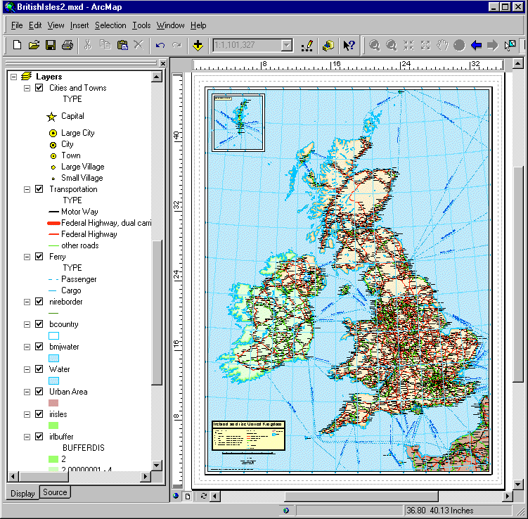
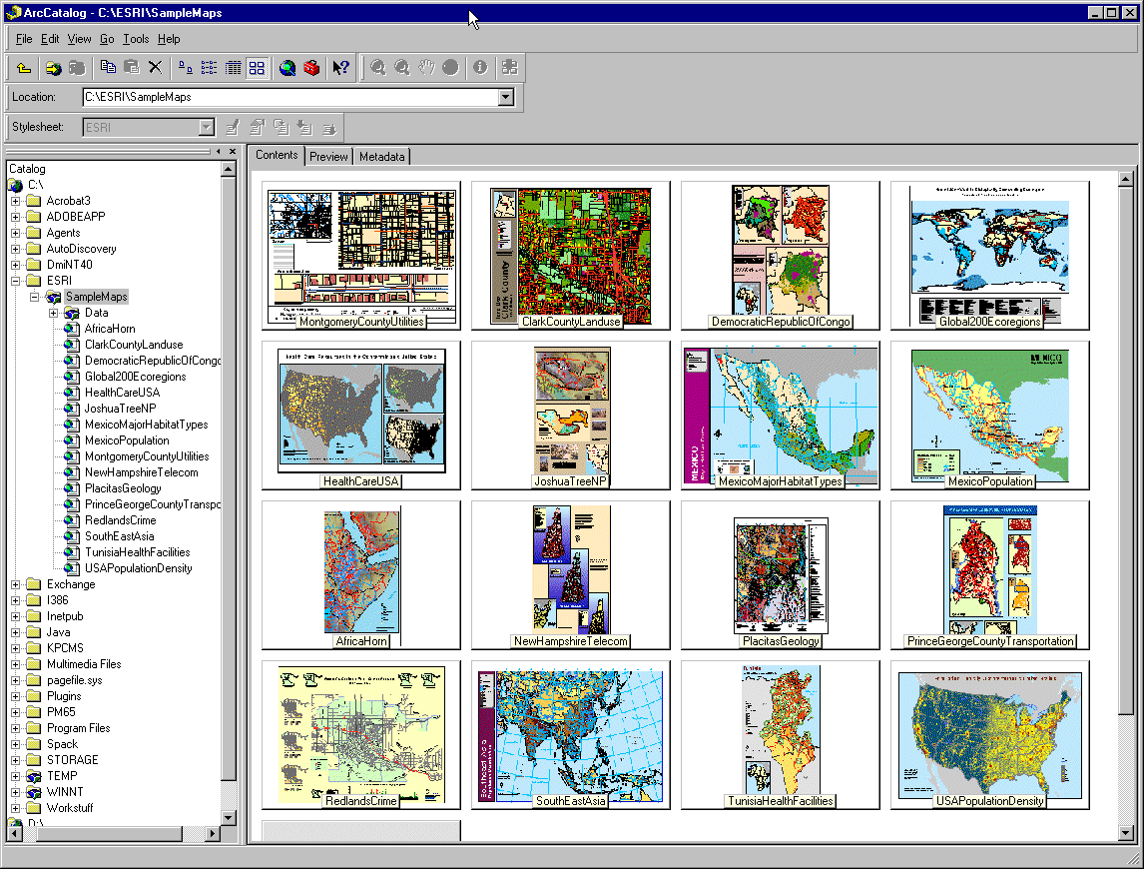
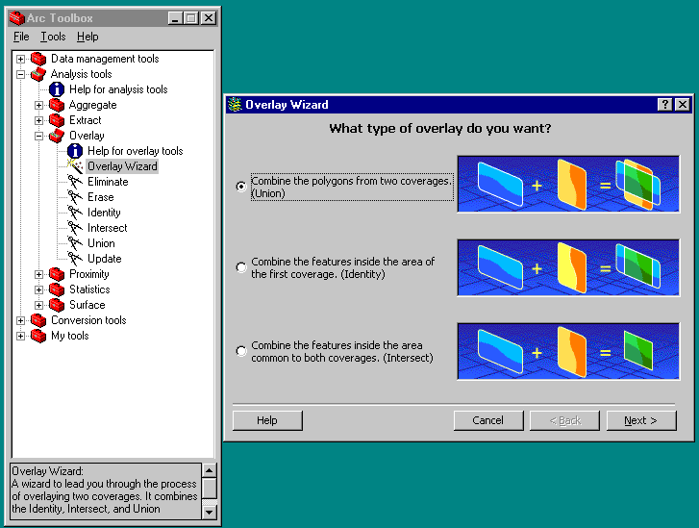
Three views of GIS
1. Smart, interactive, functional Map
2. A set of tools and procedures
  A language to perform tasks
DBMS
Data Files
3. A well-managed system of information
Notes:
28

Slide 29
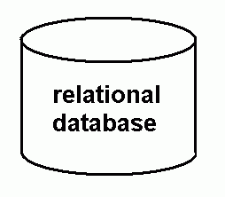
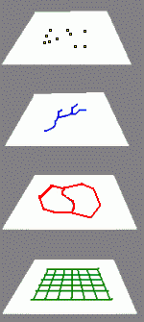
digital gazetteer
GIS layers
placename
feature type
coordinates
valid date
source note
spatial objects
29
Notes:
DIGITAL GAZETTEER
To understand what CHGIS provides and how to use it, we need to distinguish between the names for places (textual information) and the spatial objects (the points, lines, and polygons) associated with them.
First, think of CHGIS as a database of placenames and information about those places. This is what we call the gazetteer. Placename is obvious. Feature type means the kind of place. For example, does a point represent a national, provincial, or county capital or a town? Does a polygon represent the territory administered by a province, prefecture, or county? Does a line represent a river? And so on. Coordinates refer to the longitude and latitude (in decimal degrees) for this point. For history, we also need a valid date. From what year to what year is this placename at this location valid? Finally, we want to know the source of this information.
Second, think of this as a collection of spatial objects (points, lines, and polygons) that exist in a separate file. When you use GIS software and select a place from the database, the software automatically finds the spatial object associated with it and draws it on the screen.
29

Slide 30
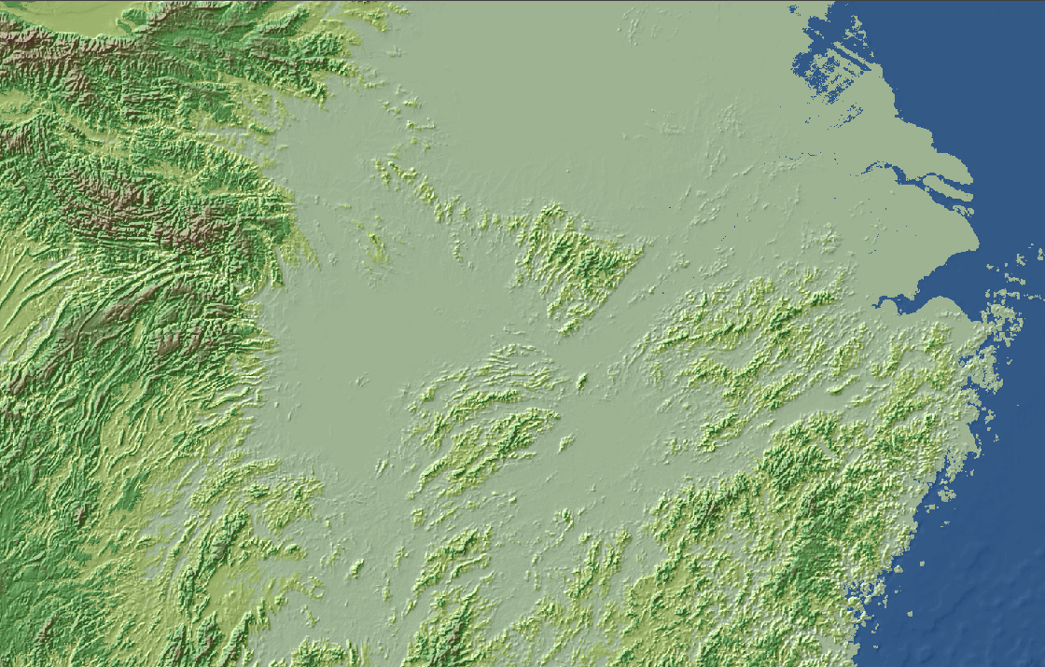
Raster data: Digital Elevation Model (DEM) or “Grid Data”

Slide 31
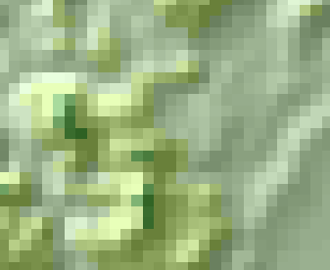
Raster data: Each pixel has a value

Slide 32
Polygon
Vector data
digital points, lines, and polygons, drawn with x,y (and z) coordinates
Line
Point

Slide 33
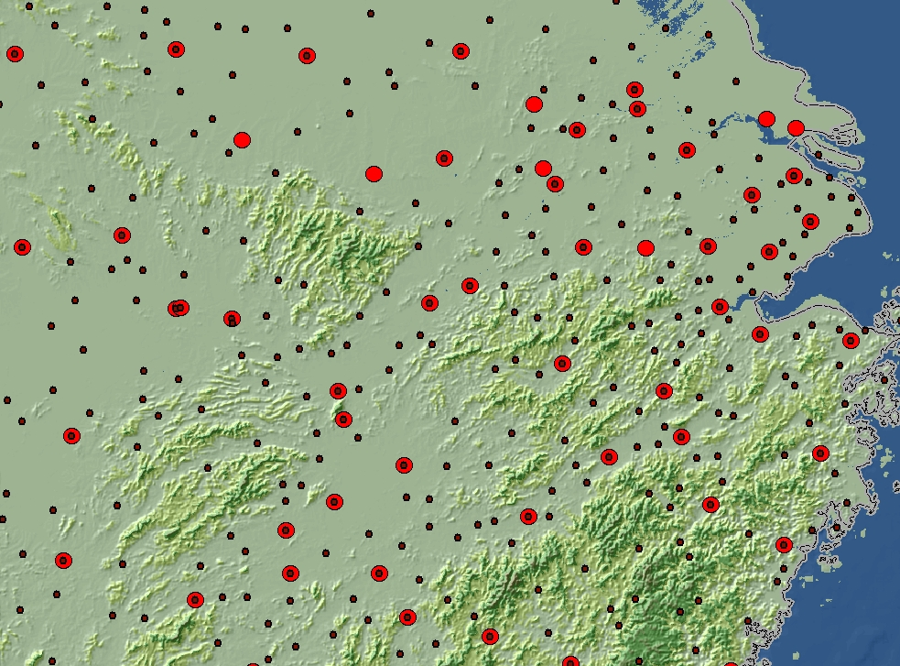
Raster and Vector Overlay,
Prefectural and County Seats (1820)
33
Notes:
33
RASTER AND VECTOR OVERLAY, PREFECTURAL AND COUNTY SEATS (1820)
In this example, we must first take a CHGIS layer of prefectural (red circles) and county seats in 1820 and lay it over a DEM showing the topography of middle-eastern China.
Sources: DEM and administrative layer for 1820 from CHGIS, copyright © 2007 Harvard Yenching Institute.

Slide 34
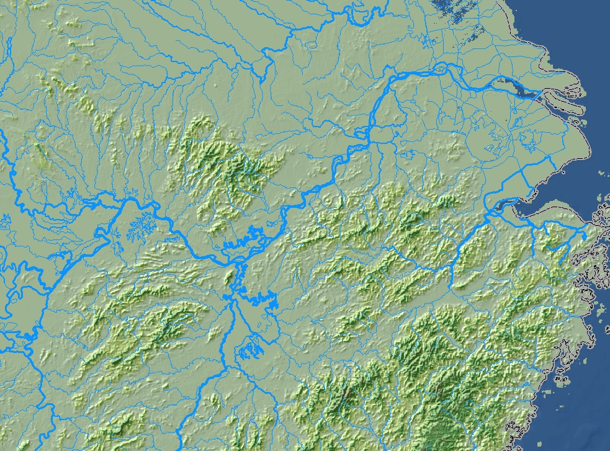
Raster and Vector Overlay
Waterways (1820) and DEM
34
Notes:
34
RASTER AND VECTOR OVERLAY, PREFECTURAL AND COUNTY SEATS, WATER, AND DEM (1820)
Now we have turned off the prefectural and county seats layer and instead displayed a layer with rivers and lakes in 1820 on top of the DEM.
Sources: DEM and hydro layer for 1820 from CHGIS, copyright © 2007 Harvard Yenching Institute.

Slide 35
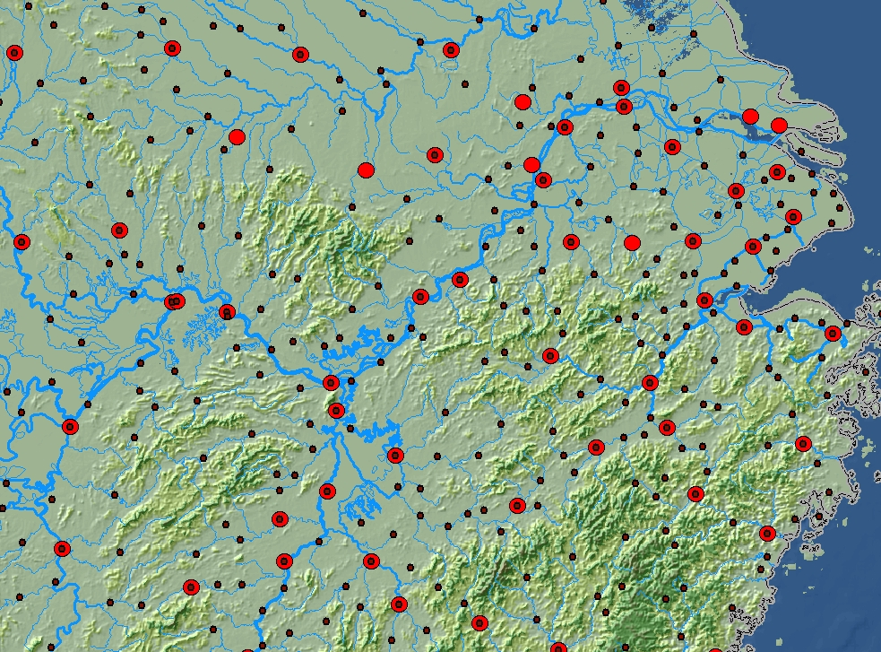
Prefectural and County Seats, Waterways, and DEM (1820)
35
Notes:
35
RASTER AND VECTOR OVERLAY, PREFECTURAL AND COUNTY SEATS, WATER, AND DEM (1820)
We have turned on all layers: DEM, rivers, and seats. We can immediately see that the administrative system and the river system are closely related. In short, now we can see the spatial relationship between the river system and the administrative system. Using GIS software, we could pursue this further and ask, for example, what percentage of seats are more than five miles away from a river? What percentage of prefectural seats is at the junction of two or more rivers? What percentage of prefectural seats is on first-, second-, third-, and fourth-order rivers?
Sources: DEM, administrative layer for 1820, and hydro layer for 1820 from CHGIS, copyright © 2007 Harvard Yenching Institute.

Slide 36
digital gazetteer
GIS layers
placename
feature type
coordinates
valid date
source note
spatial objects
CHGIS = gazetteer database + GIS layers
36
Notes:
DIGITAL GAZETTEER
To understand what CHGIS provides and how to use it, we need to distinguish between the names for places (textual information) and the spatial objects (the points, lines, and polygons) associated with them.
First, think of CHGIS as a database of placenames and information about those places. This is what we call the gazetteer. Placename is obvious. Feature type means the kind of place. For example, does a point represent a national, provincial, or county capital or a town? Does a polygon represent the territory administered by a province, prefecture, or county? Does a line represent a river? And so on. Coordinates refer to the longitude and latitude (in decimal degrees) for this point. For history, we also need a valid date. From what year to what year is this placename at this location valid? Finally, we want to know the source of this information.
Second, think of this as a collection of spatial objects (points, lines, and polygons) that exist in a separate file. When you use GIS software and select a place from the database, the software automatically finds the spatial object associated with it and draws it on the screen.
36

Slide 37
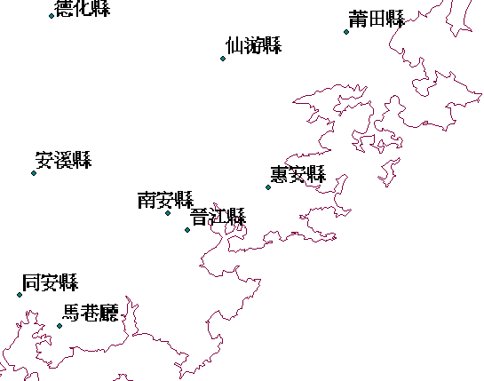
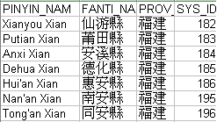
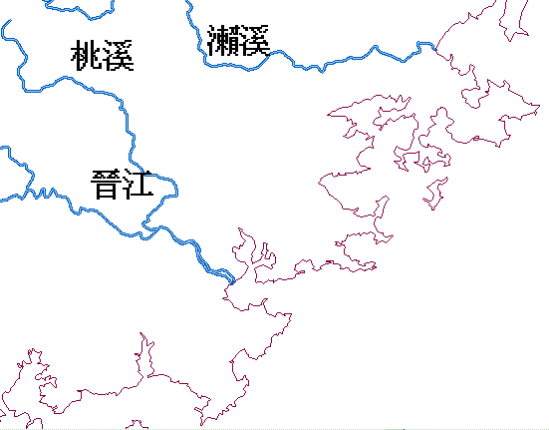

database
linked to
spatial data
points
lines

Slide 38
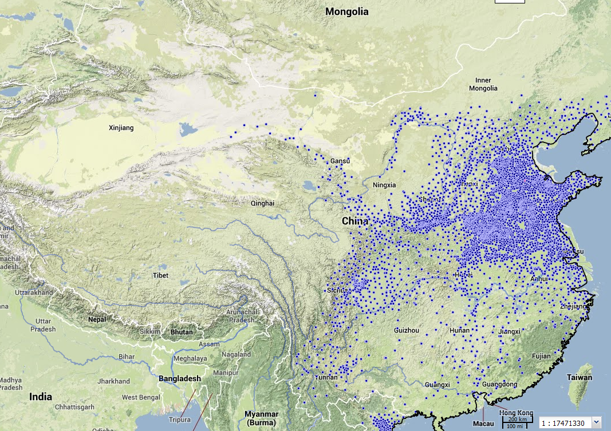
Registered population in 2 CE

Slide 39
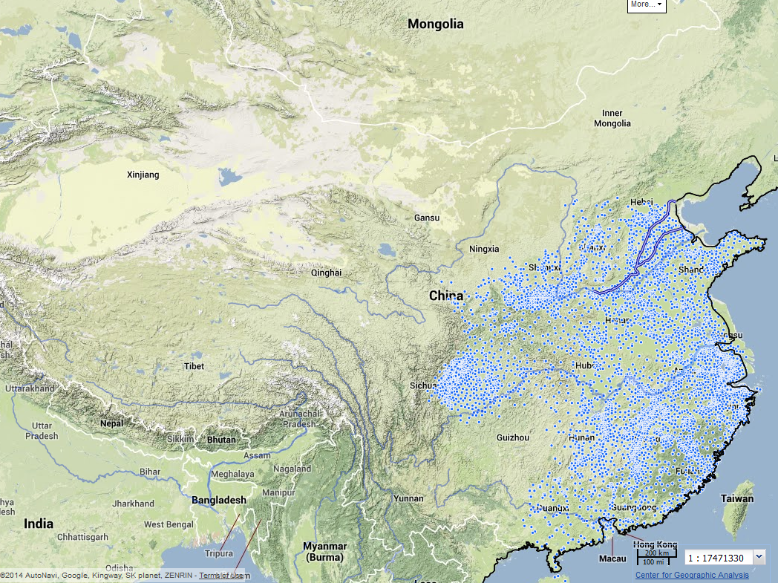
1102 CE

Slide 40
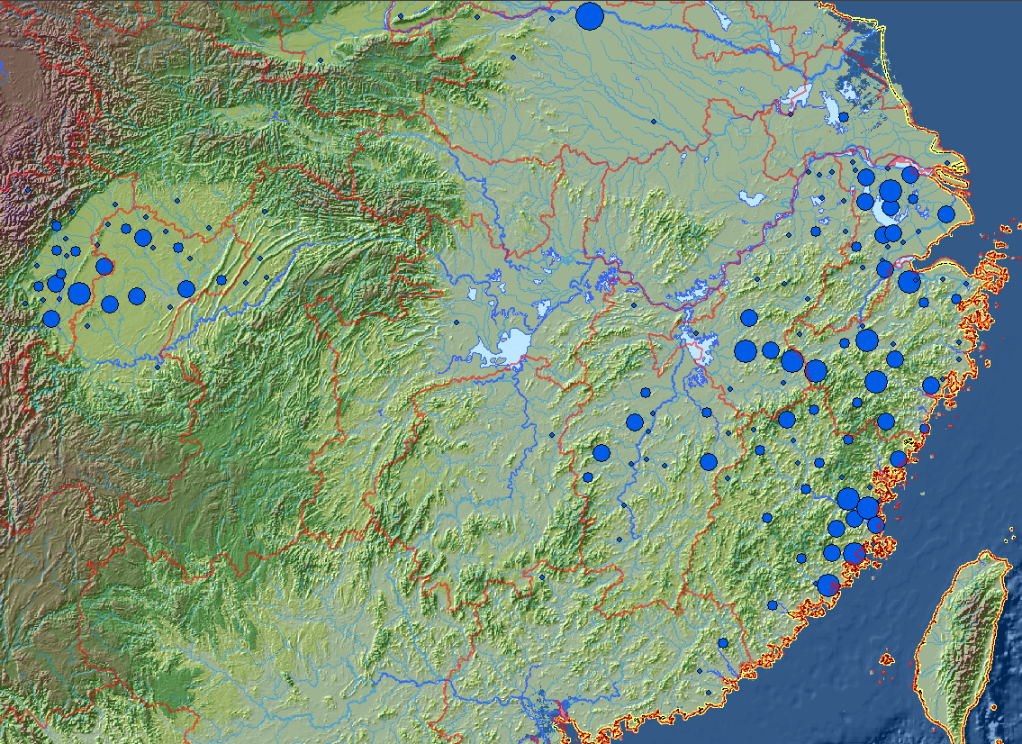
The 1148 Civil Service Examination List

Slide 41
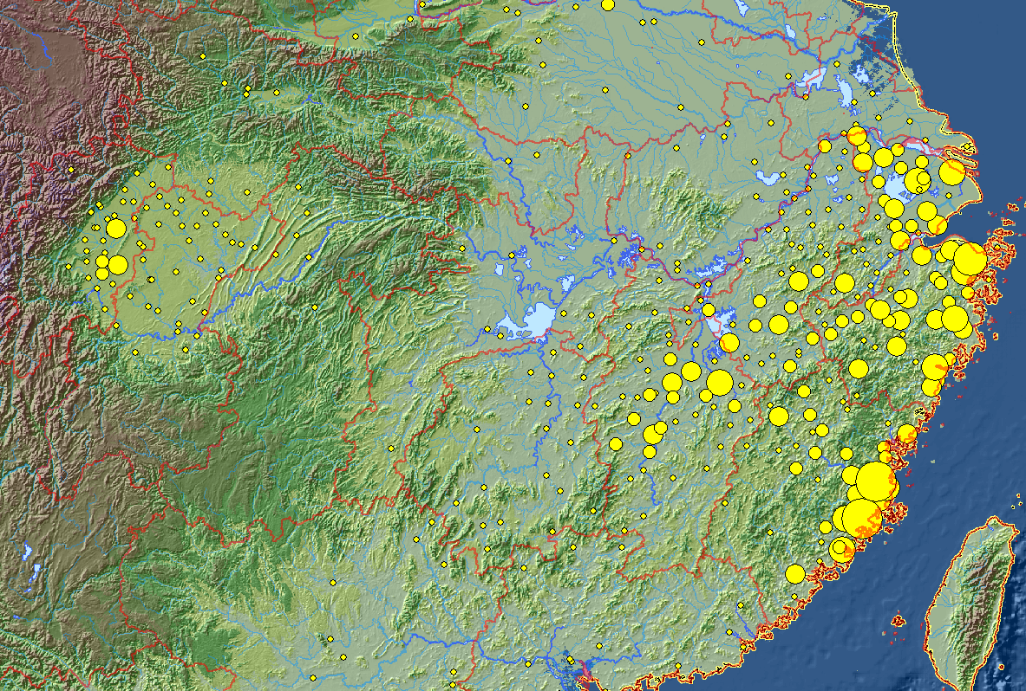
All Southern Song Degree Holders in the China Biographical Database (CBDB)

Slide 42
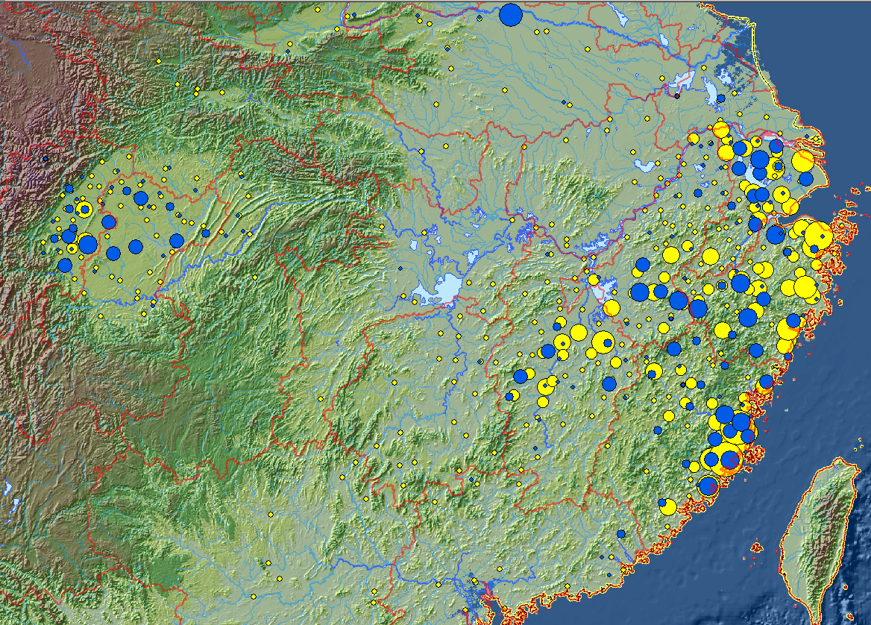

Slide 43
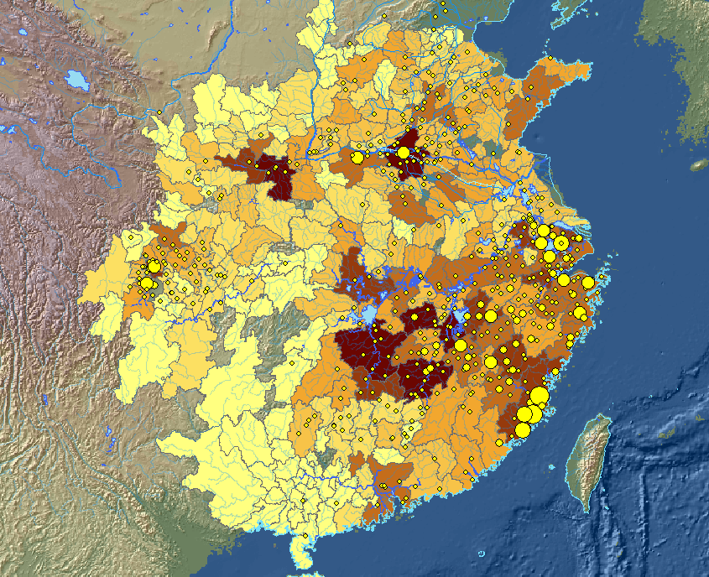
4730 Examination Degree holders, 960-1126, with population distribution as of 1080

Slide 44
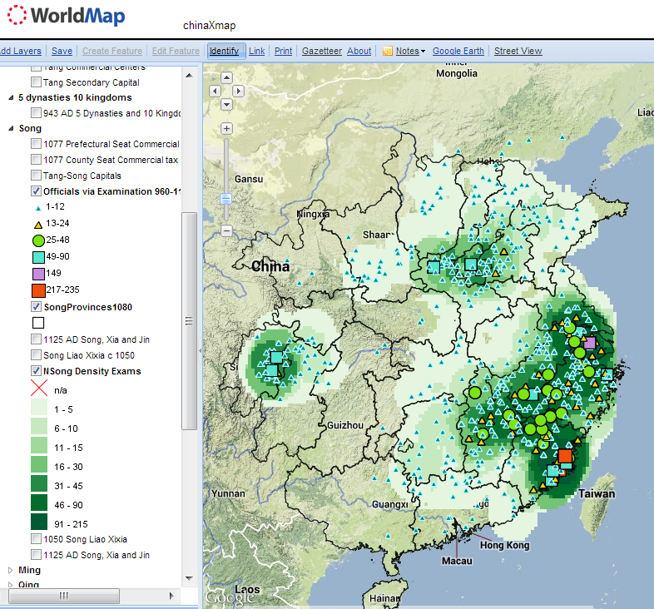
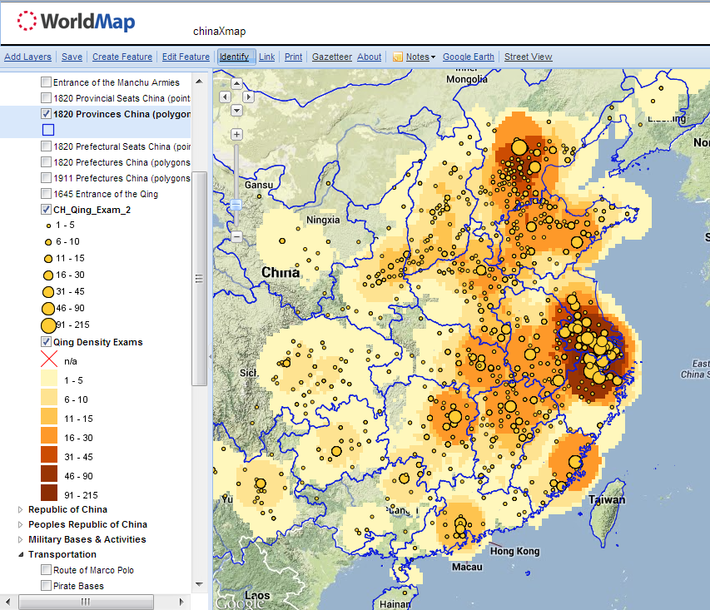
Distribution of Qing (1644-1905) Jinshi in CBDB
Distribution of Northern Song (960-1126) Jinshi in CBDB

Slide 45
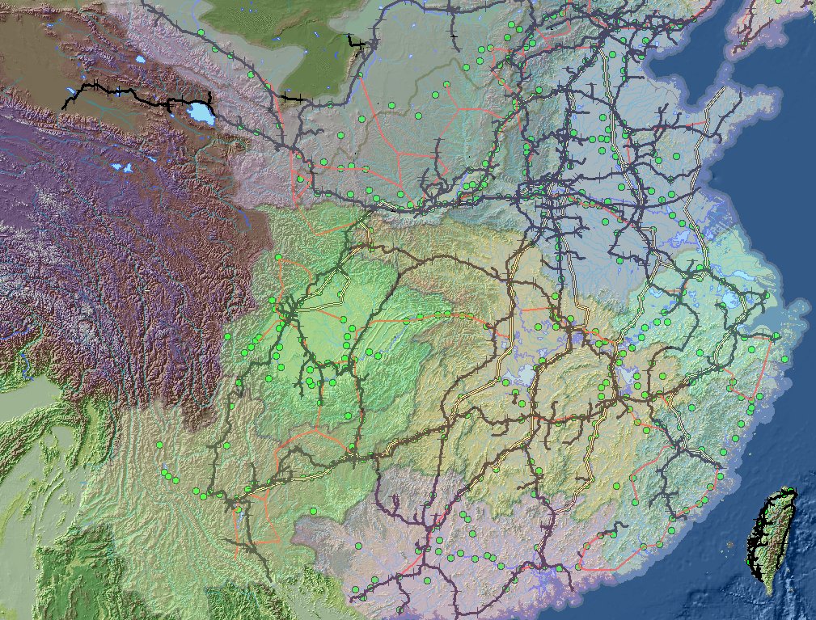
19th c. “Busy” counties (沖縣), Ming-Qing Postal Routes, 1990 Railroads

Slide 46
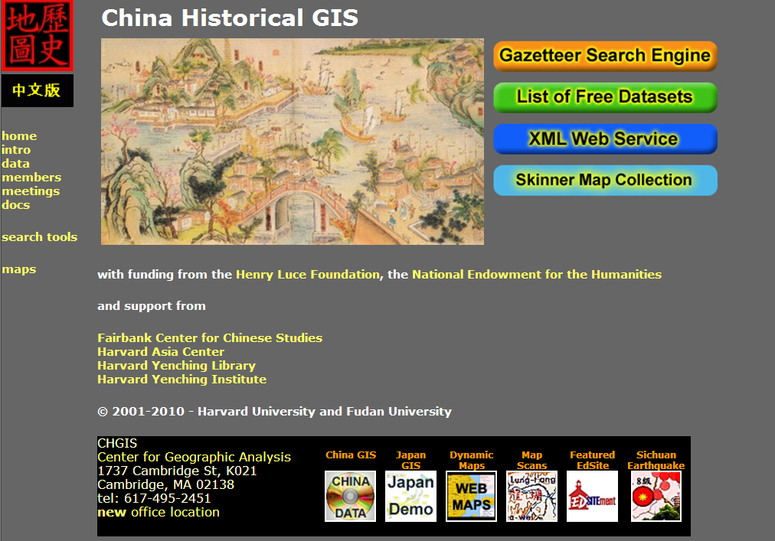
http://www.fas.harvard.edu/~chgis

Slide 47
  Conceptual Leaps:
    Text-mining/text-modeling
    Modeling lives with relational databases
    Prosopography
    Spatial analysis
    Social network Analysis

Slide 48
Social Networks
“In the short term individuals create networks; in the long term networks create individuals.”
  (borrowing from John Padgett, University of Chicago)

Slide 49
Social Network Analysis
Conceptualizing community as collections of personal relationships … provides historians with a blueprint for evaluating when, how and why people in the past used kin and non-kin in the course of their lives. The findings of social network analysts that people need and seek emotional and economic support of different kinds, from different kinds of people, suggest new analytical imperatives. It is not enough now to look solely at how people used kin in times of crisis. Rather, historians need to pursue how people in the past used the kin and friends they had, for different things, throughout the life course, and in the context of the opportunities they enjoyed and the constraints they faced courtesy of demography and culture. Other approaches might be applied to the problem, but HSNA contains the essential perspectives that cannot only advance the debate, but also help historians to meet Tilly's challenge to connect the lives of ordinary people to large-scale change in meaningful ways. (Charles Wetherell, “Historical Social Network Analysis,” International Review of Social History 43 (1998), Supplement)

Slide 50
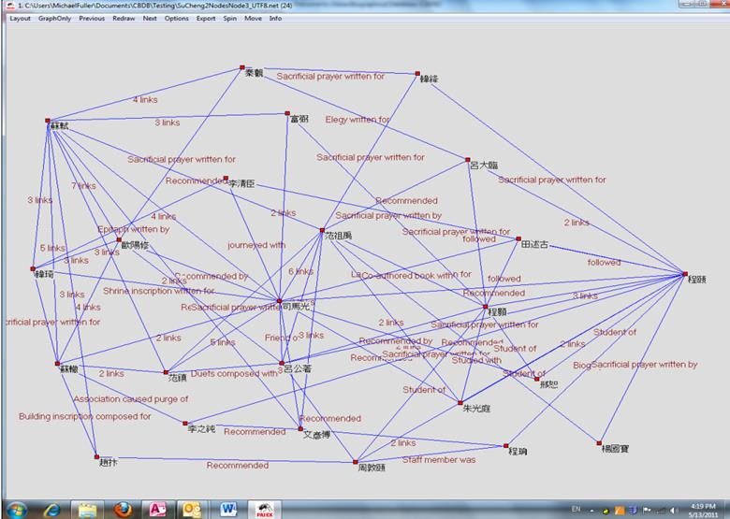

Slide 51
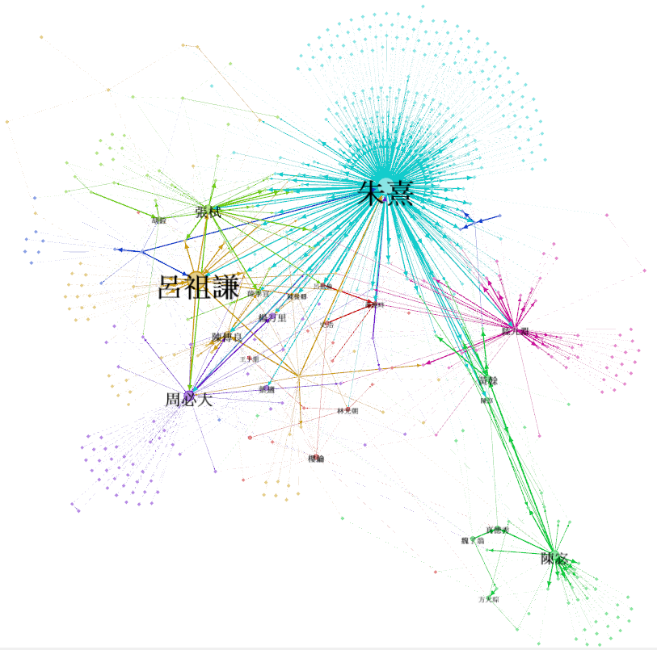
letters to and from addressees of Lü Zuqian’s letters; 597 persons. Node size (and corresponding label size) shows centrality of the person. Color shows communities.

Slide 52
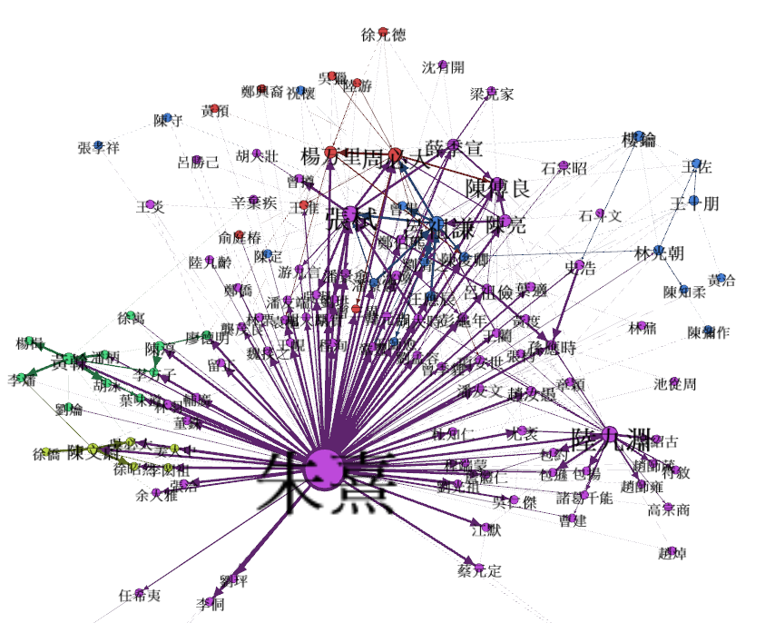
Zhu Xi’s letter network. Showing recipients of at least two letters and exchanges between them. Label size reflects the number of exchanges; color identifies subnetworks among those exchanges

Slide 53
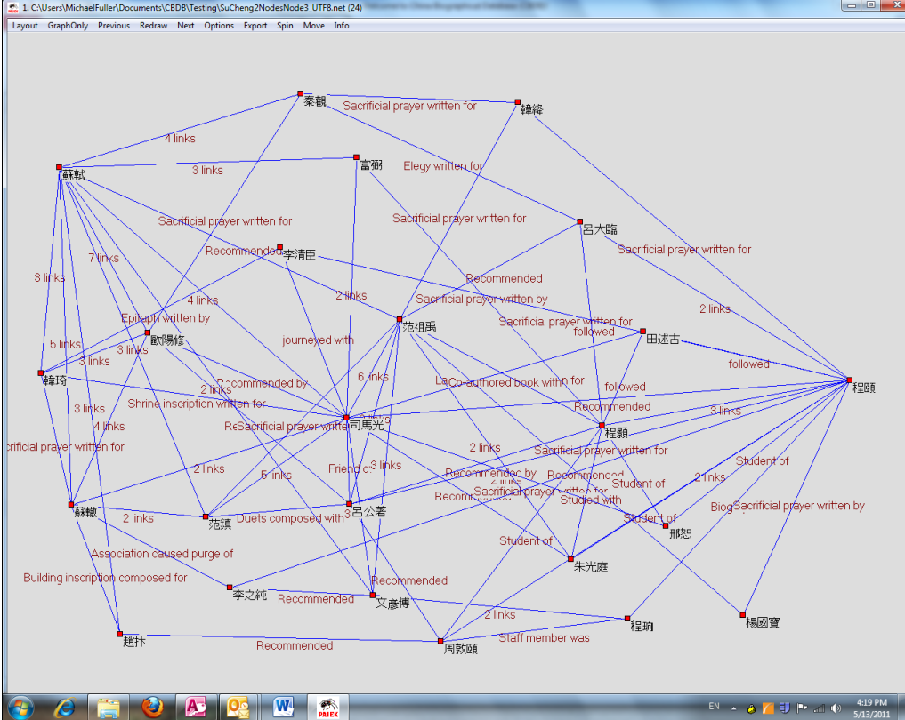

Slide 54
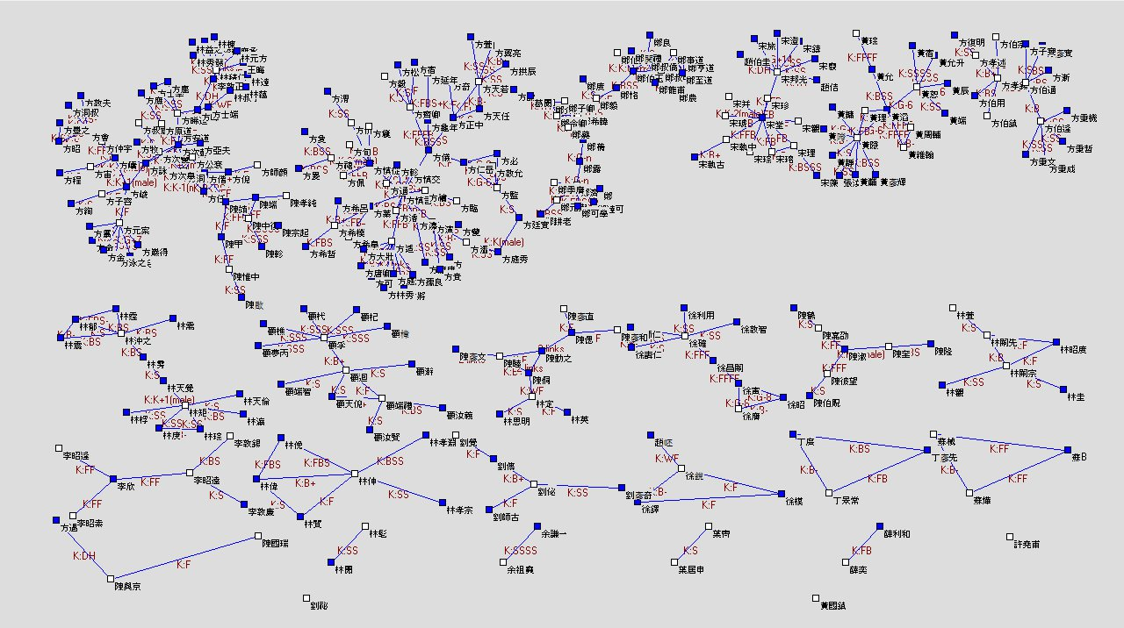
The Components of the Network of First-order kinship relations in Putian, Fujian for men who obtained the jinshi degree between 1050 and 1100
Michael A. Fuller

Slide 55
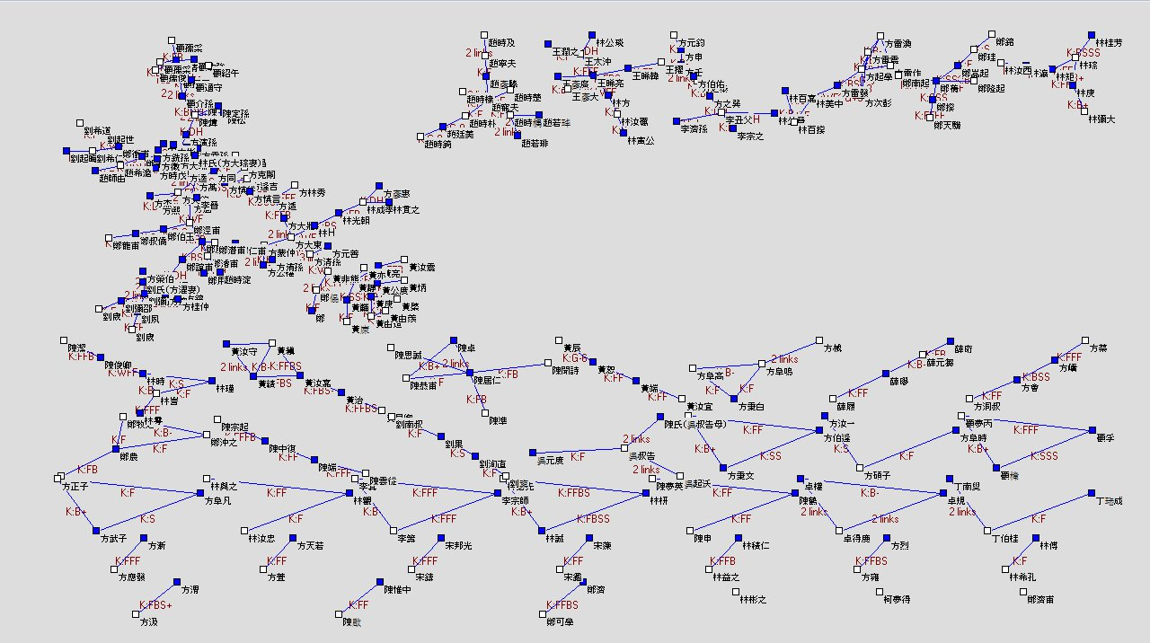
The Components of the Network of First-order kinship relations in Putian, Fujian for men who obtained the jinshi degree between 1200 and 1250
Michael A. Fuller

Slide 56
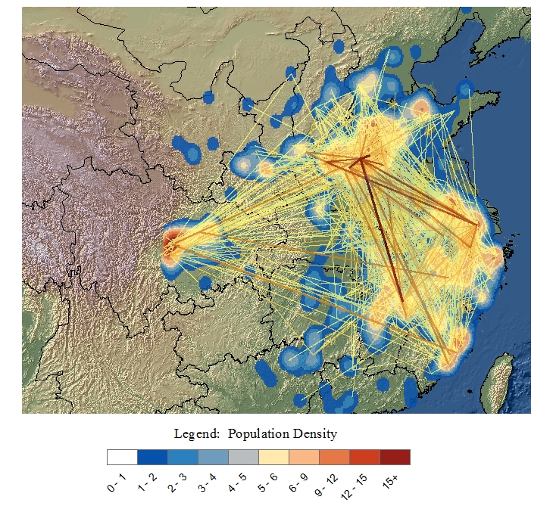
Spatial density of the China Biographical Database and exchanges of writings, both for the period 1060-1080
2359 persons out of 120,000 currently in CBDB

Slide 57
Three modes of dissemination

Slide 58
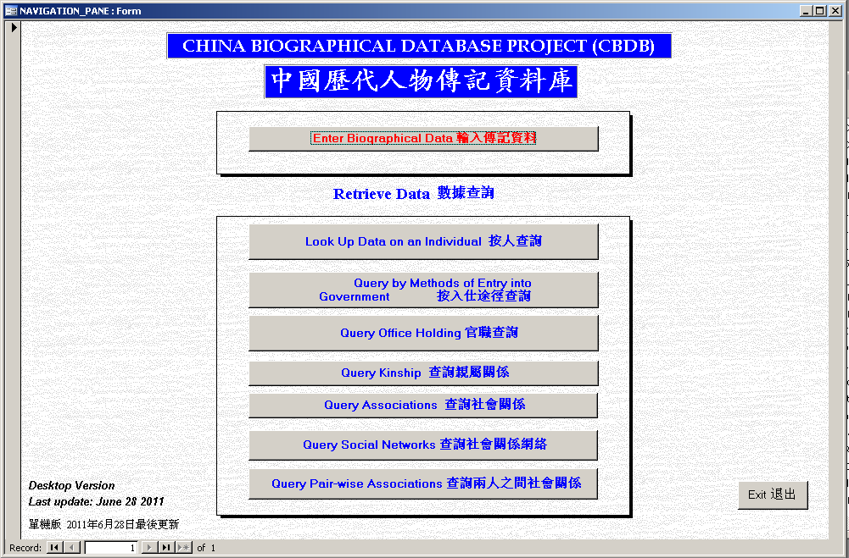
Stand-alone CBDB Database in MS Access

Slide 59
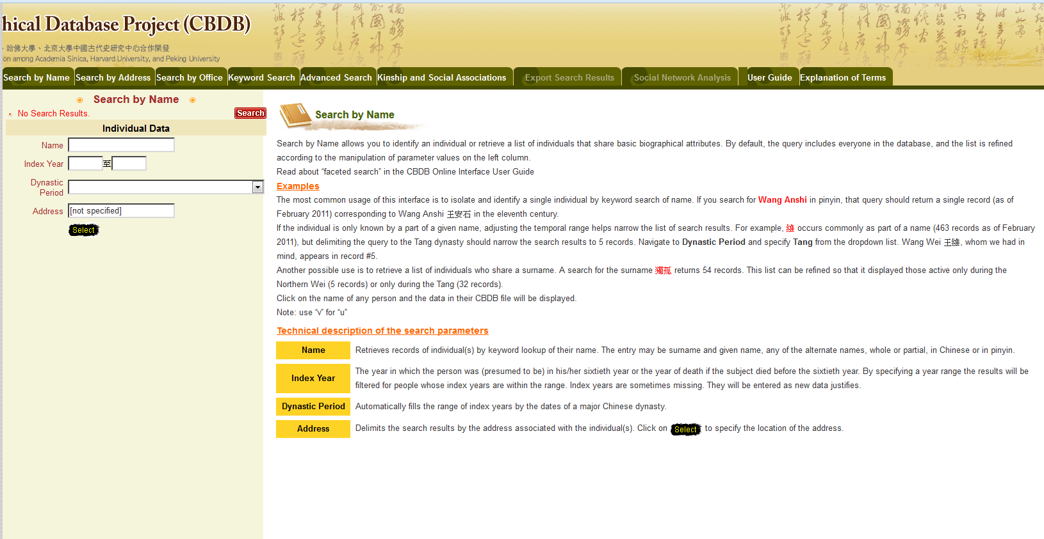

Slide 60
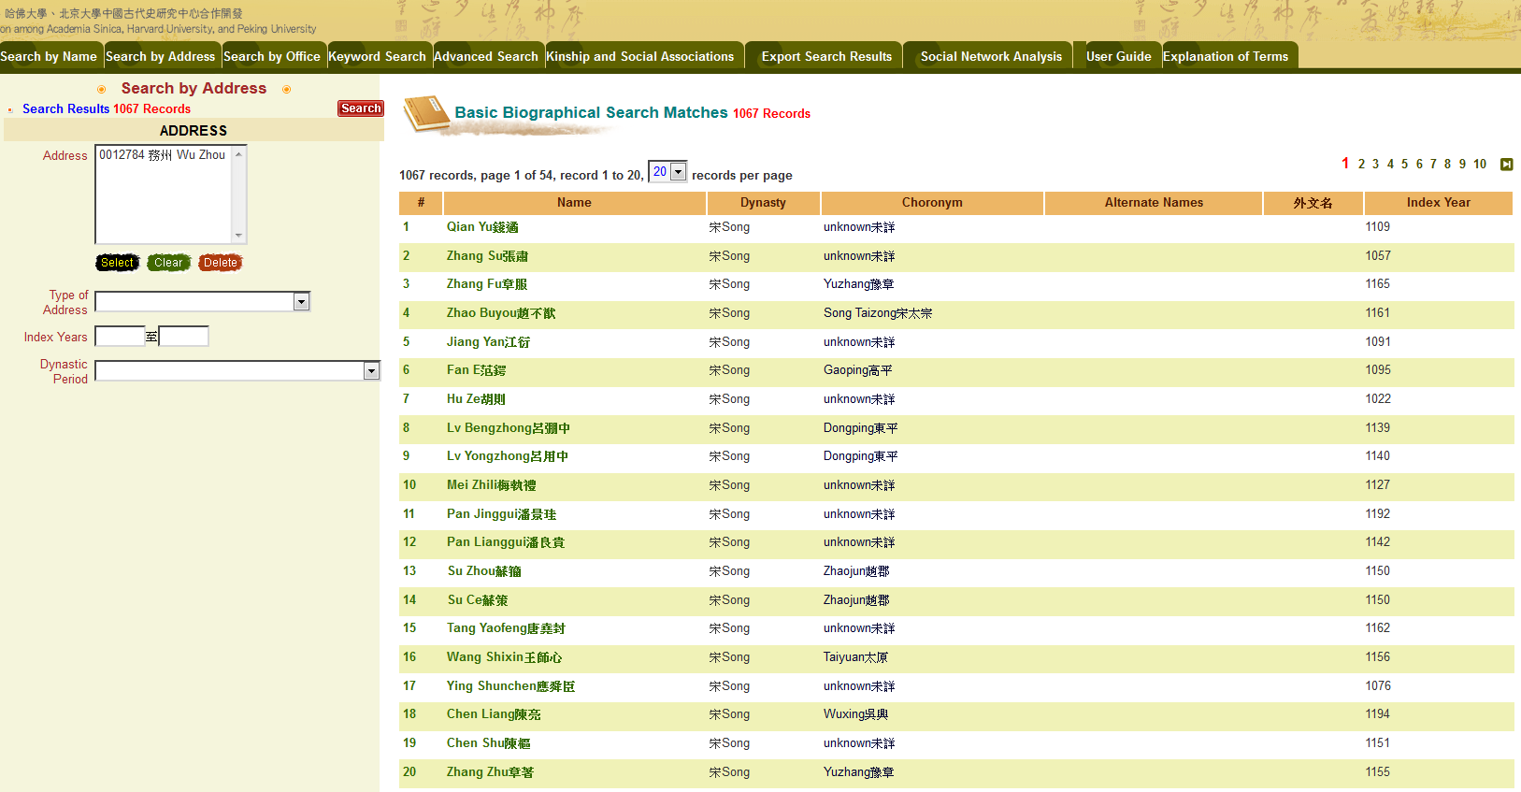

Slide 61
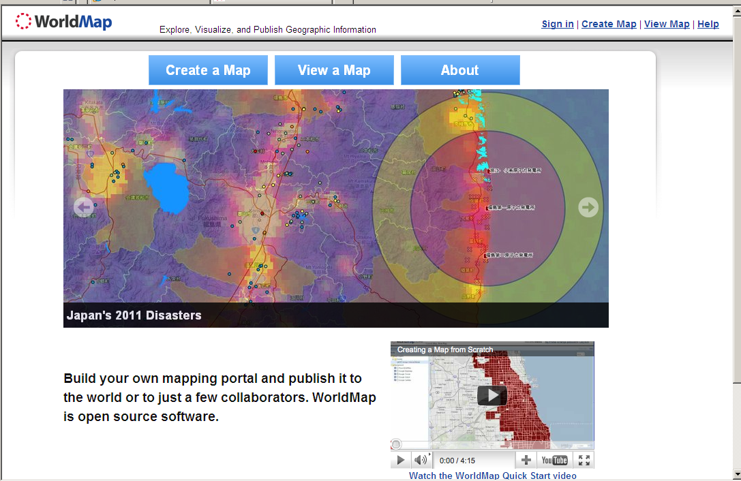
http://worldmap.harvard.edu/

Slide 62
HarvardX/EdX
http://www.youtube.com/watch?v=3go1Q7YCUPw

Slide 63
