Slide 1

China Biographical Database Project (CBDB)
T’ang Studies Society
Workshop on the
China Biographical Database
Harvard University
August 22-23, 2013
Sponsored by the T’ang Studies Society
Notes:
1

Slide 2
China Biographical Database Project (CBDB)
Session Two:
The Structure and Functions of the China Biographical Database,
with Query Examples
Michael A. Fuller
Notes:
2

Slide 3
China Biographical Database Project (CBDB)
Part One: Structuring Entities in CBDB
This morning we talked about database design in general.
In this session, we are going to look at CBDB in particular.
CBDB tracks the following entities:
People
Places
Offices
Kinship
Social Associations
Social Distinctiveness
Social Institutions
Texts
Ethnicity
Notes:
3

Slide 4
China Biographical Database Project (CBDB)
I am going to go over how CBDB represents these entities as tables in some detail for two key reasons:
First, one of the central issues you will need to think about tomorrow is how to take advantage of the entities and the table in CBDB in your projects in your projects.
Second, the details of how we designed the tables in CBDB (especially the problems of the limits and complexity of data) may be of some help as you think through the design of your own data.
In order to think about how to create and structure entities, you will need some understanding of how CBDB has approached them.
Notes:
4

Slide 5
China Biographical Database Project (CBDB)
Please open CBDB on your computer and look for the following tables:
Entity
People
Places
Offices
Kinship
Social Associations
Social Distinctiveness
Social Institutions
Texts
Ethnicity
Table
BIOG_MAIN
ADDR_CODES
OFFICE_CODES
KINSHIP_CODES
ASSOC_CODES
STATUS_CODES
SOCIAL INSTITUTION_CODES
TEXT_CODES
ETHNICITY_TRIBE_CODES
Notes:
5

Slide 6
China Biographical Database Project (CBDB)
For those of you using Macs, we need a brief detour to set up the usage of the files.
I hope everyone has installed:
1. OpenOffice Base
2. The Mac ODBC Administrator program
3. The ODBC driver for SQLite
4. The two versions of the CBDB SQLite databases
CBDBCore.db
20130818CBDBao.db
Now, go into Utilities in Finder and open ODBC Administrator
Notes:
6

Slide 7
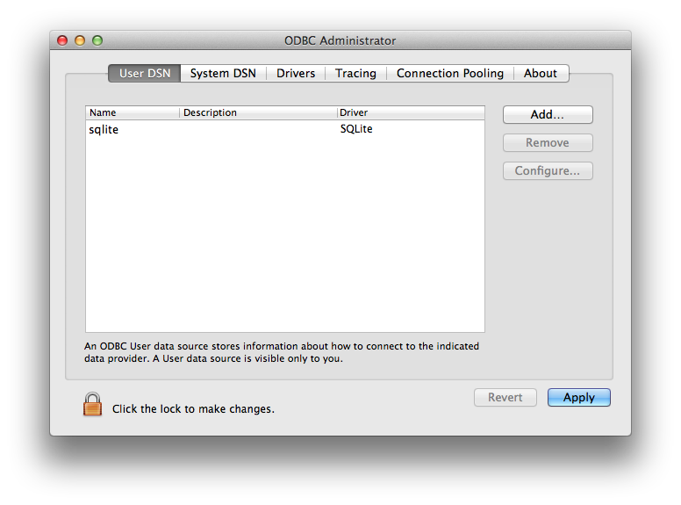
China Biographical Database Project (CBDB)
Go to User DSN and Add “CBDBFull” as an SQLite DSN
Notes:
7

Slide 8
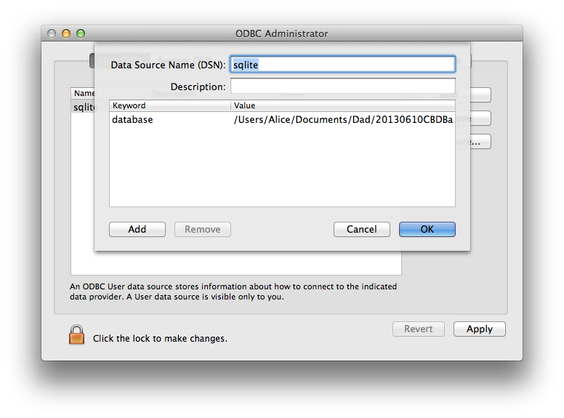
China Biographical Database Project (CBDB)
Next (and this is tedious), add the keyword “database” with the value of the full path and name of 20130818CBDBao.db
Notes:
8

Slide 9
China Biographical Database Project (CBDB)
Now launch OpenOffice Base:
Choose the third option, “Connect to an existing database”
Select CBDBFull.
Save the odb file wherever you like.
Base opens, by default with the Forms. Click on Tables.
Notes:
9

Slide 10
China Biographical Database Project (CBDB)
Entity
People
Table
BIOG_MAIN
Fields (not all of them)
c_personid the CBDB ID for the person
c_name
c_name_chn
c_index_year a year used in searches
c_female yes/no
c_ethnicity_code
c_household_status_code
c_birthyear
c_by_nh_code a code for the 年號
c_by_nh_year
c_by_range “before/during/after”
Notes:
10

Slide 11
China Biographical Database Project (CBDB)
Entity
People
Table
BIOG_MAIN
In BIOG_MAIN some fields are codes that refer to other tables.
ZZZ_BIOG_MAIN, in contrast, fills in the values of these codes by using the information from the code tables. Repeating the text descriptions violates normalization, i.e., makes the table “denormalized” but easy for humans to use. For example:
BIOG_MAIN ZZZ_BIOG_MAIN
c_ethnicity_code c_ethnicity_code
c_ethnicity_chn (from ETHNICITY_TRIBES_CODES)
c_ethnicity_rmn (from ETHNICITY_TRIBES_CODES)
Notes:
11

Slide 12
China Biographical Database Project (CBDB)
Entity
People
Table Denormalized Table
BIOG_MAIN ZZZ_BIOG_MAIN
BIOG_MAIN also uses a strategy to represent uncertainty used throughout CBDB:
sometimes texts give us broad information about dates, like “生於開元間.”
The data is useful, if this is all we have, and we record it using a combination of 年號 and “range” information:
c_by_nh_code (375 = 開元)
c_by_nh_year (NULL)
c_by_range (0 = “during”)
Notes:
12

Slide 13
China Biographical Database Project (CBDB)
Entity
People
In addition to the data recorded in BIOG_MAIN, CBDB also records names, an additional type of data concerning People that is not related to other entities.
Because one person may have many names, it requires a separate table:
ALTNAME_DATA (supported by the codes of ALTNAME_CODES)
And its denormalized version:
ZZZ_ALTNAME_DATA
Notes:
13

Slide 14
China Biographical Database Project (CBDB)
Entity
People
How People become eligible for entry into Office is not exactly an entity, but it is important. One person also may qualify for office through various distinct means (yin privilege, the 進士 examination followed by the 博學鴻詞, etc.)
Thus CBDB has a pair of tables to track entry into government:
ENTRY_CODES
ENTRY_DATA
Notes:
14

Slide 15
China Biographical Database Project (CBDB)
Entity
People
First, ENTRY_CODES (please open)
As you can see, we have 239 modes of entering service.
To simplify analytic inquiries, we have a pair of tables to aggregate these 239 modes:
ENTRY_TYPES (17 types + 7 sub-types)
ENTRY_CODE_TYPE_REL (maps codes to type/subtype)
We are now going to build a query to allow us to see all the people in the Tang dynasty who entered via examinations.
Notes:
15

Slide 16
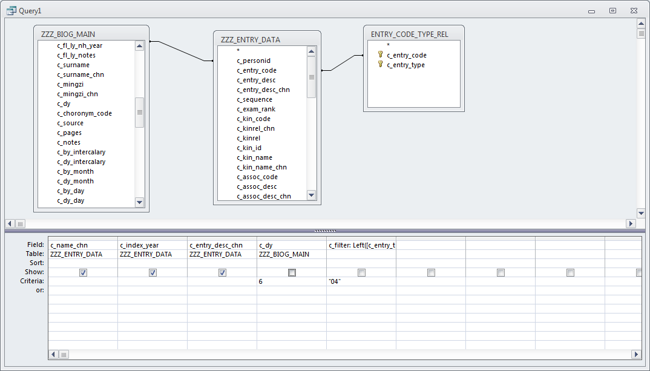
China Biographical Database Project (CBDB)
Open the Query Builder, select the tables, and create this:
This general approach works for all the sets of tables
Notes:
16

Slide 17
China Biographical Database Project (CBDB)
Entity
People
Next, returning to ENTRY_DATA, note its complexity as a table (please right-click to open in Design View):
Other people often played a role in people’s entry into office, and CBDB tracks both kin roles (esp. for yin) and social associations.
In later dynasties, specific institutions also played a role in entry into government service.
Notes:
17

Slide 18
China Biographical Database Project (CBDB)
Entity
Places
Table
ADDR_CODES
Places in CBDB are specifically administrative units, the official designations of places within the pre-modern bureaucratic system.
The table ADDR_CODES (Please open) frankly needs work.
The goal has been to create a system of codes that match those in the CHGIS (China Historical GIS) database.
We generated our codes from Robert Hartwell’s initial data to implement the rule: create a new code only when administrative unit boundaries change.
His data on boundaries was less than perfect, and current codes still are more bound to dynasties than we want.
Notes:
18

Slide 19
China Biographical Database Project (CBDB)
Entity
Places
Table
ADDR_CODES
The fields in ADDR_CODES are:
c_addr_id the basic ID used in all other tables
c_name
c_name_chn
c_first_year
c_last_year
c_admin_type this is a TEXT field, to be replaced by an ID
x_coord this is still (?) the coordinates of the
y_coord centroid for the polygon
CHGIS_PT_ID
c_notes
c_altnames this violates the one-to-many rule
Notes:
19

Slide 20
China Biographical Database Project (CBDB)
Entity
Places
Table
ADDR_CODES
Because Places are administrative units, CBDB needs to track their place within the hierarchy of units, to know what units are parts of a “place” and the unit to which it reports.
This information is captured in ADDR_BELONGS_DATA. (Please open this table)
Because this table is machine-friendly / user-unfriendly, CBDB also has a second table ADDRESSES that also shows the hierarchy. (Please open.)
Each record gives an ascending list of units ending in a dynasty.
Notes:
20

Slide 21
China Biographical Database Project (CBDB)
Entity
Places
Table
ADDR_CODES
To simplify querying, I have created a third table:
ZZZ_BELONGS_TO
It lists all the units within a given “place.”
That is, for a 州, it lists all the 縣. For a 路 or 道, it lists all the 州 and 縣, and so on.
Notes:
21

Slide 22
China Biographical Database Project (CBDB)
Entity
Offices
Table
OFFICE_CODES
Representing Office as an entity still needs work. There are three problems:
Very general titles given in texts. For example, some texts simply state 參軍, but we have 153 office titles with 參軍 in them. How should we handle this?
Cross-dynastic analyses: at present our office codes are by dynasty.
Bureaucratic structure: to do good analytic studies of bureaucratic interactions, we need a good idea of who reports to whom. We have some detail for the Song dynasty and are working on the others. (It turns out that this sort of information is difficult to reconstruct.)
Open the form frmPickOfficeTree (by double-clicking on it)
Notes:
22

Slide 23
China Biographical Database Project (CBDB)
Entity
Offices
Table
OFFICE_CODES
In any case, the core structure of OFFICE_CODES is:
c_office_id the main ID for offices
c_dy the dynasty
c_office_pinyin
c_office_chn
c_office_trans
No real surprises here. Since there are no foreign keys (codes that refer to other tables) except the dynasty, there is no denormalized equivalent.
Notes:
23

Slide 24
China Biographical Database Project (CBDB)
Entity
Offices
Table
OFFICE_CODES
However, two additional tables are needed to represent the information about bureaucratic structure that we need to know. These two tables are:
OFFICE_TYPE_TREE
OFFICE_CODE_TYPE_REL
OFFICE_TYPE_TREE lists all the institutions that make up the pre-modern Chinese bureaucracy, and OFFICE_CODE_TYPE_REL links specific offices to the bureaucratic structure.
Notes:
24

Slide 25
China Biographical Database Project (CBDB)
Entity
Kinship
Table
KINSHIP_CODES
We have far too many kinship codes (please open the table to look at them): we will need to rationalize this in the future.
The structure of KINSHIP_CODES is:
c_kincode the basic ID
c_kinrel_chn the Chinese term
c_kinrel the English term
c_kinpair_1 the obverse relation for males
c_kinpair_2 the obverse relation for females
c_upstep, c_dwnstep kinship distance values
c_marstep, c_colstep (i.e. FB = 1 up, 1 collateral)
Notes:
25

Slide 26
China Biographical Database Project (CBDB)
Entity
Social Associations
Table
ASSOC_CODES
As with kinship codes, we have many, many association codes (again, open the table and take a look) and no doubt will have more as we collect more data.
The structure of the ASSOC_CODES table itself is simple:
c_assoc_code the basic association ID
c_assoc_desc
c_assoc_desc_chn
c_assoc_pair the obverse relation
c_assoc_pair2 the third code in triadic relations
Notes:
26

Slide 27
China Biographical Database Project (CBDB)
Entity
Social Associations
Table
ASSOC_CODES
However, because we have so many specific association codes, we need to be able to aggregate them for analytic purposes. For this, we use two additional tables:
ASSOC_TYPES (please open)
ASSOC_CODE_TYPE_REL
The ASSOC_TYPES table provides categories and sub-categories under which to classify specific associations. The ASSOC_CODE_TYPE_REL table then links associations to larger categories
Let’s create a query to select a type of association for Tang.
Notes:
27

Slide 28
China Biographical Database Project (CBDB)
Entity
Social Distinctiveness
Table
STATUS_CODES
When we first began to develop CDBD, we started with Hartwell’s categories, but as we looked at textual data, Hartwell’s “status” evolved into a way of marking what people were known for in the lifetime and afterwards, hence “social distinctiveness.”
The structure of STATUS_CODES is the simplest yet:
c_status_code
c_status_desc
c_status_desc_chn
Notes:
28

Slide 29
China Biographical Database Project (CBDB)
Entity
Social Distinctiveness
Table
STATUS_CODES
Once again, we gradually accumulated many types of social distinctions (please open STATUS_CODES) and needed to develop larger analytic categories. For this we use:
STATUS_TYPES (please open)
STATUS_CODE_TYPE_REL (please open)
These are works in progress.
Notes:
29

Slide 30
China Biographical Database Project (CBDB)
Entity
Social Institutions
Table
SOCIAL INSTITUTION_CODES
Social Institutions are a new entity in CBDB, based primarily on Yuan and Ming data. At present, there are three main types: Buddhist institutions, Daoist institutions, and academies.
What should be considered a singular instance of a Social Institution” proves a bit complex: it can change from a Buddhist temple to Daoist and back again and still be the same institution. It can change names and even move and yet be the same institution. Our data structures capture this.
Notes:
30

Slide 31
China Biographical Database Project (CBDB)
Entity
Social Institutions
Table
SOCIAL INSTITUTION_CODES
SOCIAL_INSTITUTION_CODES has the following structure:
c_inst_code a unique ID
c_inst_name_code a name ID
c_inst_type_code
c_inst_begin_year (etc.)
c_inst_end_year (etc.)
c_inst_last_known_year
c_source
c_pages
c_notes
Notes:
31

Slide 32
China Biographical Database Project (CBDB)
Entity
Social Institutions
Table
SOCIAL INSTITUTION_CODES
To complete our information about “social institutions,” however, we need two additional tables—following the rule about one-to-many relations—because an institution may have more than one name and more than one address:
SOCIAL_INSTITUTION_NAME_CODES
SOCIAL_INSTITUTION_ADDR
Notes:
32

Slide 33
China Biographical Database Project (CBDB)
Entity
Texts
Table
TEXT_CODES
We are almost done with our survey of entities. The next to last is Texts.
In order to avoid “mission creep,” CBDB does not list individual titles within literary collections, nor does it record full texts nor give hyperlinks to texts (although this probably will come).
Notes:
33

Slide 34
China Biographical Database Project (CBDB)
Entity
Texts
Table
TEXT_CODES
TEXT_CODES records core information about texts but does not list all extant editions, etc. (Please open in design mode.)
c_textid the basic text ID
c_title_chn
c_title
c_title_trans
c_extant other information
c_text_country
c_text_dy
(etc.)
Notes:
34

Slide 35
China Biographical Database Project (CBDB)
Entity
Texts
Table
TEXT_CODES
The author of a text is one way in which People interact with Texts, and we will discuss the tables that record how People interact with other entities in the part of the presentation.
Notes:
35

Slide 36
China Biographical Database Project (CBDB)
Entity
Ethnicity
Table
ETHNICITY_TRIBE_CODES
One can argue whether “Ethnicity” is an entity or just an attribute of People. I suspect that views change depending on the dynasty. It may well be an entity in the Yuan and Qing.
In any case, please open the table. At present we have 467 designations, and this is not likely to grow much.
The core structure is:
c_ethnicity_code the ID for ethnicity
c_name
c_name_chn
c_group_code the largest category (Uyghur, etc.)
c_subgroup_code
Notes:
36

Slide 37
China Biographical Database Project (CBDB)
We now have seen the main ENTITIES in CBDB. However, the heart of the database is not these entities but their interactions with People.
Entity
Places
Offices
Kinship
Social Associations
Social Distinctiveness
Social Institutions
Texts
Ethnicity
Table
ADDR_CODES
OFFICE_CODES
KINSHIP_CODES
ASSOC_CODES
STATUS_CODES
SOCIAL INSTITUTION_CODES
TEXT_CODES
ETHNICITY_TRIBE_CODES
Interactions with People
BIOG_ADDR_DATA
POSTED_TO_ADDR_DATA
POSTING_DATA
POSTED_TO_OFFICE_DATA
KIN_DATA
ASSOC_DATA
ENTRY_DATA
STATUS_DATA
BIOG_INST_DATA
ENTRY_DATA
TEXT_DATA
BIOG_SOURCE_DATA
(BIOG_MAIN)
Notes:
37

Slide 38
China Biographical Database Project (CBDB)
Notes on Entities interacting with People
Because a single posting may include more than one office in more than one place, we divide postings data into three separate tables:
POSTING_DATA
POSTED_TO_OFFICE_DATA
POSTED_TO_ADDR_DATA
Social associations can be complex, and the structure of ASSOC_DATA reflects this complexity. (Please open in Design View.)
Notes:
38

Slide 39
China Biographical Database Project (CBDB)
Notes on Entities interacting with People
Please open BIOG_ADDR_CODES. These are the types of place associations we track as present.
Please open TEXT_ROLE_CODES. These are the types of roles for people we track. (Note that a single text may have more than one author, recipient, etc., and hence needs the separate table TEXT_DATA.)
Notes:
39

Slide 40
China Biographical Database Project (CBDB)
Part Two: Entities in the Access Query Builder
(Here we switch over to Access.)
Notes:
40

