Slide 1

Living Toward Death
A Brief Description of Epitaph Data Processing Methods in "Complete Song Prose" and Research on the Tomb of the Deceased
向死而生
——《全宋文》中墓志數據處理方法述略
及傳主墓葬研究
Weile Li李威樂
CBDB, IQSS中國歷代人物傳記數據庫
Institute of Cultural Heritage and Museology, Zhejiang University
浙江大學文化遺產與博物館學研究所

Slide 2
"Living toward death. Only when you are infinitely close to death can you deeply understand the meaning of life."
——Martin Heidegger
“向死而生，當你無限接近死亡，
才能深切體會生的意義。”
——德國哲學家馬丁·海德格爾

Slide 3

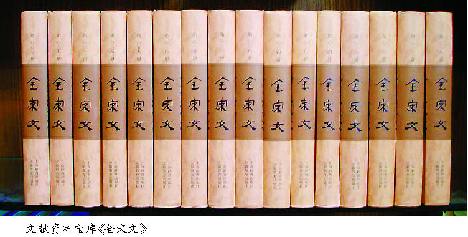
PPT模板下载：www.1ppt.com/moban/ 行业PPT模板：www.1ppt.com/hangye/
节日PPT模板：www.1ppt.com/jieri/ PPT素材下载：www.1ppt.com/sucai/
PPT背景图片：www.1ppt.com/beijing/ PPT图表下载：www.1ppt.com/tubiao/
优秀PPT下载：www.1ppt.com/xiazai/ PPT教程： www.1ppt.com/powerpoint/
Word教程： www.1ppt.com/word/ Excel教程：www.1ppt.com/excel/
资料下载：www.1ppt.com/ziliao/ PPT课件下载：www.1ppt.com/kejian/
范文下载：www.1ppt.com/fanwen/ 试卷下载：www.1ppt.com/shiti/
教案下载：www.1ppt.com/jiaoan/ PPT论坛：www.1ppt.cn
全宋文
"Quansongwen" is divided into 15 major categories, with a total of 360 volumes and a total of more than 100 million words. The content covers literature, art, history, philosophy and other aspects. Among the more than 100,000 articles in various styles collected in the book, many materials are published publicly for the first time, and 95% of the writers have not been included in a special collection before.
《全宋文》分15個大類，共360冊，總字數逾1億字，內容遍及文學、藝術、歷史、哲學等各個方面。在全書所收的10餘萬篇各種體例文章中，不少資料是首次公開發表，95%的作家在此以前未被編入過專集。

Slide 4
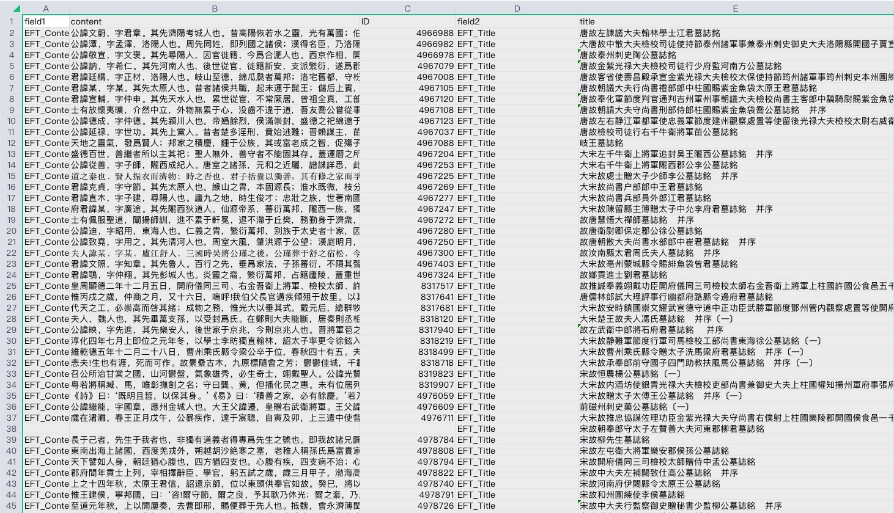
PPT模板下载：www.1ppt.com/moban/ 行业PPT模板：www.1ppt.com/hangye/
节日PPT模板：www.1ppt.com/jieri/ PPT素材下载：www.1ppt.com/sucai/
PPT背景图片：www.1ppt.com/beijing/ PPT图表下载：www.1ppt.com/tubiao/
优秀PPT下载：www.1ppt.com/xiazai/ PPT教程： www.1ppt.com/powerpoint/
Word教程： www.1ppt.com/word/ Excel教程：www.1ppt.com/excel/
资料下载：www.1ppt.com/ziliao/ PPT课件下载：www.1ppt.com/kejian/
范文下载：www.1ppt.com/fanwen/ 试卷下载：www.1ppt.com/shiti/
教案下载：www.1ppt.com/jiaoan/ PPT论坛：www.1ppt.cn
全宋文
公諱迪，字昭用，東海人也。仁義之胄，繁衍萬邦，别族于太史者十家，因封而占籍者四郡，而有郯之邑，鉅人實多，著于簡編，可以揚搉。唐室云季，天下崩離，江淮之間，獨爲漢守。惟我大父，首從義兵。受遺戡難，同伊尹之相太甲；字孤立後，如有虞之保少康。故得勳銘鼎鍾，世享茅土，連姻合族，與國存亡。考諱知詢，爲江西節度使。公生于郡廨，方孩而孤。四歲免喪，即加五品之服；幼學就傅，遂疏百里之封。立朝侍祠，恩禮優渥，自太子中允累遷至衛尉卿。天姿嚴肅，常持謙下之禮；世祿隆盛，每存恭儉之規。不讀非聖人之書，自爲保家之主。思不出位，時無間言，始終一心，出入三紀。嗚呼!星迴日薄，棟折榱崩，命有所懸，義無茍免。享年四十有六，開寶八年冬十有一月二十有八日沒于難。明年春三月，權窆于大塋之側。至某年月，始備大葬之禮，卜祔焉。夫人王氏、張氏、劉氏，皆早世，并南朝之名族，享小君之命數，壼儀婦順，彤史存焉。子太素、太初、太沖等，皆修令名，不墜前訓，故能以淪胥之後，具飾終之禮。奉先之孝，時以爲難，宗人永懷，是有紀述。辭曰：於惟我宗，昭時顯庸。積德垂範，爰生我公。出孝入悌，夷心直躬。生能業官，沒不忘忠。是有慶靈，鍾于令子。不墜其訓，葬之以禮。謀卜謀筮，維桑維梓。神道永謐，流光不已。來者難誣，斯文用紀。《徐公文集》卷三〇。

Slide 5
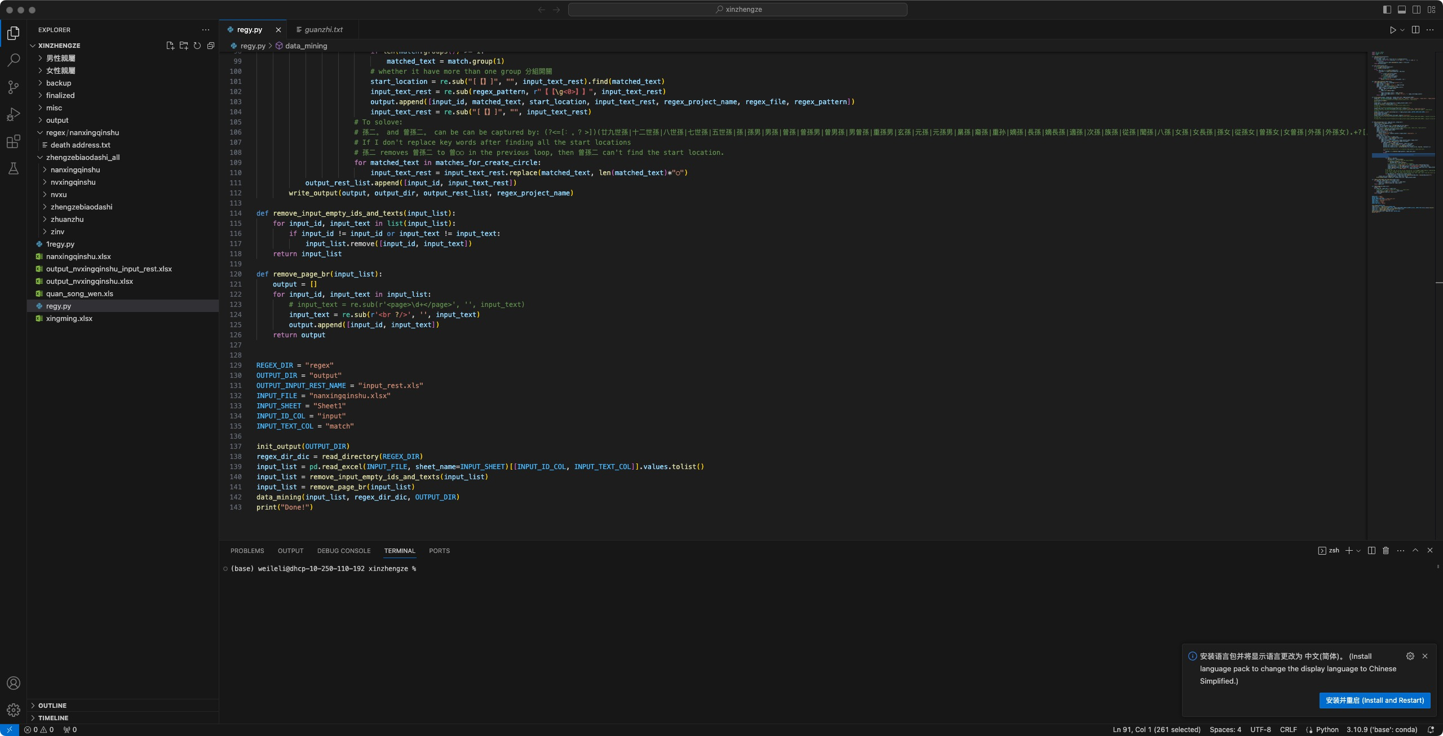
全宋文
PPT模板下载：www.1ppt.com/moban/ 行业PPT模板：www.1ppt.com/hangye/
节日PPT模板：www.1ppt.com/jieri/ PPT素材下载：www.1ppt.com/sucai/
PPT背景图片：www.1ppt.com/beijing/ PPT图表下载：www.1ppt.com/tubiao/
优秀PPT下载：www.1ppt.com/xiazai/ PPT教程： www.1ppt.com/powerpoint/
Word教程： www.1ppt.com/word/ Excel教程：www.1ppt.com/excel/
资料下载：www.1ppt.com/ziliao/ PPT课件下载：www.1ppt.com/kejian/
范文下载：www.1ppt.com/fanwen/ 试卷下载：www.1ppt.com/shiti/
教案下载：www.1ppt.com/jiaoan/ PPT论坛：www.1ppt.cn
Preliminary regular expressions
基本的正則表達式
(?<=。)[^。]{0,50}?(祖|先|父|考|伯|叔|舅|兄|侄|哥|弟)[^。]{0,50}?(?=。)
(?<=。)[^。]{0,50}?(妻|夫人|繼室|母|姑|妣|妗|姨|甥女|孫婦|姊|妹)[^。]{0,50}?(?=。)
(?<=。)[^。]{0,100}?(妹|姊|女|姪|婦|姑|甥)[^。]{0,100}?[許適嫁歸][^。]{0,100}?(?=。)
(?<=。)[^。]{0,100}?(公|君|夫人|府|禪師|父|王|先生){0,10}?(孫|子|男|女)[姓諱名曰][^：‘’“”。]{0,100}?(?=。)
(?<=。)[^。]{0,100}?(孫|子|男|女)+[一二三四五六七八九十][^。]{0,100}?(?=。)
^[^。]{0,100}?公諱[^：‘“][^。]{0,100}?(?=。)
[^。]{0,100}?[^先]公諱[^：‘“][^。]{0,100}?(?=。)
^[^。]{0,100}(夫人|府|先生|諱|姓)[^。]{1,100}?(?=。)
[^。]{0,100}?[^先大](公|君|夫人|府|禪師|王|太師|先生|君子|氏|府君)[^。]{0,100}?[姓諱字曰][^：“‘][^。]{0,100}?(?=。)
^[^。]{0,100}(公|君|禪師|太師|氏|君子|名|曰)[^：“‘][^。]{1,100}?(?=。)
^[^。]{0,100}?[字墓死][^。]{0,100}?(?=。)
^余[^。]{0,100}?(?=。)
[^。]{0,100}?字[^。]{0,100}?(?=。)
^[^。]{0,100}?人[^。]{0,100}?(?=。)

Slide 6
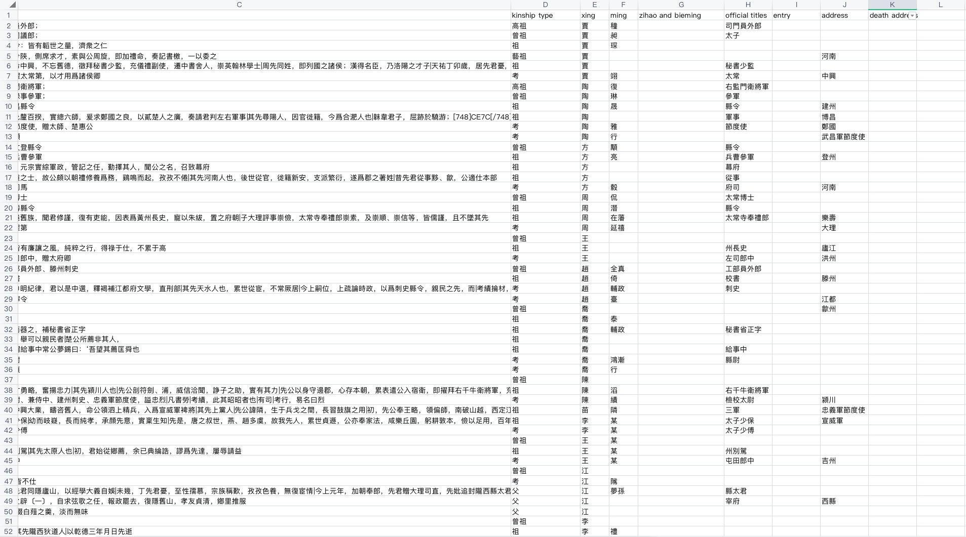
全宋文
PPT模板下载：www.1ppt.com/moban/ 行业PPT模板：www.1ppt.com/hangye/
节日PPT模板：www.1ppt.com/jieri/ PPT素材下载：www.1ppt.com/sucai/
PPT背景图片：www.1ppt.com/beijing/ PPT图表下载：www.1ppt.com/tubiao/
优秀PPT下载：www.1ppt.com/xiazai/ PPT教程： www.1ppt.com/powerpoint/
Word教程： www.1ppt.com/word/ Excel教程：www.1ppt.com/excel/
资料下载：www.1ppt.com/ziliao/ PPT课件下载：www.1ppt.com/kejian/
范文下载：www.1ppt.com/fanwen/ 试卷下载：www.1ppt.com/shiti/
教案下载：www.1ppt.com/jiaoan/ PPT论坛：www.1ppt.cn
Precise Regular Expressions
精確的正則表達式
諱(.{1,2}?)，
高祖諱(.{1,2}?)，
高祖(.{1,2}?)，
高祖(.{1,2}?)、
曾祖諱(.{1,2}?)，
曾祖(.{1,2}?)，
曾祖(.{1,2}?)、
祖諱(.{1,2}?)，
祖(.{1,2}?)，
祖(.{1,2}?)、
考諱(.{1,2}?)，
考(.{1,2}?)，
考(.{1,2}?)、
父諱(.{1,2}?)，
父(.{1,2}?)，
考(.{1,2}?)、
伯父諱(.{1,2}?)，
伯父(.{1,2}?)，

Slide 7
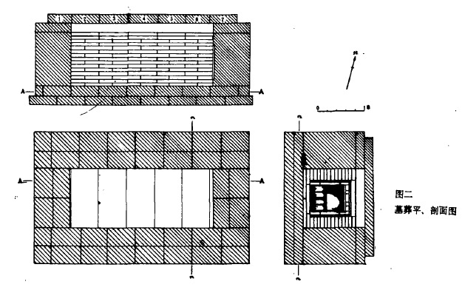
PPT模板下载：www.1ppt.com/moban/ 行业PPT模板：www.1ppt.com/hangye/
节日PPT模板：www.1ppt.com/jieri/ PPT素材下载：www.1ppt.com/sucai/
PPT背景图片：www.1ppt.com/beijing/ PPT图表下载：www.1ppt.com/tubiao/
优秀PPT下载：www.1ppt.com/xiazai/ PPT教程： www.1ppt.com/powerpoint/
Word教程： www.1ppt.com/word/ Excel教程：www.1ppt.com/excel/
资料下载：www.1ppt.com/ziliao/ PPT课件下载：www.1ppt.com/kejian/
范文下载：www.1ppt.com/fanwen/ 试卷下载：www.1ppt.com/shiti/
教案下载：www.1ppt.com/jiaoan/ PPT论坛：www.1ppt.cn
墓葬
Rectangular Vertical Cavity Brick Chamber Tomb
長方形，豎穴，磚室墓
Plans and Sections Views of the Tomb
河南方城金湯寨北宋范致祥墓葬平、剖面圖

Slide 8
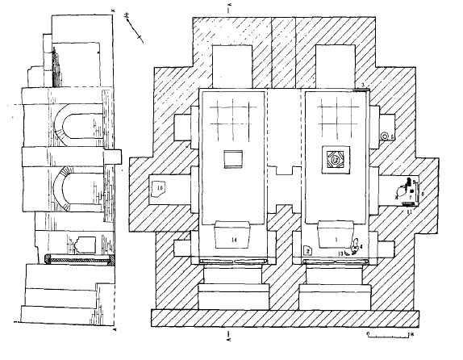
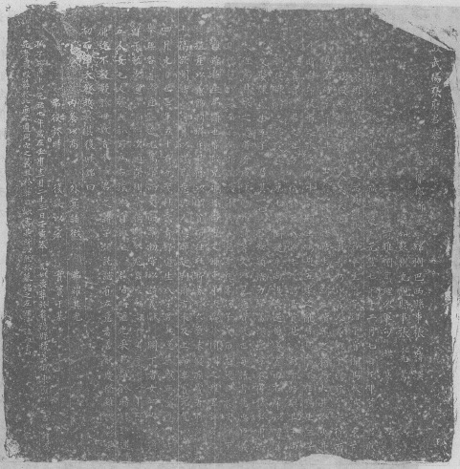
PPT模板下载：www.1ppt.com/moban/ 行业PPT模板：www.1ppt.com/hangye/
节日PPT模板：www.1ppt.com/jieri/ PPT素材下载：www.1ppt.com/sucai/
PPT背景图片：www.1ppt.com/beijing/ PPT图表下载：www.1ppt.com/tubiao/
优秀PPT下载：www.1ppt.com/xiazai/ PPT教程： www.1ppt.com/powerpoint/
Word教程： www.1ppt.com/word/ Excel教程：www.1ppt.com/excel/
资料下载：www.1ppt.com/ziliao/ PPT课件下载：www.1ppt.com/kejian/
范文下载：www.1ppt.com/fanwen/ 试卷下载：www.1ppt.com/shiti/
教案下载：www.1ppt.com/jiaoan/ PPT论坛：www.1ppt.cn
墓葬
Rectangular Double-chamber Tomb with Arch Roof
長方形雙室券頂墓
Plans and Sections Views of the Tomb
成都東郊北宋張確夫婦墓平、剖面圖
Epitaph of Zhang Que
張確的墓志銘

Slide 9
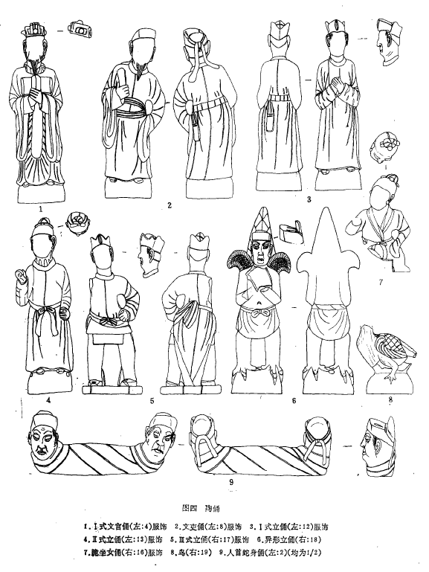
文化因素分析
PPT模板下载：www.1ppt.com/moban/ 行业PPT模板：www.1ppt.com/hangye/
节日PPT模板：www.1ppt.com/jieri/ PPT素材下载：www.1ppt.com/sucai/
PPT背景图片：www.1ppt.com/beijing/ PPT图表下载：www.1ppt.com/tubiao/
优秀PPT下载：www.1ppt.com/xiazai/ PPT教程： www.1ppt.com/powerpoint/
Word教程： www.1ppt.com/word/ Excel教程：www.1ppt.com/excel/
资料下载：www.1ppt.com/ziliao/ PPT课件下载：www.1ppt.com/kejian/
范文下载：www.1ppt.com/fanwen/ 试卷下载：www.1ppt.com/shiti/
教案下载：www.1ppt.com/jiaoan/ PPT论坛：www.1ppt.cn
未寢疾，嘗著《時議》數十篇，欲聞諸朝，非以謀己，意與人息弊起利爾。言未及上而卒，實元豐四年四月九日也，享年五十有九。
——張確墓志銘
Pottery Figurine
陶俑

Slide 10
富弼家族墓
PPT模板下载：www.1ppt.com/moban/ 行业PPT模板：www.1ppt.com/hangye/
节日PPT模板：www.1ppt.com/jieri/ PPT素材下载：www.1ppt.com/sucai/
PPT背景图片：www.1ppt.com/beijing/ PPT图表下载：www.1ppt.com/tubiao/
优秀PPT下载：www.1ppt.com/xiazai/ PPT教程： www.1ppt.com/powerpoint/
Word教程： www.1ppt.com/word/ Excel教程：www.1ppt.com/excel/
资料下载：www.1ppt.com/ziliao/ PPT课件下载：www.1ppt.com/kejian/
范文下载：www.1ppt.com/fanwen/ 试卷下载：www.1ppt.com/shiti/
教案下载：www.1ppt.com/jiaoan/ PPT论坛：www.1ppt.cn
Types of Fu Bi Family Tombs
富弼家族墓墓葬類型
Round single-chamber tomb with slope path
斜坡墓道圓形單室墓
IM2761（富弼夫婦墓）
IM2760（富鼎夫婦墓）
IM2743（富紹京夫婦墓）
Rectangular single-chamber tomb with vertical cave path
豎穴墓道長方形單室墓
IM2735（富紹寧夫婦墓）
IM2737（富紹修夫婦墓）
IM2744（富紹榮夫婦墓）
Rectangular single-chamber tomb with slope path
斜坡墓道長方形單室墓
IM2721（富直英墓）

Slide 11
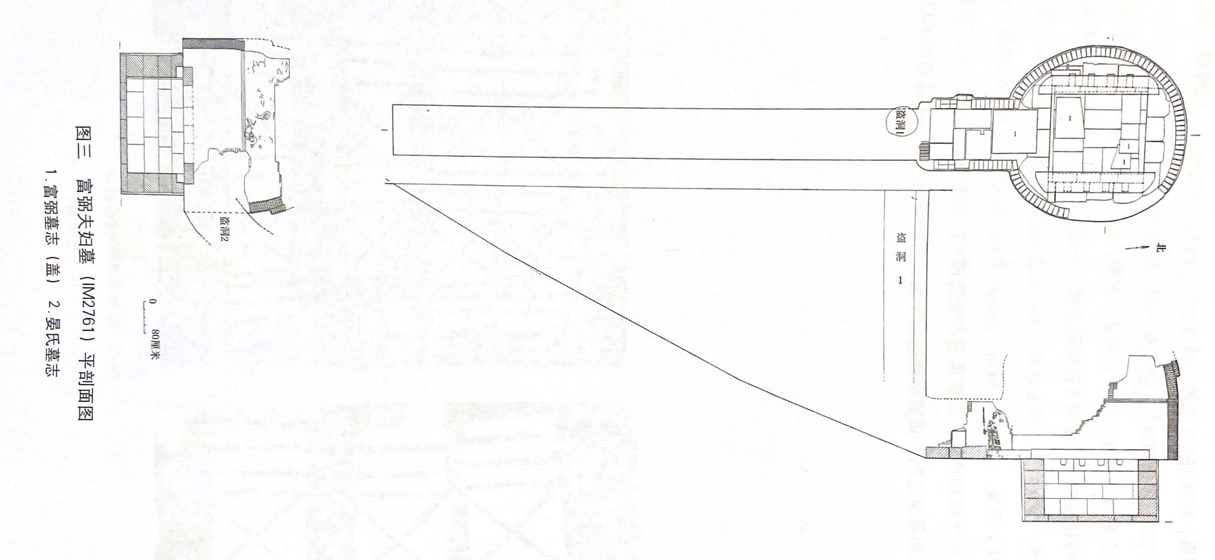
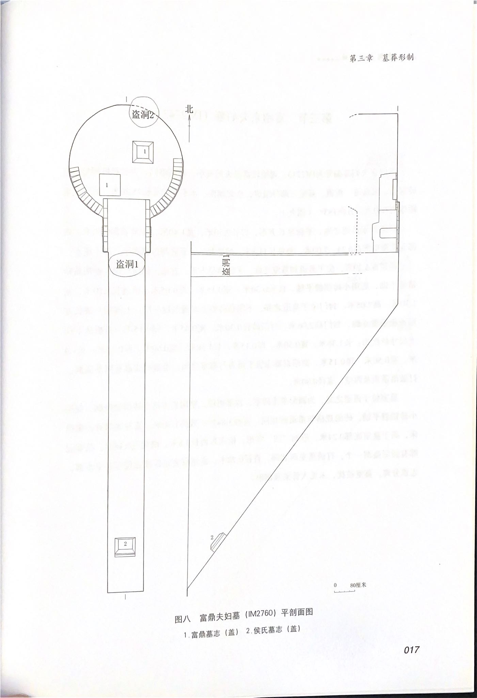
富弼家族墓
PPT模板下载：www.1ppt.com/moban/ 行业PPT模板：www.1ppt.com/hangye/
节日PPT模板：www.1ppt.com/jieri/ PPT素材下载：www.1ppt.com/sucai/
PPT背景图片：www.1ppt.com/beijing/ PPT图表下载：www.1ppt.com/tubiao/
优秀PPT下载：www.1ppt.com/xiazai/ PPT教程： www.1ppt.com/powerpoint/
Word教程： www.1ppt.com/word/ Excel教程：www.1ppt.com/excel/
资料下载：www.1ppt.com/ziliao/ PPT课件下载：www.1ppt.com/kejian/
范文下载：www.1ppt.com/fanwen/ 试卷下载：www.1ppt.com/shiti/
教案下载：www.1ppt.com/jiaoan/ PPT论坛：www.1ppt.cn
Round single-chamber tomb with slope path
斜坡墓道圓形單室墓
Plans and Sections View of the Tomb
for Fu Bi and his wife
富弼夫婦墓（IM2761）平、剖面圖
It consists of five parts: tomb passage, closed door, corridor, tomb chamber, and coffin chamber.
墓葬由墓道、封門、甬道、墓室、槨室五部分組成。
Plans and Sections View of the Tomb
for Fu Ding and his wife
富鼎夫婦墓（IM2760）平、剖面圖
It consists of three parts: tomb passage, corridor, tomb chamber.
墓葬由墓道、甬道、墓室三部分組成。

Slide 12
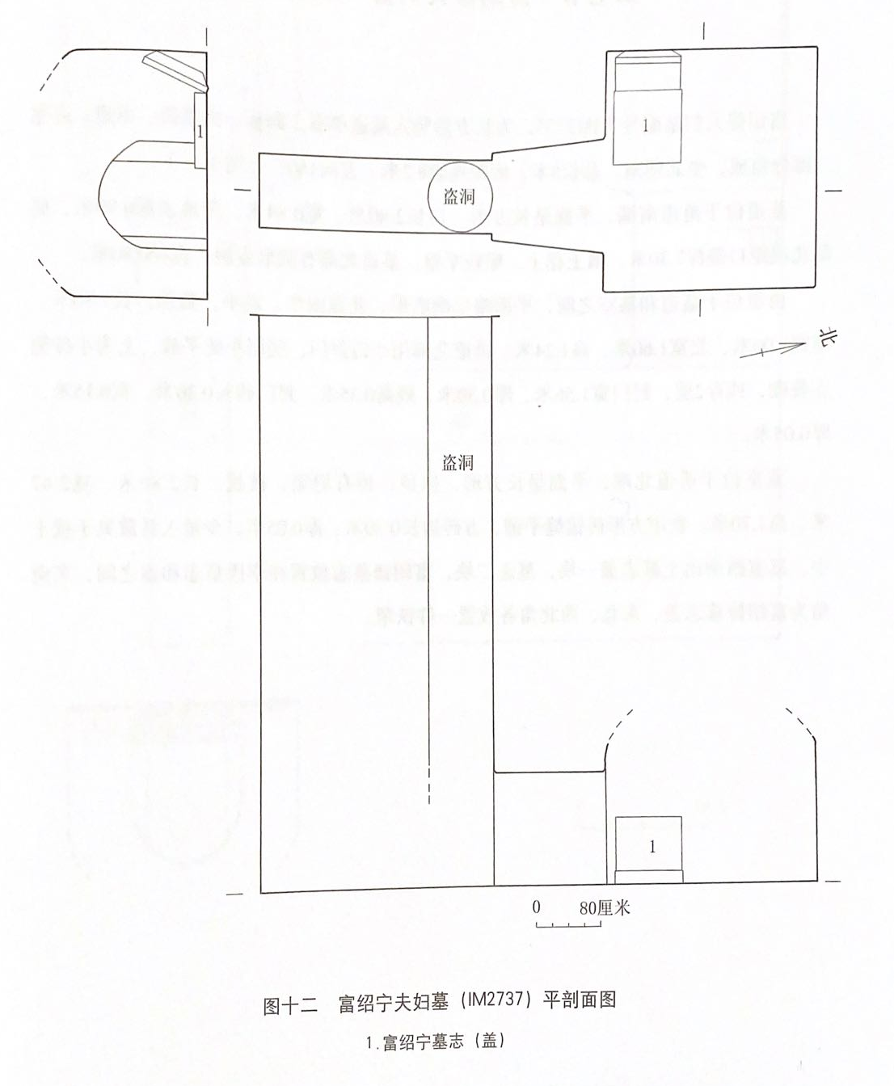
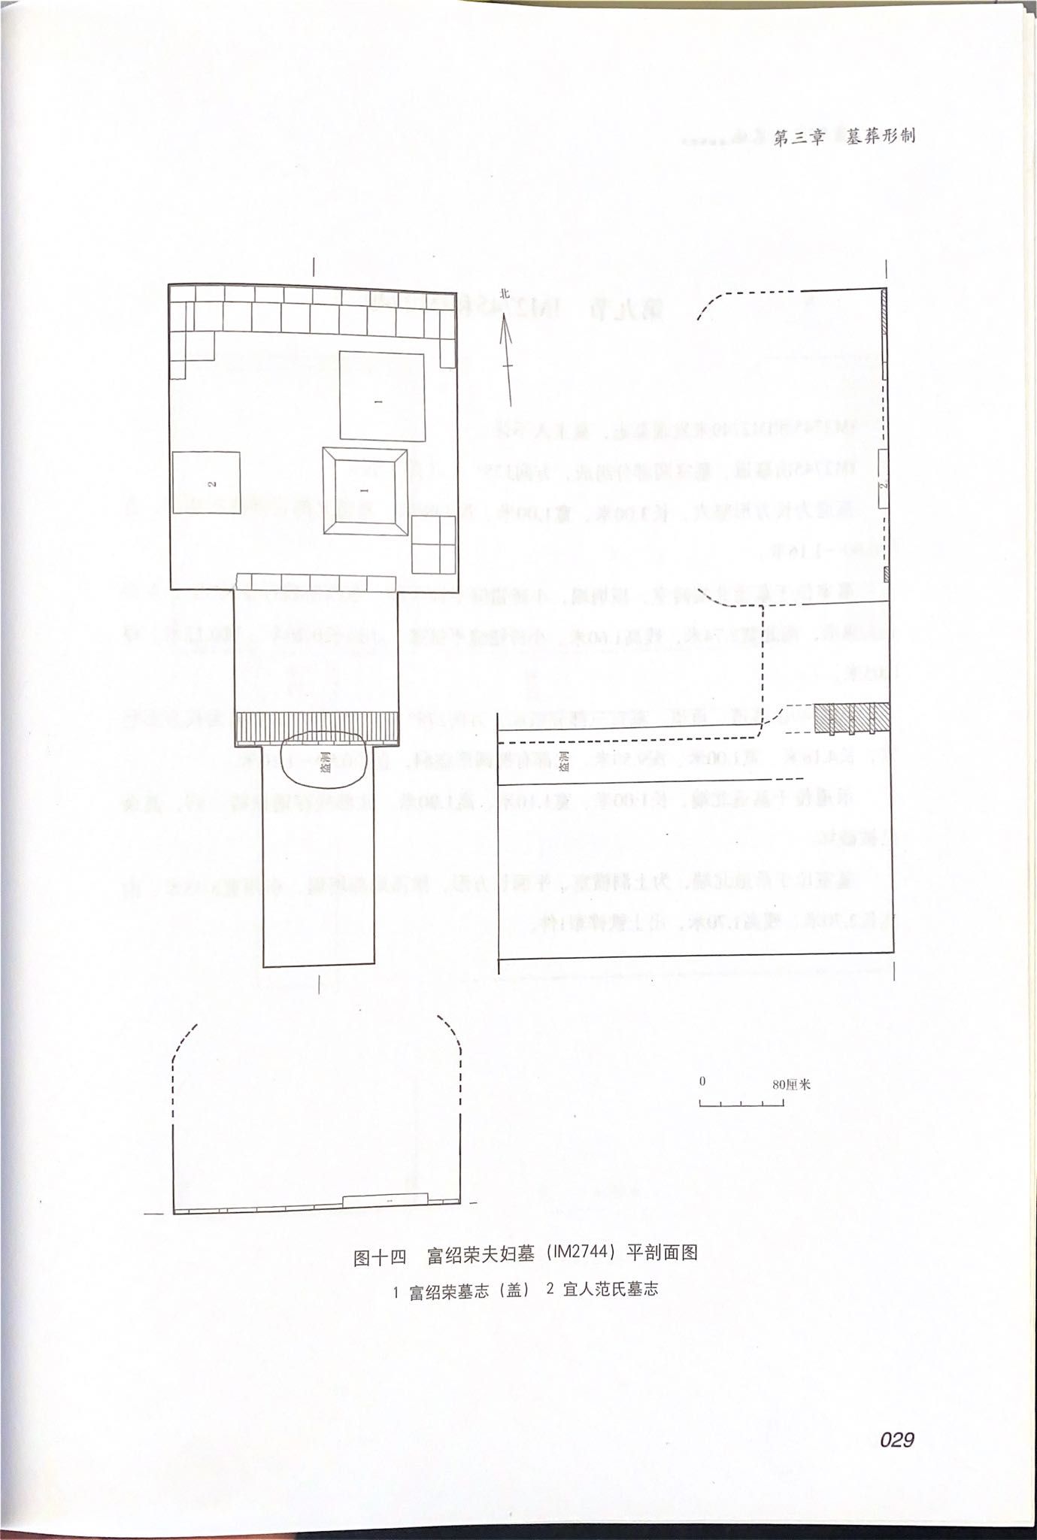
富弼家族墓
PPT模板下载：www.1ppt.com/moban/ 行业PPT模板：www.1ppt.com/hangye/
节日PPT模板：www.1ppt.com/jieri/ PPT素材下载：www.1ppt.com/sucai/
PPT背景图片：www.1ppt.com/beijing/ PPT图表下载：www.1ppt.com/tubiao/
优秀PPT下载：www.1ppt.com/xiazai/ PPT教程： www.1ppt.com/powerpoint/
Word教程： www.1ppt.com/word/ Excel教程：www.1ppt.com/excel/
资料下载：www.1ppt.com/ziliao/ PPT课件下载：www.1ppt.com/kejian/
范文下载：www.1ppt.com/fanwen/ 试卷下载：www.1ppt.com/shiti/
教案下载：www.1ppt.com/jiaoan/ PPT论坛：www.1ppt.cn
Rectangular single-chamber tomb with vertical cave path
豎穴墓道長方形單室墓
Plans and Sections View of the Tomb
for Shaoning Fu and his wife
富紹寧夫婦墓（IM2737）平、剖面圖
Plans and Sections View of the Tomb
for Shaorong Fu and his wife
富紹榮夫婦墓（IM2744）平、剖面圖

Slide 13
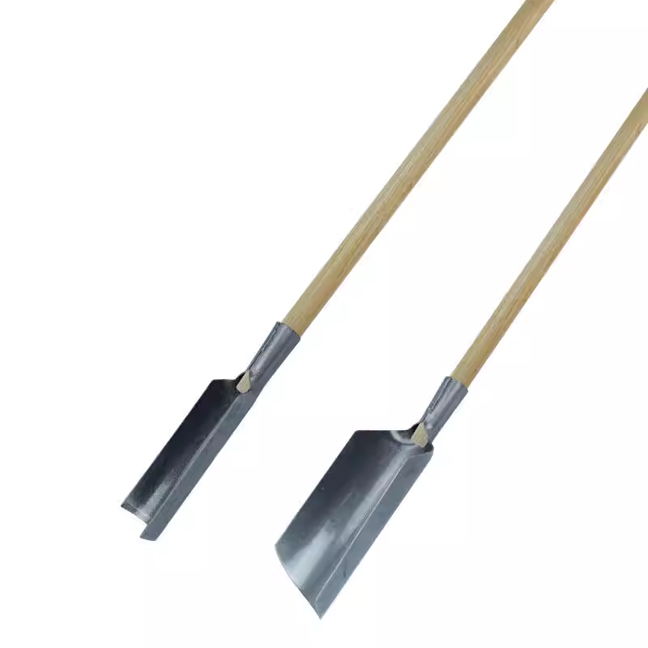
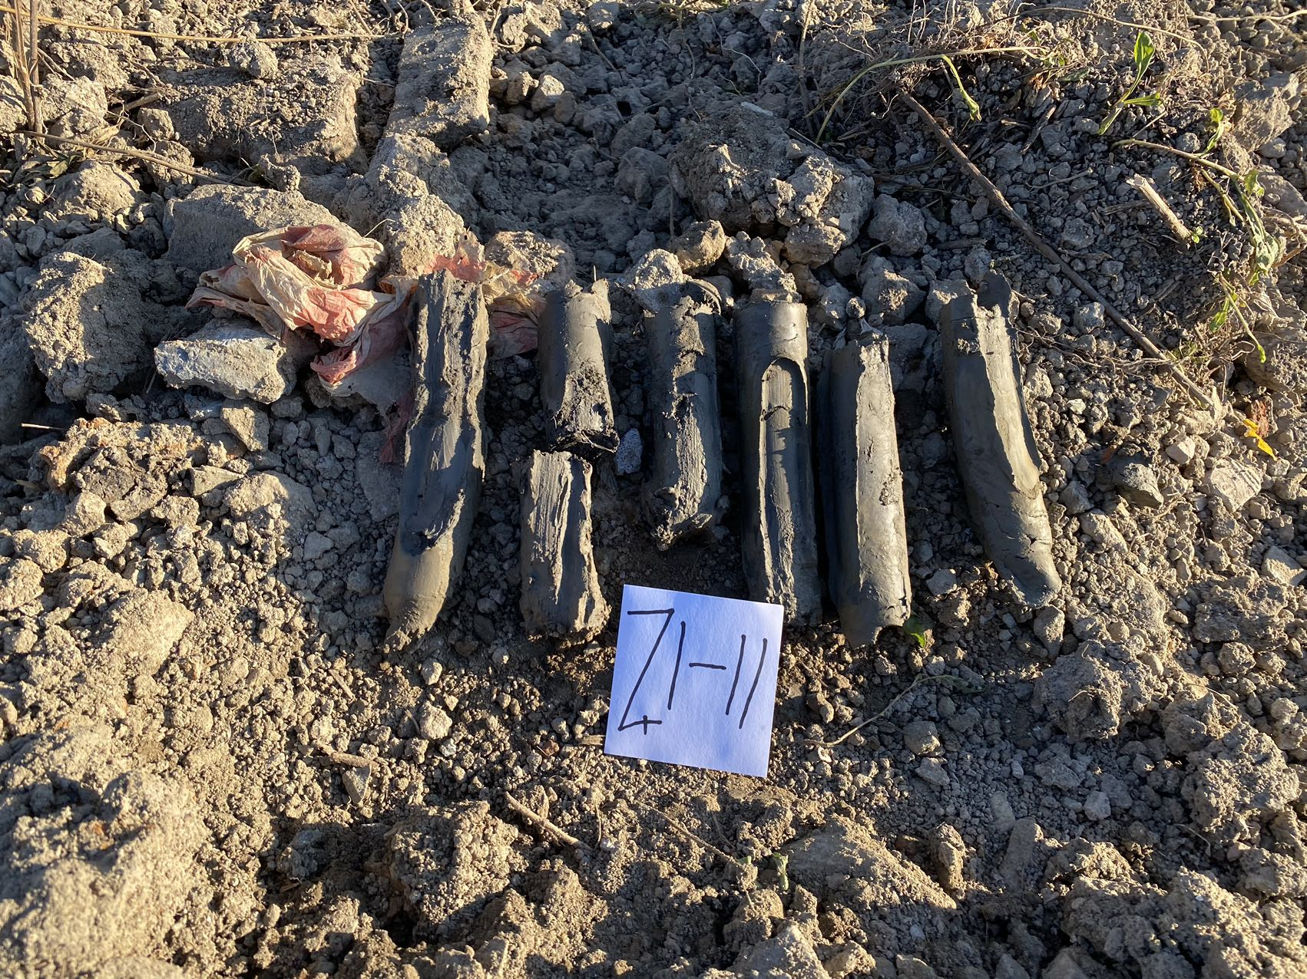
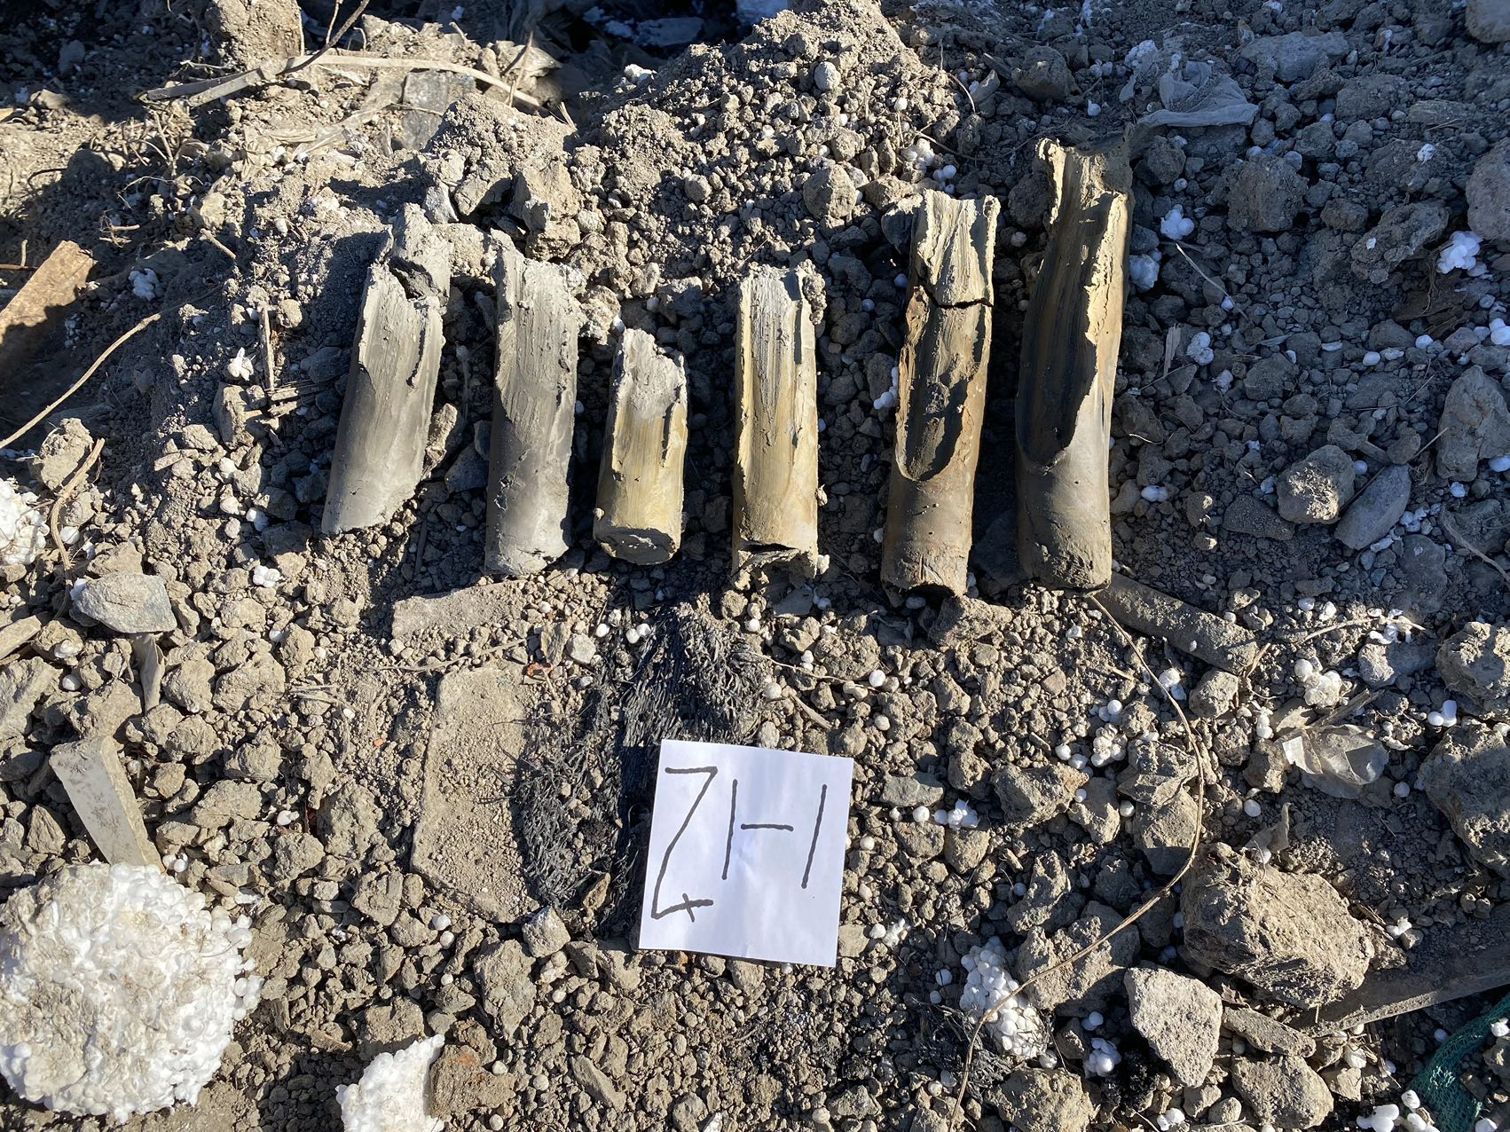
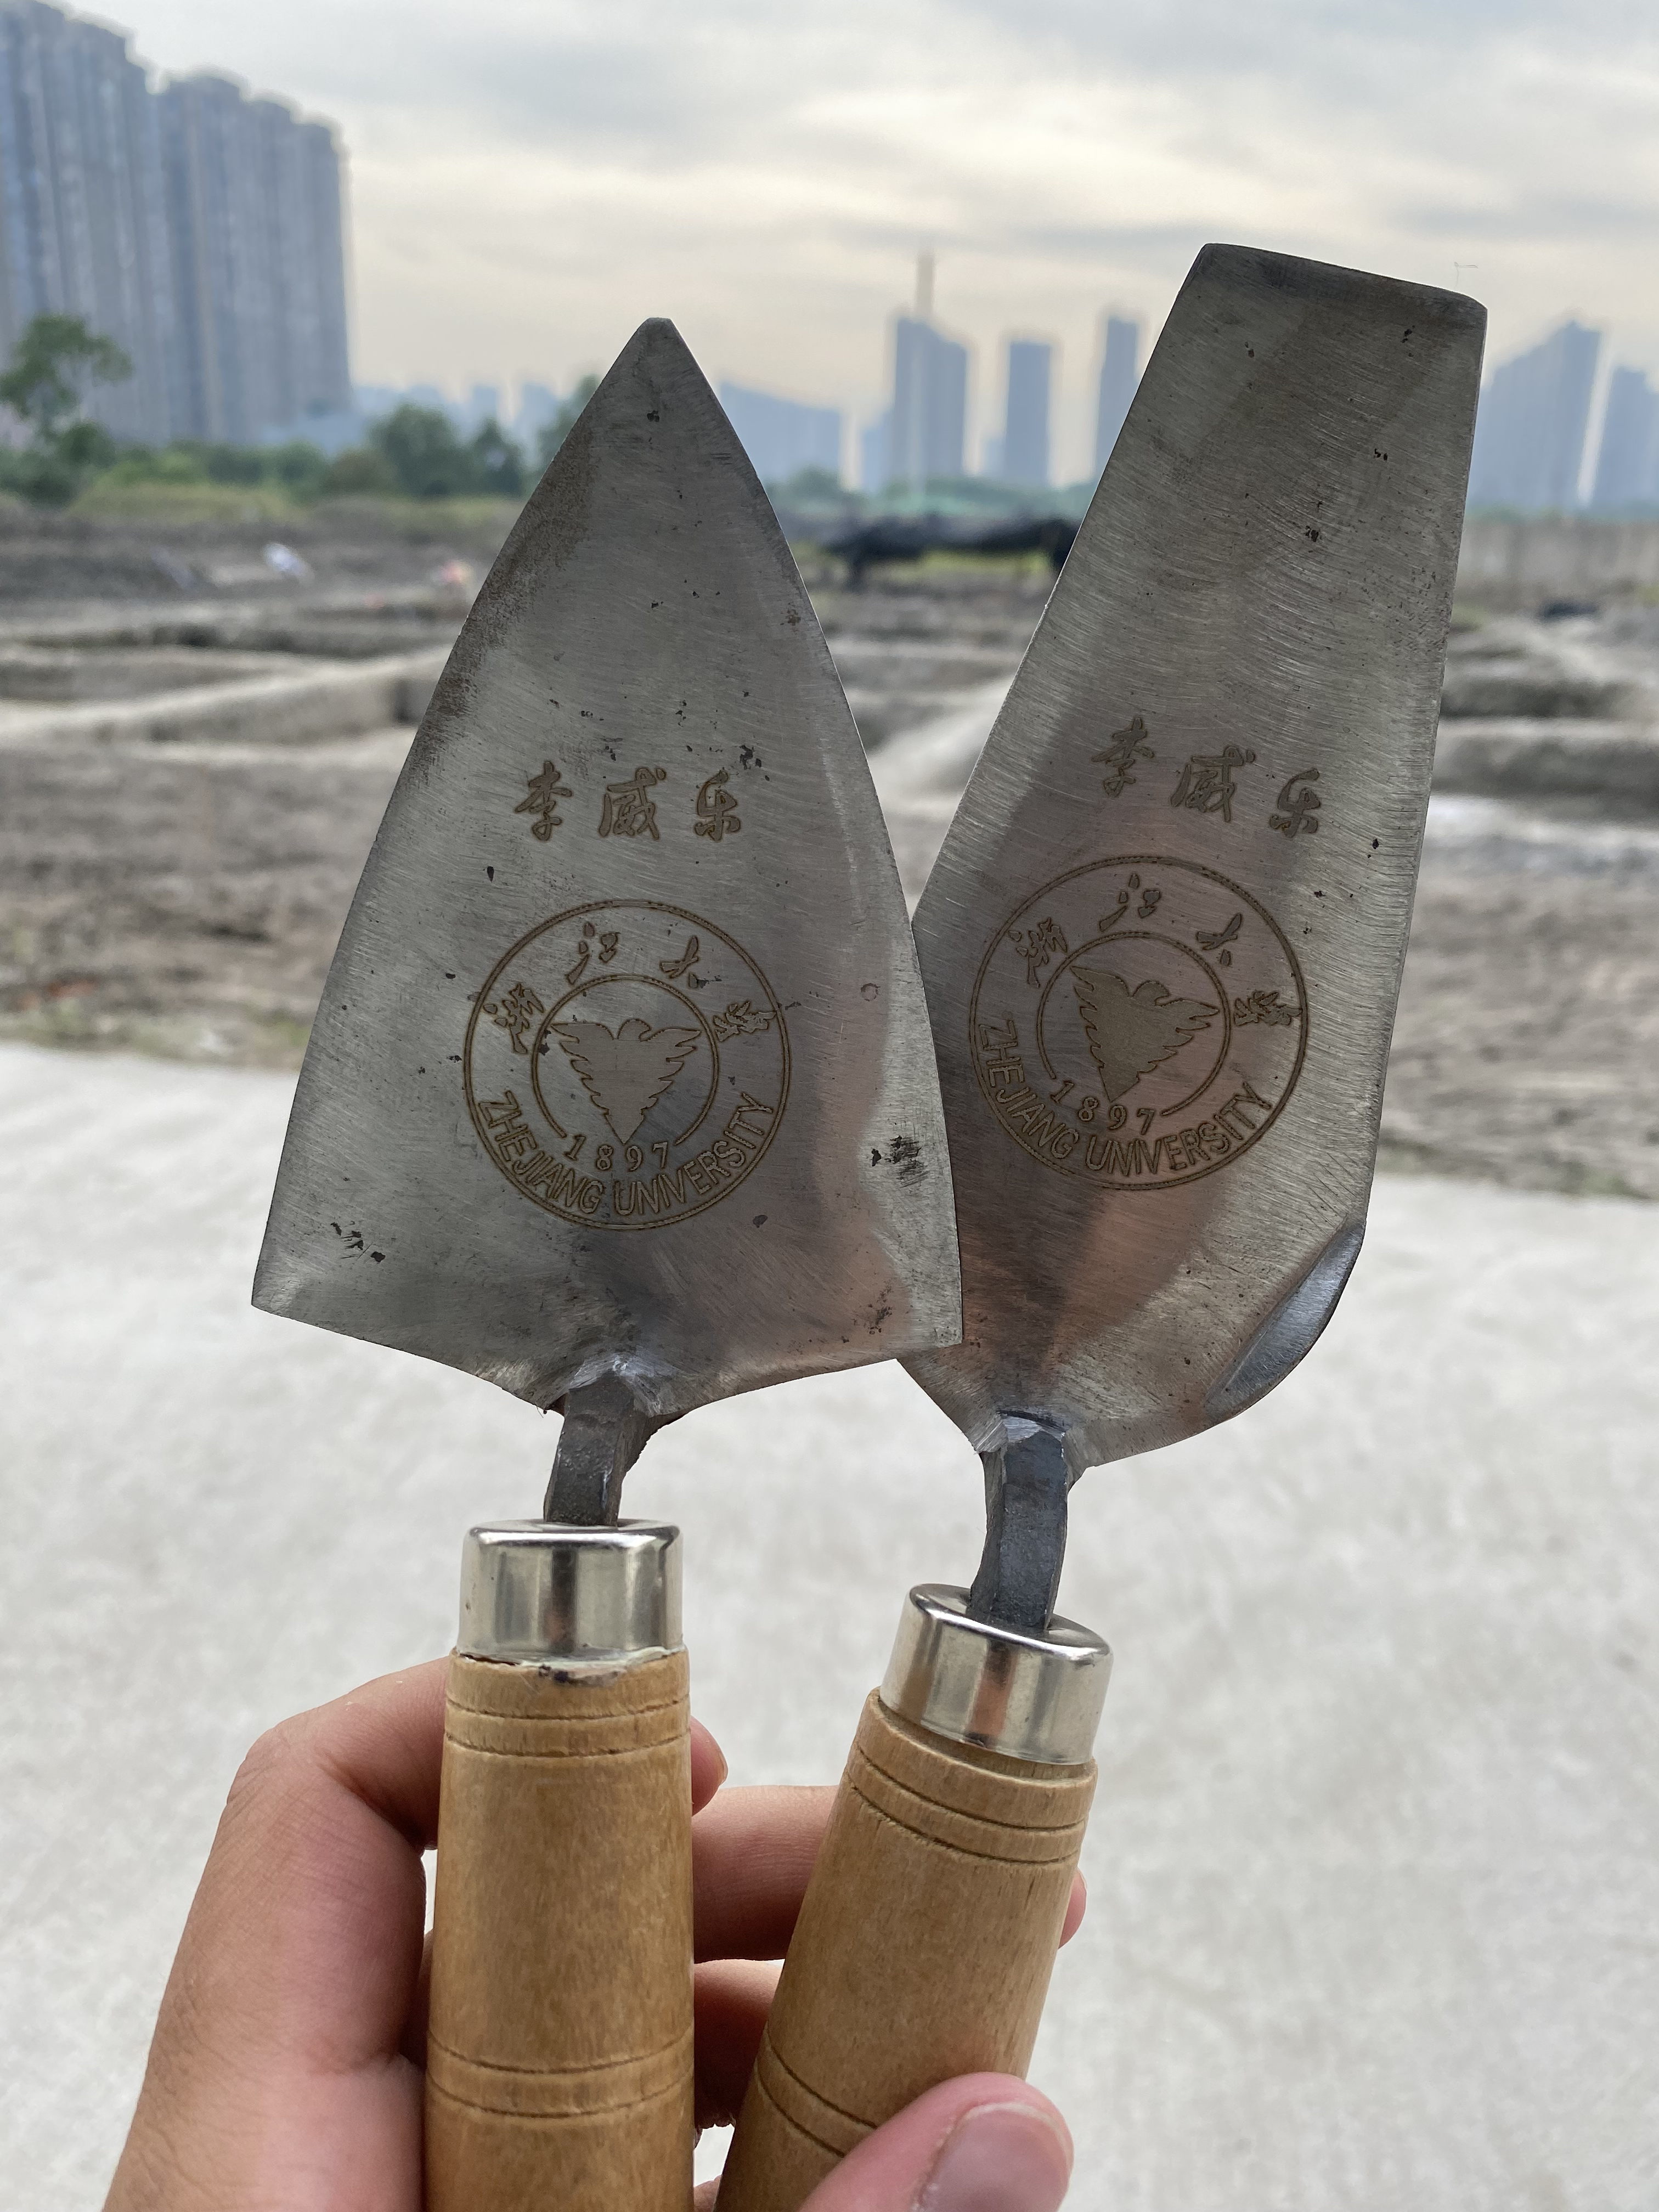
考古發掘
PPT模板下载：www.1ppt.com/moban/ 行业PPT模板：www.1ppt.com/hangye/
节日PPT模板：www.1ppt.com/jieri/ PPT素材下载：www.1ppt.com/sucai/
PPT背景图片：www.1ppt.com/beijing/ PPT图表下载：www.1ppt.com/tubiao/
优秀PPT下载：www.1ppt.com/xiazai/ PPT教程： www.1ppt.com/powerpoint/
Word教程： www.1ppt.com/word/ Excel教程：www.1ppt.com/excel/
资料下载：www.1ppt.com/ziliao/ PPT课件下载：www.1ppt.com/kejian/
范文下载：www.1ppt.com/fanwen/ 试卷下载：www.1ppt.com/shiti/
教案下载：www.1ppt.com/jiaoan/ PPT论坛：www.1ppt.cn
Exploration Shovel
探鏟
Soil Samples
土樣
Hand shovel
手鏟

Slide 14
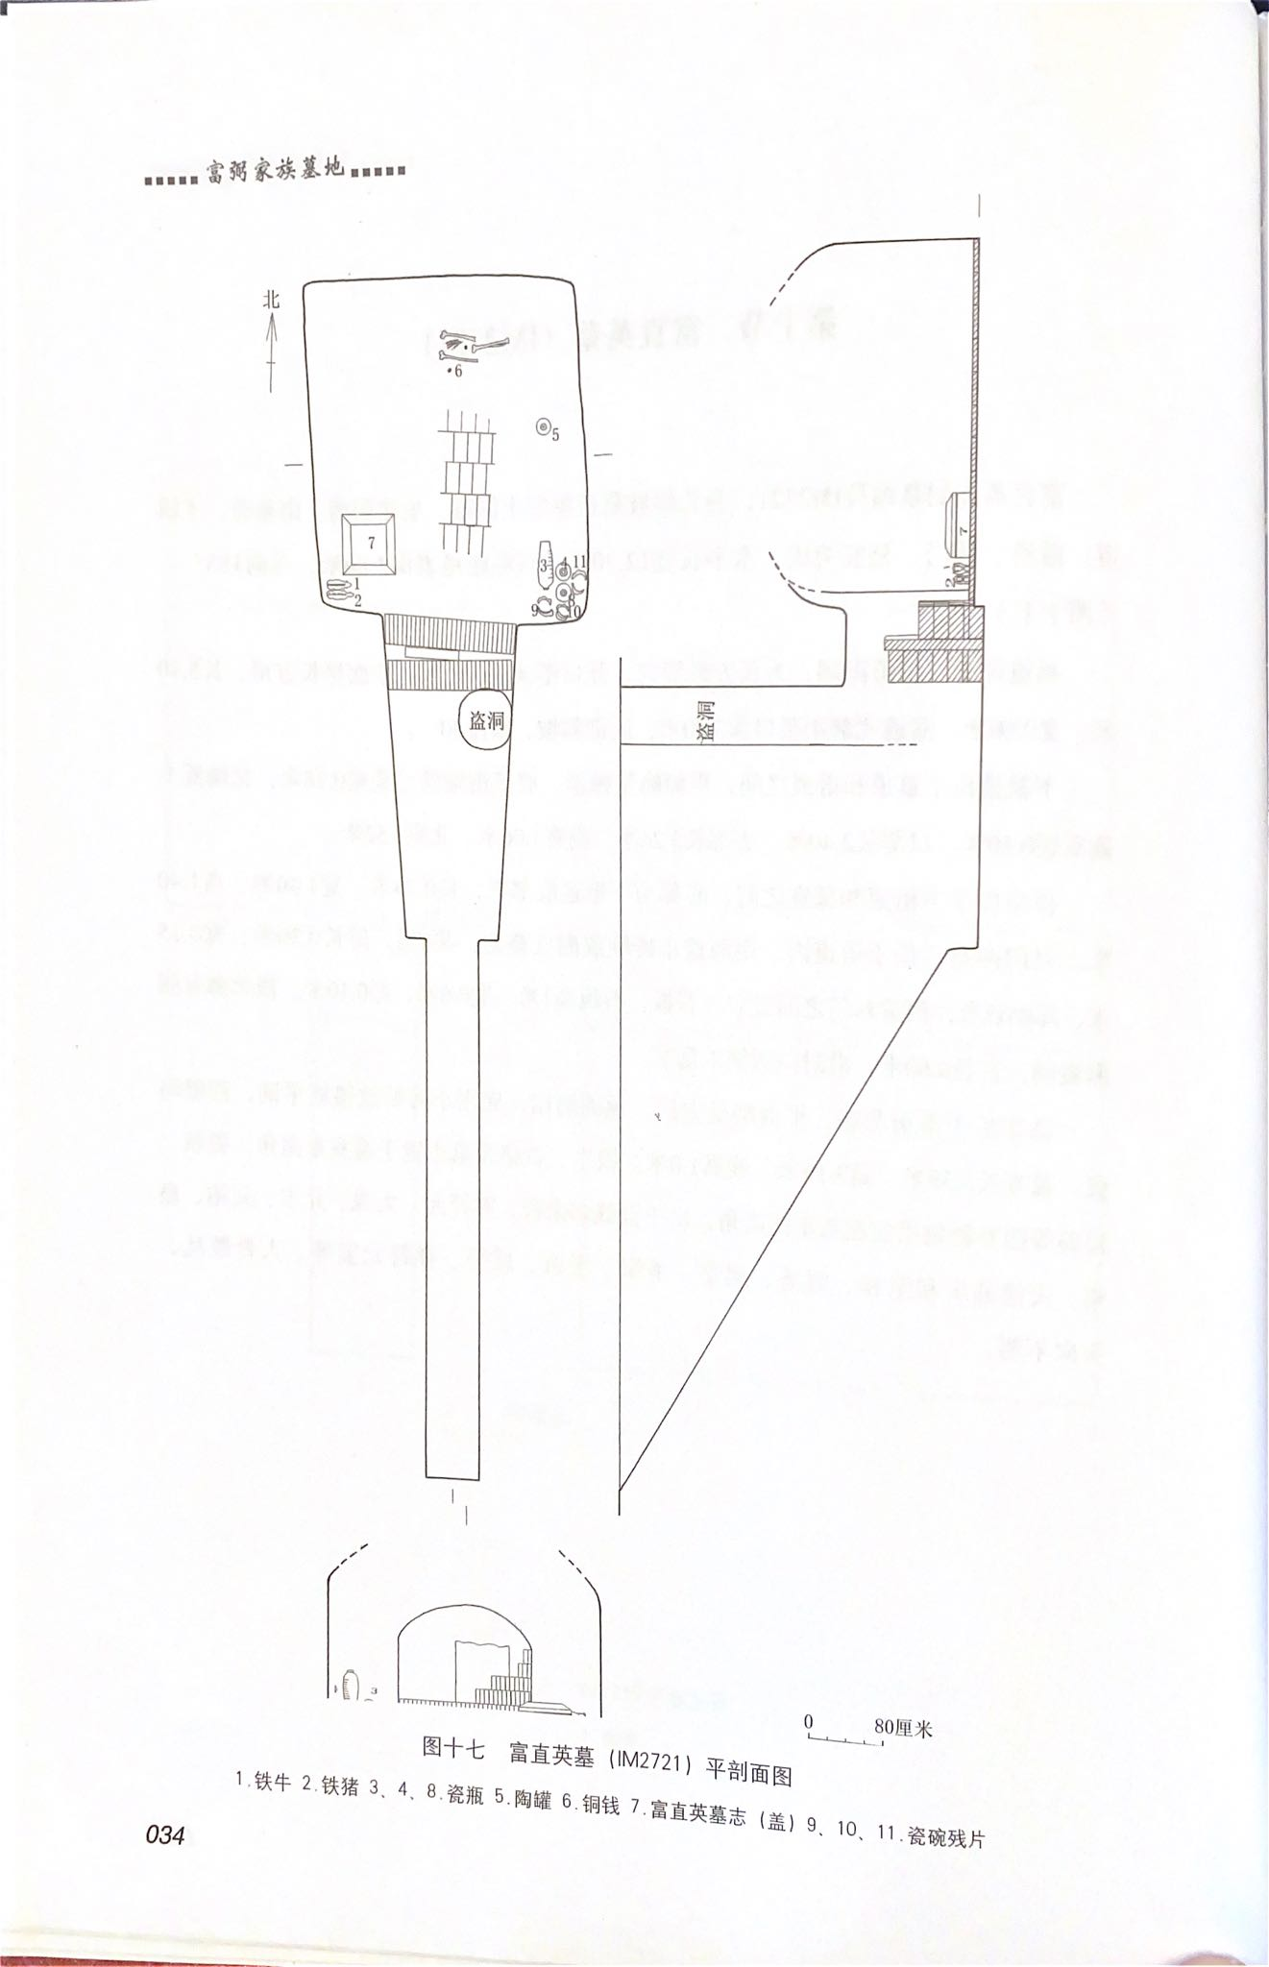
富弼家族墓
PPT模板下载：www.1ppt.com/moban/ 行业PPT模板：www.1ppt.com/hangye/
节日PPT模板：www.1ppt.com/jieri/ PPT素材下载：www.1ppt.com/sucai/
PPT背景图片：www.1ppt.com/beijing/ PPT图表下载：www.1ppt.com/tubiao/
优秀PPT下载：www.1ppt.com/xiazai/ PPT教程： www.1ppt.com/powerpoint/
Word教程： www.1ppt.com/word/ Excel教程：www.1ppt.com/excel/
资料下载：www.1ppt.com/ziliao/ PPT课件下载：www.1ppt.com/kejian/
范文下载：www.1ppt.com/fanwen/ 试卷下载：www.1ppt.com/shiti/
教案下载：www.1ppt.com/jiaoan/ PPT论坛：www.1ppt.cn
Rectangular single-chamber tomb with slope path
斜坡墓道長方形單室墓
Plans and Sections View of the Tomb
for Shaoning Fu and his wife
富直英墓（IM2721）平、剖面圖

Slide 15
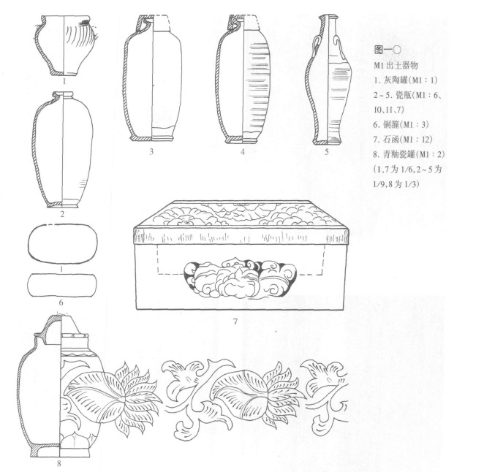
器物組合
PPT模板下载：www.1ppt.com/moban/ 行业PPT模板：www.1ppt.com/hangye/
节日PPT模板：www.1ppt.com/jieri/ PPT素材下载：www.1ppt.com/sucai/
PPT背景图片：www.1ppt.com/beijing/ PPT图表下载：www.1ppt.com/tubiao/
优秀PPT下载：www.1ppt.com/xiazai/ PPT教程： www.1ppt.com/powerpoint/
Word教程： www.1ppt.com/word/ Excel教程：www.1ppt.com/excel/
资料下载：www.1ppt.com/ziliao/ PPT课件下载：www.1ppt.com/kejian/
范文下载：www.1ppt.com/fanwen/ 试卷下载：www.1ppt.com/shiti/
教案下载：www.1ppt.com/jiaoan/ PPT论坛：www.1ppt.cn
Common funerary object combinations
常见的随葬品组合
Tomb of Li Baoshu:
Gray pottery jar, celadon porcelain jar, copper hoop, mercury, copper coins, porcelain vase, stone epitaph, stone tombstone, stone box
李保樞墓：
灰陶罐(早期韓瓶？)、青釉瓷罐、銅箍、水銀、銅錢、瓷瓶、石墓志、石墓碑、石函

Slide 16
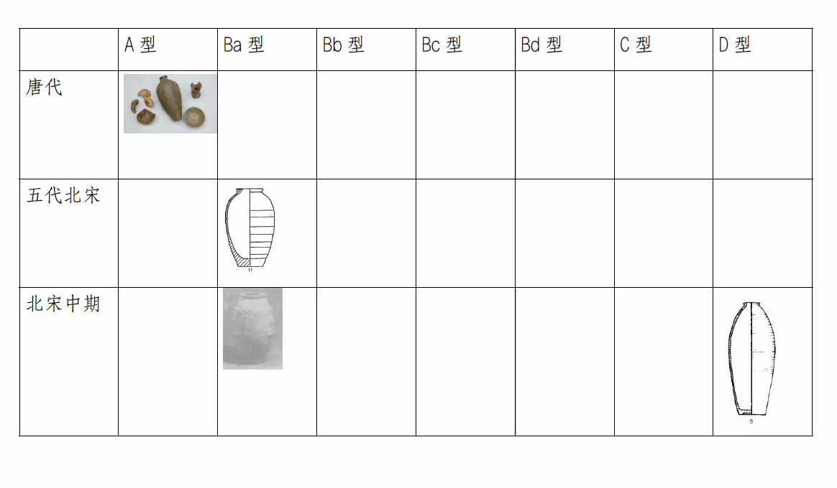

Slide 17

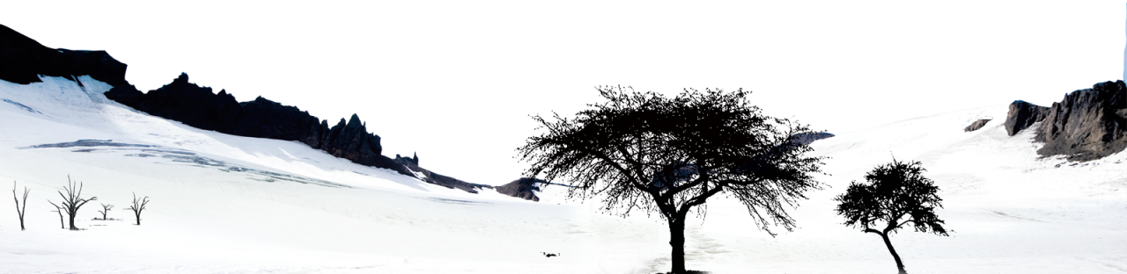

結
束
From the moment we are born, we are heading towards death. Every day we live, no matter whether we are sad or happy, we cannot change the final outcome. Death is the process of life.
我們從出生開始，便向著死亡而去，我們活著的每一天，不論悲喜，都無法改變最終結局，死亡，便是人生的歷程。

Slide 18


[1]钱永章.浙江象山县清理北宋黄浦墓[J].考古,1986(09):861-863.
[2]贡昌.浙江兰溪县北宋石室墓[J].考古,1985(02):155-157.
[3]周到.宋魏王赵頵夫妻合葬墓[J].考古,1964(07):349-354+10.
[4]李绍连.宋苏适墓志及其他[J].文物,1973(07):63-69.
[5]刘玉生,魏仁华.河南方城金汤寨北宋范致祥墓[J].文物,1988(11):61-65+39.
[6]吴敬.关于成都地区宋代墓葬出土陶俑的几点认识[J].四川文物,2010(06):65-67+96.
[7]翁善良,罗伟先.成都东郊北宋张确夫妇墓[J].文物,1990(03):1-13+98-99.[8]
[8]王磊,呼安林,王久刚.西安长安区郭杜镇清理的三座宋代李唐王朝后裔家族墓[J].文物,2008(06):36-53+97.
[9]薛尧.江西南城、清江和永修的宋墓[J].考古,1965(11):571-576+9-12.
[10]洛阳市第二文物工作队.富弼家家族墓地[M].中州古籍出版社,2009.
[11]巫鸿著，施杰译.黄泉下的美术[M].生活·读书·新知 三联书店,2010.
[12]河南省文物考古研究所.北宋皇陵[M].中州古籍出版社,1997.
参
考
文
献

