Slide 1


Geocoding the Past World:
Unearthing Coordinates of Early China from Texts
Using Large Language Models
Yuqi Chen
CBDB Project
Institute for Quantitative Social Science, Harvard University

Slide 2



What is Geocoding
Texts
Coordinates
Geocoding
Notes:
First, what is geocoding?
Basically, it refers to the process of converting textual addresses into geographic coordinates, such as latitude and longitude. This allows us to pinpoint locations on a map, enabling both visualization and a range of spatial analyses.

Slide 3
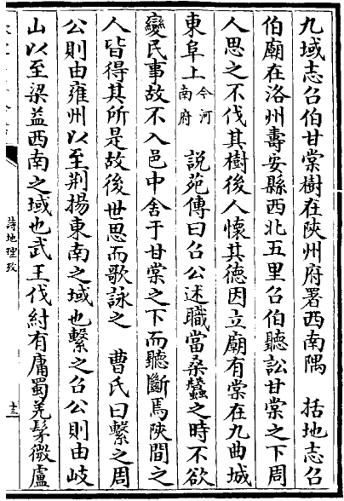
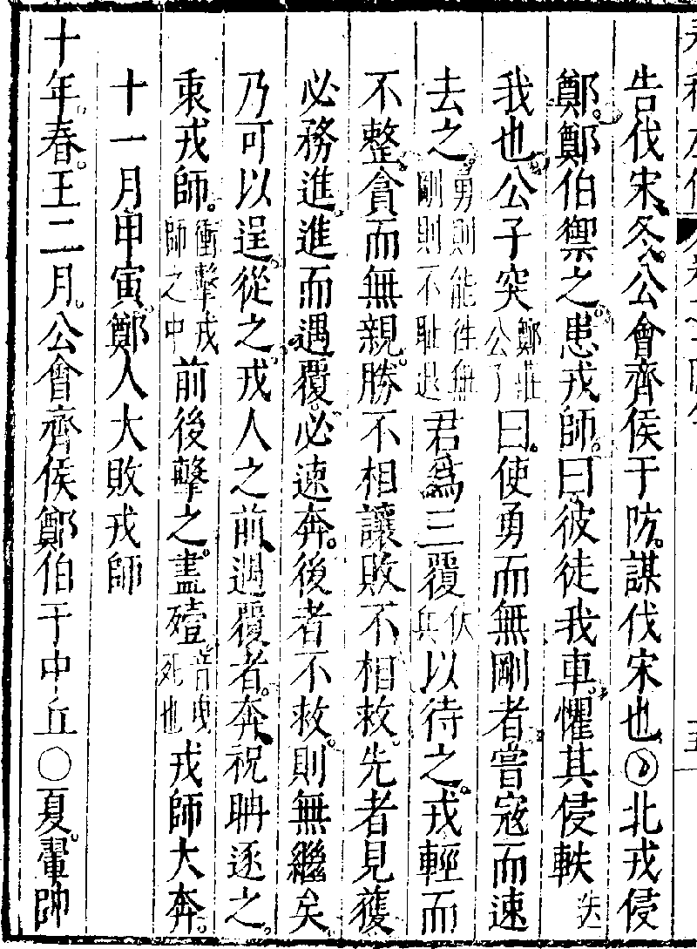
Historical Toponyms
詩地理考
春秋左傳
Notes:
Here are two example pages from 詩地理考 and 春秋左傳.
Imagine you have a Table of Wars, which lists the locations of wars in different periods.
You may wonder if the locations of wars are related to geographic features such as elevation and rivers.
Alternatively, if you have some biographies of historical figures, you might be curious about the distribution pattern of their birthplaces.
To perform these analyses, you need to obtain the coordinates of these toponyms or place names.
Only if you have these coordinates, you can proceed with the next steps.

Slide 4
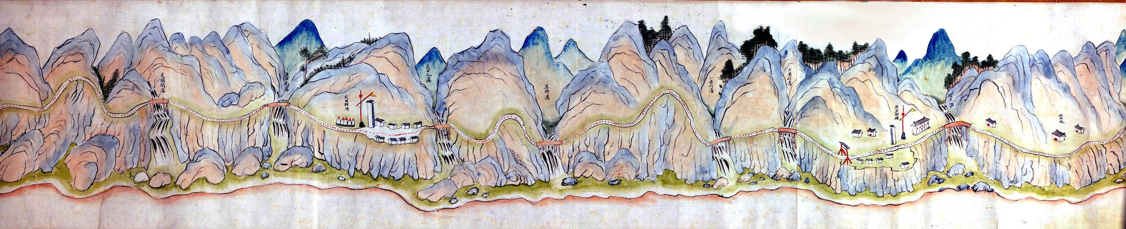



CHGIS: China Historical Geographic Information System
Notes:
The most convenient way to obtain coordinates for historical place names is by using the CHGIS database, which is an amazing project that has been a long-standing collaboration between the Center for Geographic Analysis at Harvard University and the Center for Historical Geographical Studies at Fudan University.
Professor Bol is also the director of the project.

Slide 5
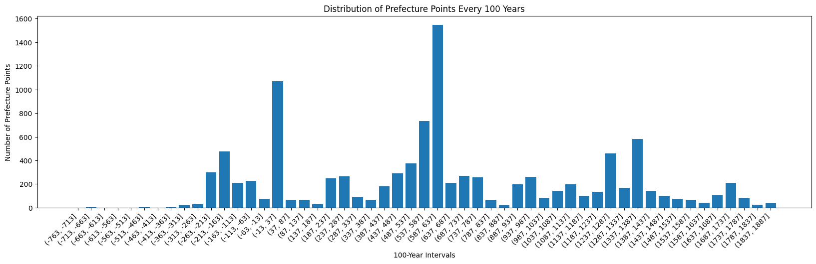
CHGIS: China Historical Geographic Information System
Gap in Early China Data
* CHGIS V6 TIME SERIES Data
Notes:
However, up to now, the CHGIS database still severely lacks geographical data for early China.
Here is a statistical chart based on 100-year intervals, showing the number of prefecture points in different time periods from the CHGIS Time Series Data.
It can be seen that there are significant gaps in the early periods of China.

Slide 6
Chain of Annotations and Commentaries
初楚范巫矞似，謂成王，與子玉，子西，曰，三君皆將強死，城濮之役，王思之，故使止子玉曰，毋死，不及，止子西，子西縊而縣絕，王使適至，遂止之，使為商公。
770 – 476 BC
春秋左傳
222 – 285 AD
杜預註
商，楚邑。今上雒商縣。
1681 – 1762 AD
春秋地理考實
楚成王時，楚地未能至商州，其使子西為商公，或是商密之地。
據《左傳》文公十年載商公子西“沿漢溯江，將人郢”來分析，商縣當在漢水流域，由其商縣之名來推測，其地恐近商密，在今湖北省均縣附近。
2009 AD
中國行政區劃通史
Notes:
How can we determine the location of a specific place from ancient times, especially when its name is absent from current databases like CHGIS?
This is a challenge often encountered in the field of Early China studies.
There are actually various types of clues in the text itself.
The tradition of annotation and commentary on ancient Chinese texts has resulted in a large number of later scholars providing annotations for historical place names mentioned in these texts.
And we don't need to start the textual research from the beginning. Brilliant historians in the past have already done a lot of work on this.
Here is an example of a chain of annotations and commentaries on a specific place name: “商”.
We can follow along this chain until we link to an address with existing coordinate information.

Slide 7
Toponym Recognition and Relation Extraction 地名识别与关系抽取
據《左傳》文公十年載商公子西“沿漢溯江，將入郢”
來分析，商縣當在漢水流域，由其商縣之名來推測，
其地恐近商密，在今湖北省均縣附近。
Toponym Recognition
據《左傳》文公十年載商公子西“沿漢溯江，將入郢”
來分析，商縣當在漢水流域，由其商縣之名來推測，
其地恐近商密，在今湖北省均縣附近。
Relation Extraction
Notes:
However, we still need to invest a significant amount of effort in order to extract truly useful location-related information from these unstructured and lengthy texts.
This process includes two steps: Toponym Recognition and Relation Extraction .
In the text example above, the highlighted parts should be recognized as place names, also called toponyms.
In the text example below, the relation that needs to be extracted is that "Shang County" is located near present-day Jun County in Hubei Province.

Slide 8





Comparison of Different Methods
  Rule-Based Methods
    Regular Expression
    Dictionary Matching
  Data-Driven Methods
    Task-Specific Models
      Need to be finetuned
    General-Purpose Model
      Zero-shot
      Prompt engineering
Notes:
Technical experts have been dedicated to achieving true automation of this process to save manpower.
The methods can generally be divided into two categories: rule-driven methods including regular expression, and data-driven methods including different kinds of AI models.
The biggest drawback of past Task-Specific Models was the need to provide different training datasets for different tasks, which itself required a significant investment.
Nowadays, popular General-Purpose Models like ChatGPT, can truly achieve zero-shot, which means they don’t require any training datasets and only need a prompt.

Slide 9
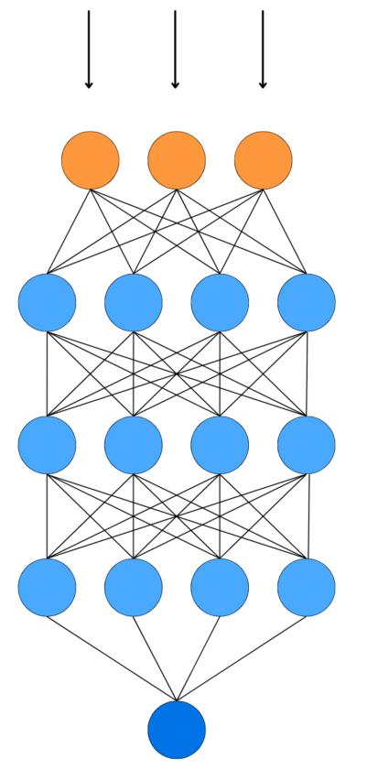
Large Language Models
权本为子姓小国，后为楚武王所灭，并被改建为县。《左传》庄公十八年载：“初，楚武王克权，使斗缗尹之。”《水经·沔水注》曰：“沔水自荆城东南流，迳当阳县之章山东，山上有故城，太尉陶侃伐杜曾所筑也。……沔水又东，右会权口，水出章山，东南流权城北，古之权国也。”《大清一统志》卷安陆府古迹权城下亦云：“在钟祥县西南。”是权县当位于今湖北省荆门县东南。杨伯峻《春秋左传注》以为在今湖北省当阳县东南，恐非，当是将古当阳县（位于今荆门县西南）与今当阳县错混而致误。
  Accuracy: 77.91%
权县：今湖北省荆门县东南
Notes:
We tested ChatGPT 3.5 using 500 texts for the textual research of pre-Qin toponyms, and it achieved an accuracy of 77.91% in extracting toponyms and relationships.
Considering the semantic complexity of such texts, this is already a very satisfactory performance.
Take a look at this example,
The AI model needs to be able to distinguish that the text marked in red is incorrect, while the text marked in blue is the useful information.

Slide 10
Toponym Resolution and Matching 地名解析与匹配
Difficulty
  Variant Characters
  Typographical Errors
  Toponymic Alias
  Toponymic Ambiguity
  Toponymic change
Notes:
After extracting toponym information from texts, we still need to parse the toponyms so that they can be matched with existing toponyms in databases, in order to obtain accurate coordinates.
The challenges that exist in this task include:

Slide 11

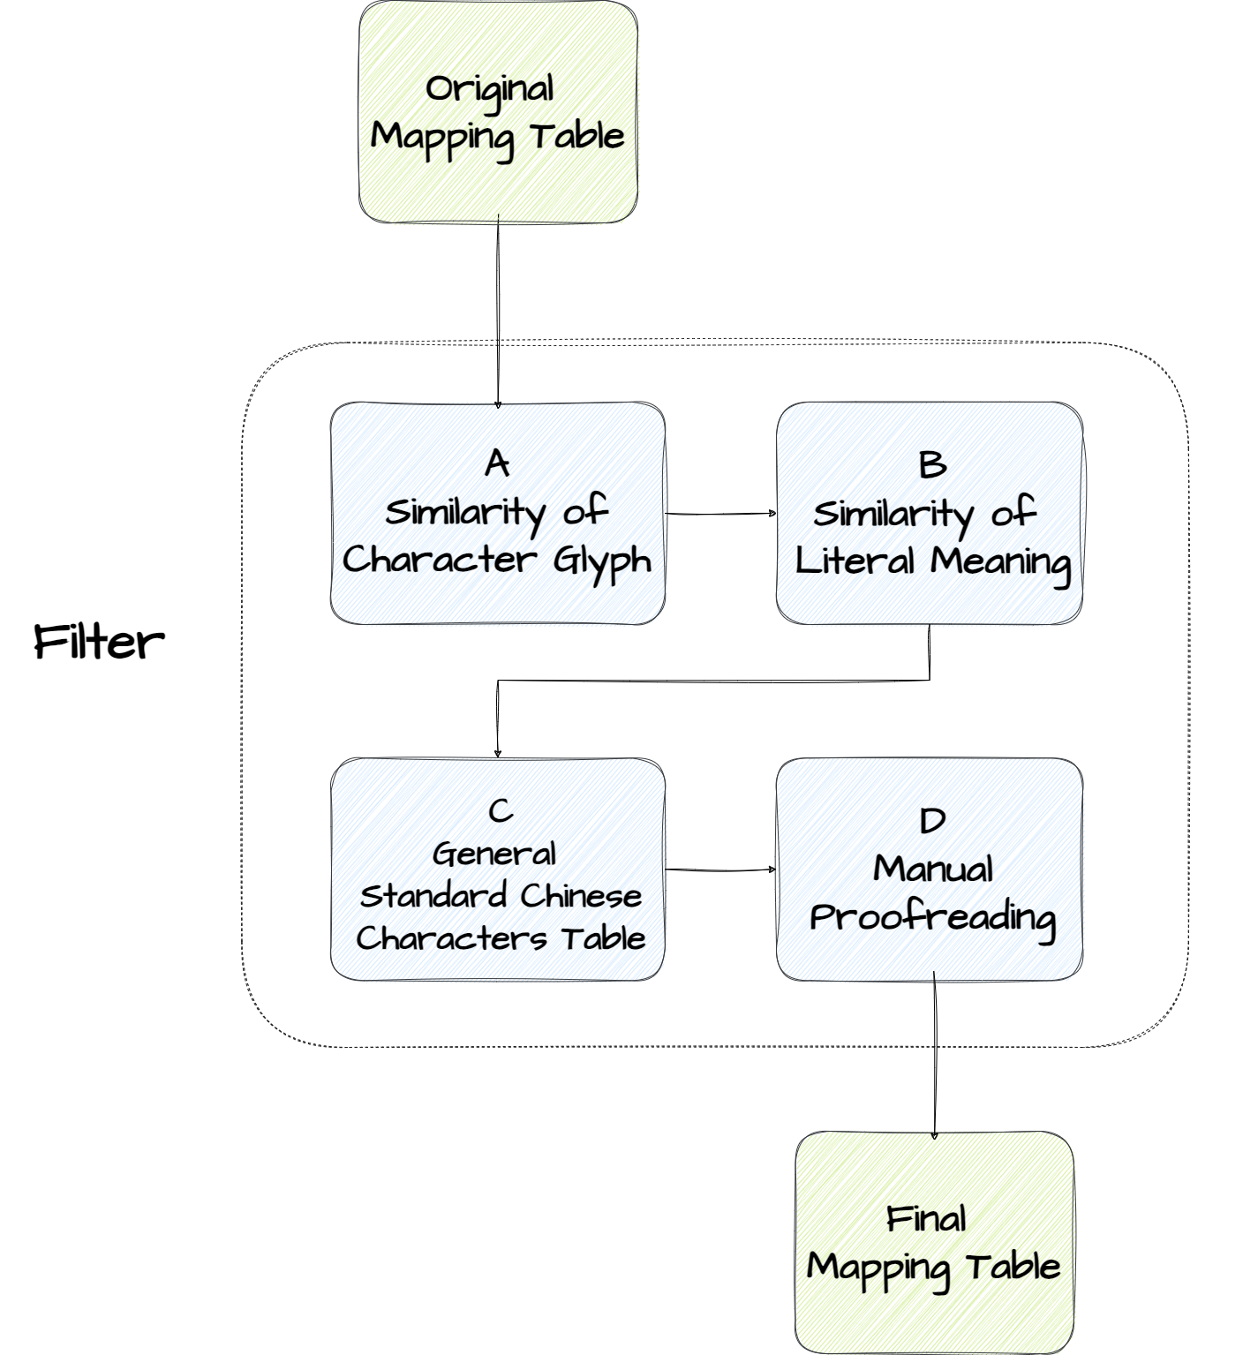



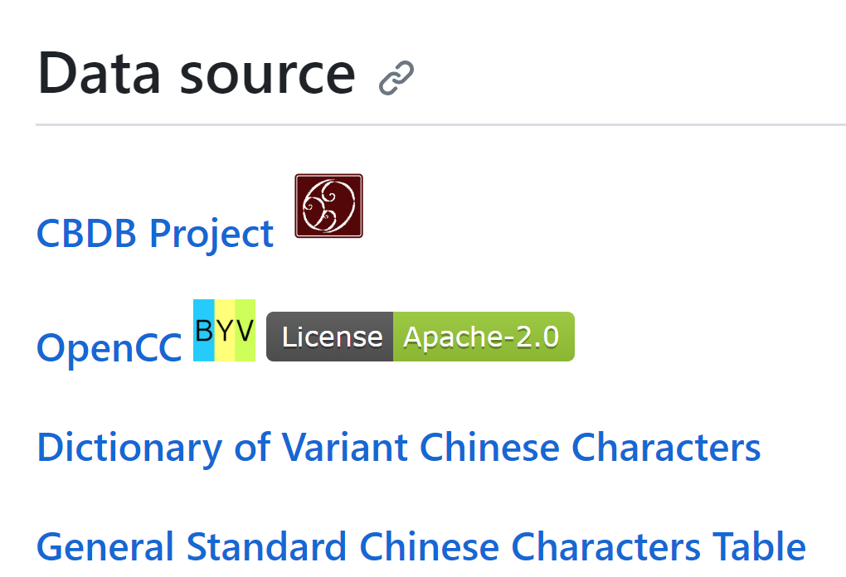
CHAR: Chinese Variant Character Converter 异体字转换器
https://github.com/yukiyuqichen/CHAR
https://github.com/cbdb-project/CHAR
2000 variant-standard
characters pairs
Notes:
In response to the issue of matching failures caused by variant characters,
we have recently developed a project called CHAR, which has been released and open-sourced.
We have gathered variant character data from various sources and, through multiple filtering methods, we have ultimately obtained around 2,000 pairs of variant characters and their corresponding standard characters.
Hongsu, our brilliant project manager, initiated this project, and I was responsible for data collection, processing, and final program development.
My colleagues Yiyi and Fengyi also participated in data collection and proofreading.

Slide 12
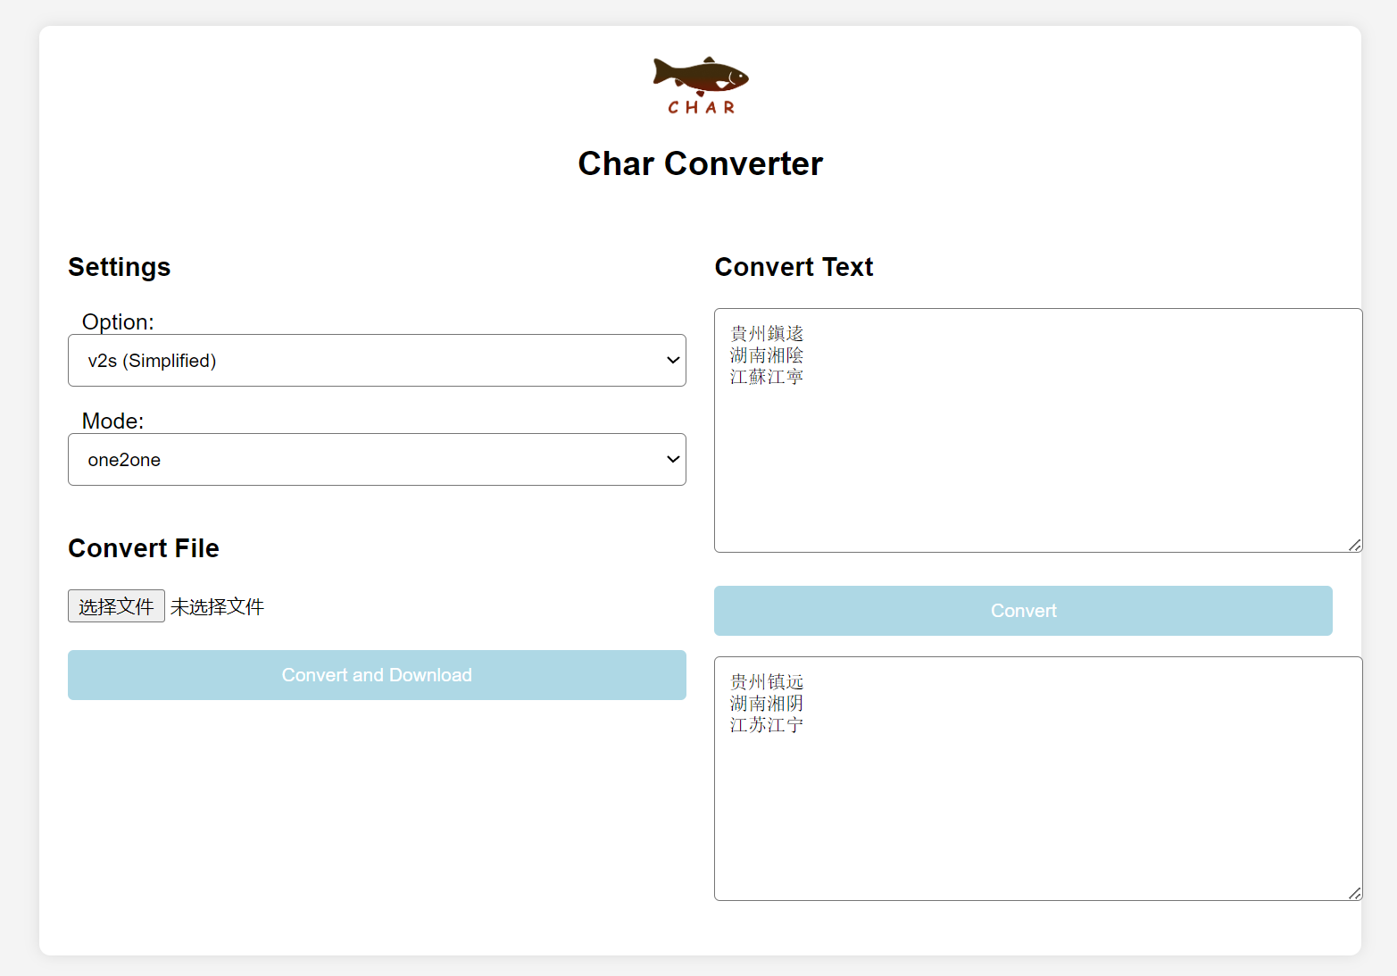
CHAR: Chinese Variant Character Converter 异体字转换器
Notes:
You can easily try it out through our online demo.

Slide 13
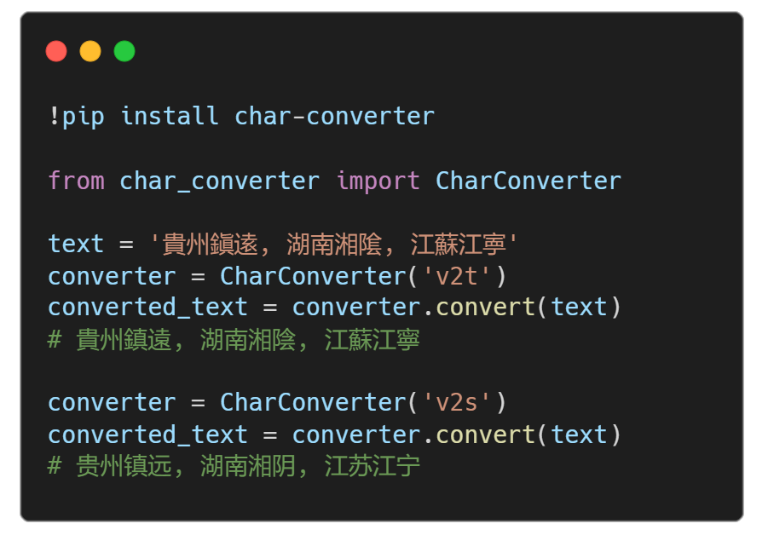
CHAR: Chinese Variant Character Converter 异体字转换器
鎭逺 - 鎮遠
湘隂 - 湘陰
江寕 - 江寧
Notes:
You can also easily use it within Python by "pip install char-converter."
It's still a beta version.
There may still be some errors in our data, but we'll keep updating it.
All kinds of feedback are welcome.

Slide 14


Historical Geocoder 历史地理编码器
Textual Addresses
  Handle:
  Typographical Errors
  Toponymic Alias
  Toponymic Ambiguity
  Toponymic change
Geo Database
Geocoder
Will be released in the future
Geographic Coordinates
Notes:
Apart from the issue of variant characters,
other problems still need to be addressed.
To address them, we have also developed a geocoder for Chinese historical toponyms. We hope that it can eventually handle all of these issues.
This program is not yet live, but we will release it in the future.

Slide 15
Workflow
Toponym Recognition
Large Language Model
Relation Extraction
* With manual checking
Variant Converter
Toponym Resolution
Historical
Geocoder
Toponym Matching
Geographic Database
Notes:
The workflow we’re introducing does not only suit Early China texts.
It’s actually a general pipeline, which could be implemented to any historical periods.
In summary, this is our complete workflow.
We perform toponym recognition and relation extraction using large language models such as ChatGPT.
Toponym resolution is carried out using our Chinese variant character converter and Historical Geocoder.
And finally, we match it with existing geographical databases.
The input to this workflow can be any unstructured text related to toponyms, and the output will be structured coordinate data.

Slide 16
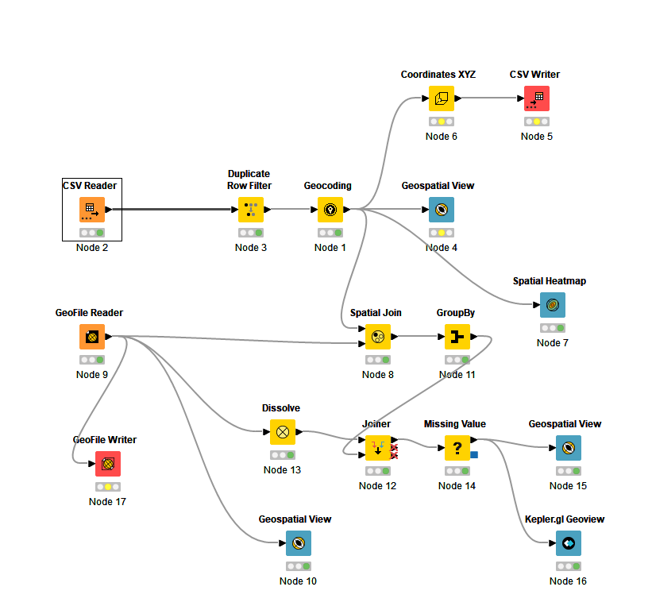

KNIME Workflow
Notes:
Currently, we are also in the process of implementing the entire workflow in KNIME.
Postdocs Liu Lingbo and Fu Xiaokang from the Geographic Analysis Center at Harvard have provided significant assistance.
In the future, we also plan to release the related KNIME extension.

Slide 17
Case Study 1: Native Places of Officials in the Qing Dynasty
  China Government Employee Database – Qing (CGED-Q)
  Out of 513,199 entries for officials' native places, 506,879 (98.7%) were successfully geocoded.
  When not using CHAR (Chinese variant character converter), the success rate was only 89.4%.
Notes:
To demonstrate the effectiveness of this workflow,
I have prepared two case studies.
The first example is geocoding the birthplace information of officials in the China Government Employee Database.
Before using CHAR for variant character conversion, the accuracy rate was 89.4%.
After using CHAR, the accuracy rate increased to 98.7%.

Slide 18
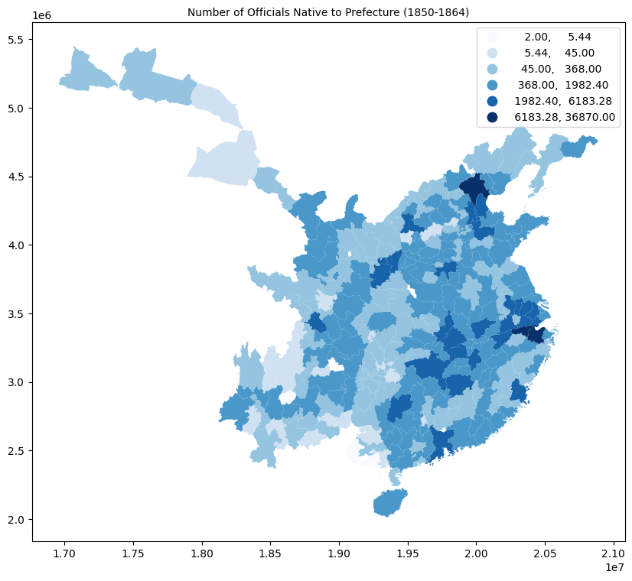
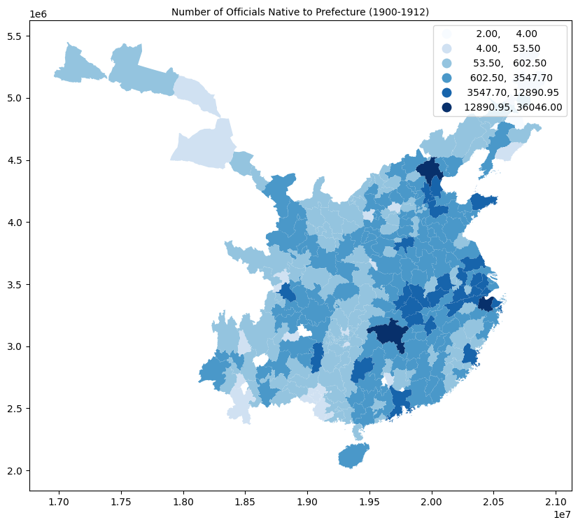
Case Study 1: Native Places of Officials in the Qing Dynasty
Notes:
These are the maps after geocoding.
Since this presentation primarily emphasizes the workflow, I won’t delve into the detailed interpretation of the results here.

Slide 19
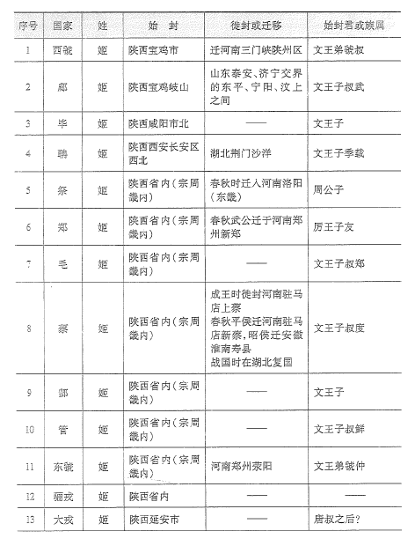
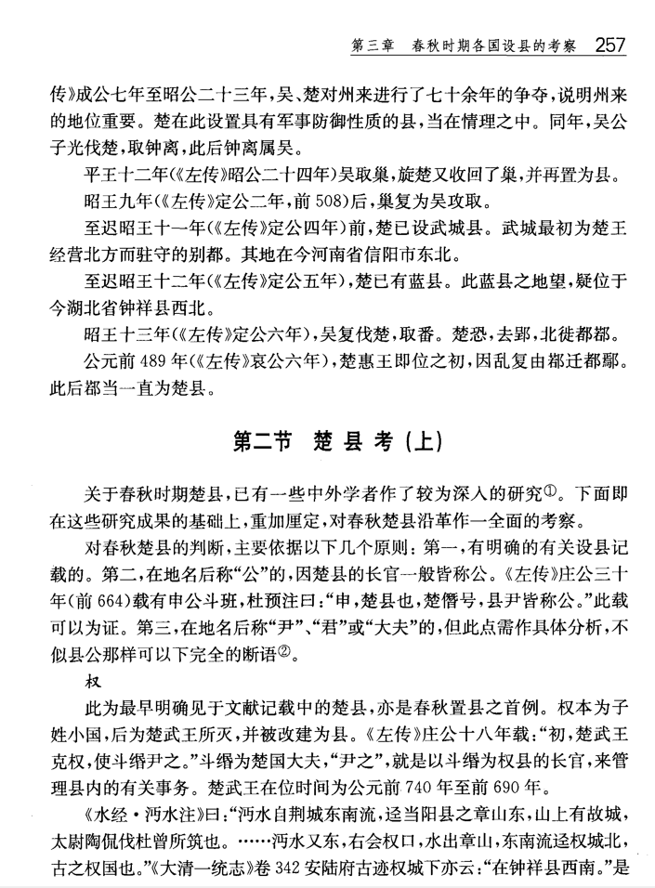
Case Study 2: Early China
西周封國政治地理的結構
中國行政區劃通史·先秦卷
Notes:
The second example is extracting toponym data in the pre-Qin period from different reference books.

Slide 20
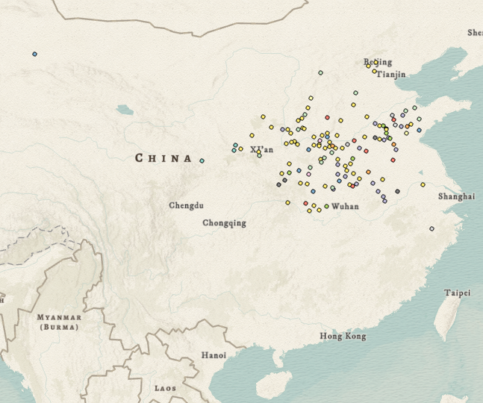
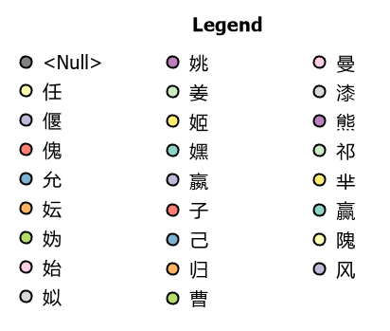
Case Study 2: Early China – States in Western Zhou
Notes:
Including the coordinates of 190 states in the Western Zhou

Slide 21
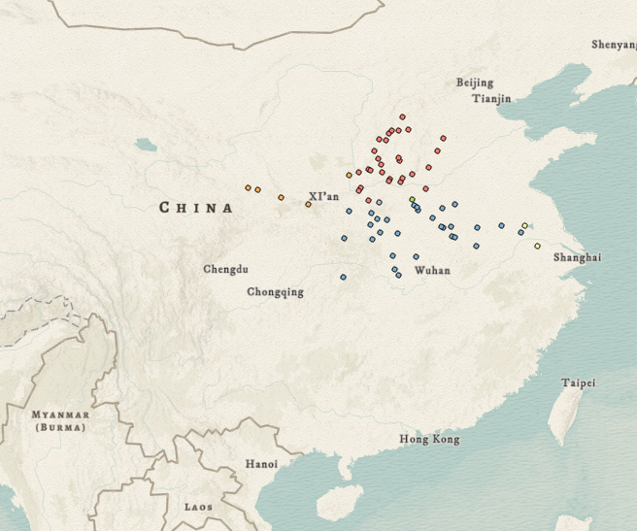
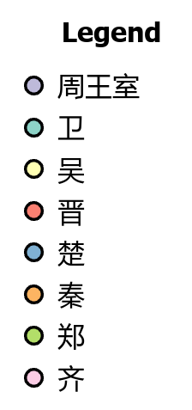
Case Study 2: Early China – Counties in Spring and Autumn
Notes:
78 counties in the Spring and Autumn period

Slide 22
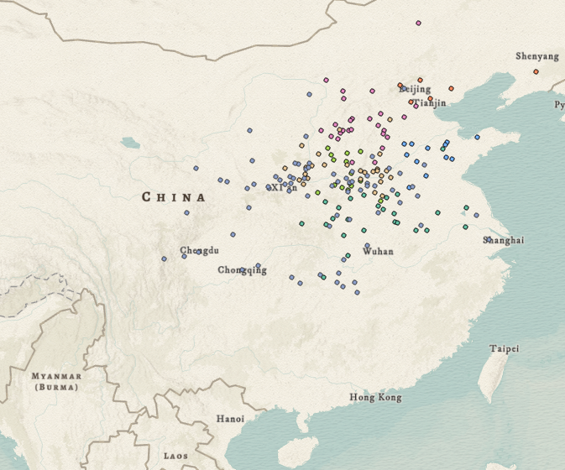
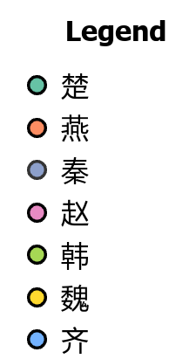
Case Study 2: Early China – Counties in Warring States
Notes:
238 counties in the Warring States period.
Considering the gaps in early Chinese data within CHGIS, these data are very valuable, and we will compile them into the first pre-Qin address table for CBDB.
That’s all.
Thanks

